Slide 1

Energy Access Explorer Report
Uganda
A Data-driven, Integrated and Inclusive Approach to Achieving Universal Access to Energy for Equitable Development
Prepared by Ebuka Okonkwo
The report has been developed using data available on the Energy Access Explorer
https://www.energyaccessexplorer.org/
Mon Nov 09 2026

Slide 2

0
Report Summary

Slide 3
Platform Overview
Energy Access Explorer is the first, open-source, online and interactive geospatial platform that enables energy planners, clean energy entrepreneurs, donors, and development institutions to identify high-priority areas for energy access interventions. EAE functions also as a dynamic information system, reducing software engineering and data transaction costs for both data providers and users and facilitating data management and governance.
Who are the primary audiences of Energy Access Explorer?
Energy planning agencies can use the platform to explore the potential for grid extension, off-grid systems, clean cooking technologies and renewables for energy access in their countries.
Clean energy enterprises can use the platform to access demographic and socio-economic data, which indicate consumer ability to pay for energy services. This information can help identify gaps in market opportunities.
Donors and Development Finance Institutions can use the platform to identify areas where grants and support will have the most impact.
Service delivery institutions in the health, education, productive use of energy and agriculture sectors can use the platform to get a better understanding of energy needs associated to development services.
Clean Cooking Sector organizations and agencies can use the platform to identify areas where the uptake of clean cooking technologies should be prioritized based on location specific data on demand, supply, and environment.

Slide 4
How it Works
Energy Access Explorer synthesizes and analyzes more than 50 geographic data sets (per geography) on both energy supply and demand. It runs multi-criteria analysis that uses location-specific resource availability and infrastructure data to represent energy supply. It also incorporates demographic data and data on social and productive uses to visualize demand for energy services. Together, these supply and demand indicators enable more comprehensive energy planning. Spatial analysis tools, including multi-criteria analysis, overlays, filters and buffer zones, help users identify, rank, and prioritize locations and interventions for energy services.
The tool incorporates remote sensing data as well as data from global, national, sub-national and census databases that are either publicly available or provided by international partners and local stakeholders. It can host data available in various resolutions, scales and formats allowing for better or new datasets to be incorporated once available. The selection of data is based on literature review, a survey WRI conducts on the importance of certain datasets in geospatial energy access planning and user feedback. The list of essential data is reviewed by local stakeholders to ensure the platform is relevant and applicable in the local context.
Methodology
Datasets
Demand: demographics, social and productive uses
Supply: resources and infrastructure
User Interactions
Select and overlay data, apply buffer zones and filters, assign data importance.
Multi-Criteria Analysis
Customize multi-criteria analyses with data representing potential energy demand and supply.
High Priority Areas
Identify, rank, and prioritize locations and interventions.

Slide 5
Open Data
World Resources Institute is committed to transparency and open data. Energy Access Explorer is a research initiative led by World Resources Institute. Partners and local stakeholders contribute to the development and update of the platform. To learn more about Energy Access Explorer, inquire regarding data sources, or provide feedback, contact our team at energyaccessexplorer@wri.org.
All the products, methodologies and datasets that make up Energy Access Explorer are available subject to the Terms of Use. While analyses are compiled with various data sources, the details about the original data sources are available by hovering over the data list on the left of the screen and clicking on the information symbol "i" that appears. This information will include links to the original data. See also instructions under Attribution Requirements.
If you use this platform, partially or entirely, you must follow the attribution requirements.

Slide 6
Selected Demand Index Datasets
Dataset | Unit | Range | Selected Range | Importance (1-5)
Population Count | proximity in km | min: 0, max: 20000 | min: 0, max: 20000 | 5
Relative Wealth Index | proximity in km | min: -2, max: 2 | min: -2, max: 2 | 4
Health facilities | proximity in km | min: 0, max: 250 | min: 0, max: 5 | 5

Slide 7
Selected Supply Index Datasets
Dataset | Unit | Range | Selected Range | Importance (1-5)
Global Horizontal Irradiation | proximity in km | min: 500, max: 2800 | min: 500, max: 2800 | 1
Distribution Lines | proximity in km | min: 0, max: 700 | min: 0, max: 700 | 4

Slide 8
Uganda
Geospatial Analytical Outputs
Share of area for each Index (District)
Energy Access Potential Identifies areas with higher energy demand and supply which are characterized with higher index values. It is an aggregated measure of all selected data sets under both Demand and Supply categories.
 | High | Medium-High | Medium | Low-Medium | Low | Outside the analysis
Assistance Need Index | 2,674 | 28,736 | 52,058 | 40,271 | 3,674 | 115,903
Energy Access Potential | 1,573 | 16,791 | 53,512 | 45,974 | 9,563 | 115,903
Demand Index | 1,435 | 14,099 | 49,988 | 51,107 | 10,784 | 115,903
Supply Index | 43,287 | 60,456 | 22,806 | 760 | 104 | 115,903
Demand Index Identifies areas with higher energy demand which are characterized with higher index values. It is an aggregated and weighted measure of all selected data sets under Demographics and Socio-economic activities.
Total: 243,316 District — 2,674 District in the high bucket
Supply Index Identifies areas with higher energy supply which are characterized with higher index values. It is an aggregated and weighted measure of all selected data sets under Resource Availability and Infrastructure.
Share of population for each Index (people)
 | High | Medium-High | Medium | Low-Medium | Low | Outside the analysis
Assistance Need Index | 5,162,302 | 17,420,556 | 14,156,540 | 5,060,115 | 102,394 | 4,148,293
Energy Access Potential | 5,544,542 | 12,354,881 | 16,466,930 | 7,115,319 | 420,233 | 4,148,293
Demand Index | 5,317,664 | 11,092,969 | 16,823,703 | 8,182,734 | 484,834 | 4,148,293
Supply Index | 12,188,037 | 22,495,962 | 6,846,734 | 340,398 | 30,774 | 4,148,293
Assistance Need Index Identifies areas where market assistance is needed the most which are characterized with higher index values. It is an aggregated and weighted measure of selected data sets under both Demand and Supply categories indicating high energy demand, low economic activity, and low access to infrastructure and resources.
Total: 46,050,198 people — 5,162,302 people in the high bucket

Slide 9
1
Analysis

Slide 10
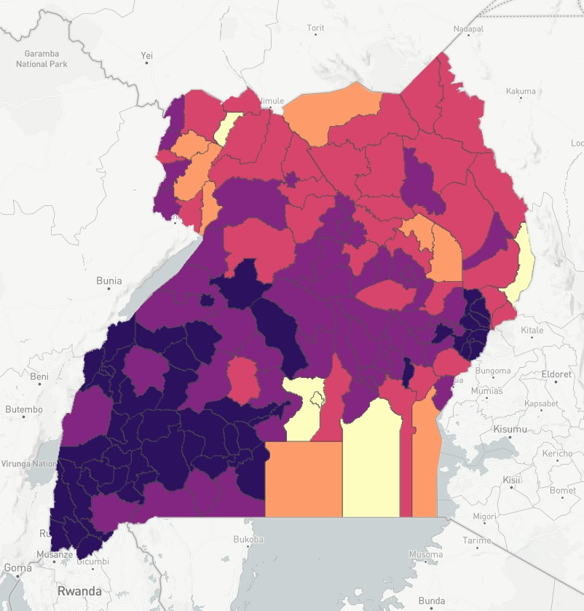
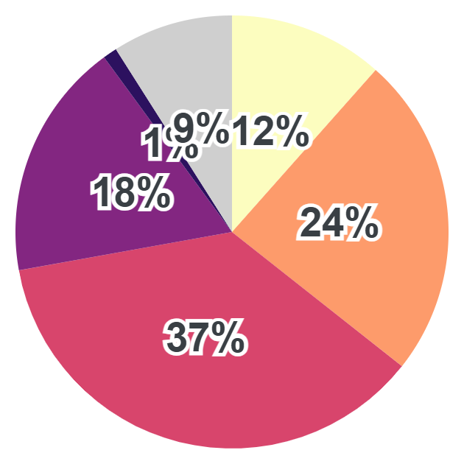
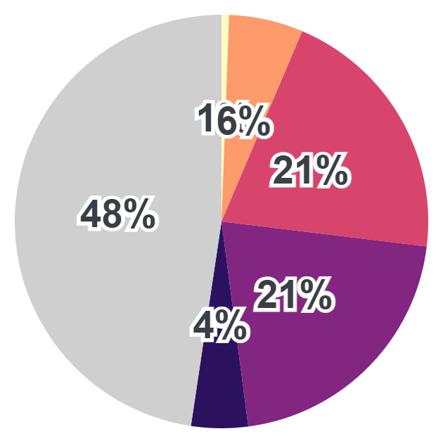

Demand Index
Demand Index Identifies areas with higher energy demand which are characterized with higher index values. It is an aggregated and weighted measure of all selected data sets under Demographics and Socio-economic activities.
Population where demand is medium-high or high | 16,411,432
Number healthcare facilities, where demand is medium-high or high | 3,824
Low | Medium | High
Population Share (people)
Area Share (km²)
High
5,317,664
High
1,435
Medium-High
11,092,969
Medium-High
14,099
Medium
16,823,703
Medium
49,988
Low-Medium
8,182,734
Low-Medium
51,107
Low
484,834
Low
10,784
Outside the analysis
4,148,293
Outside the analysis
115,903
Showing demand index for areas affecting 46,050,198 people, of whom 5,317,664 people are situated in areas of high demand index.
Showing demand index for areas spanning 243,316 km², of which 1,435 km² has high demand index.
200 km / 124 mi
© Mapbox

Slide 11
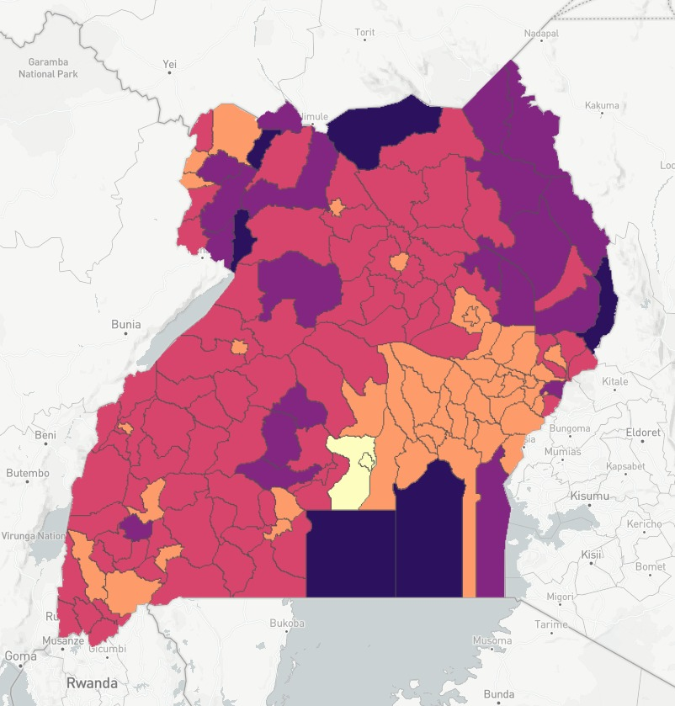
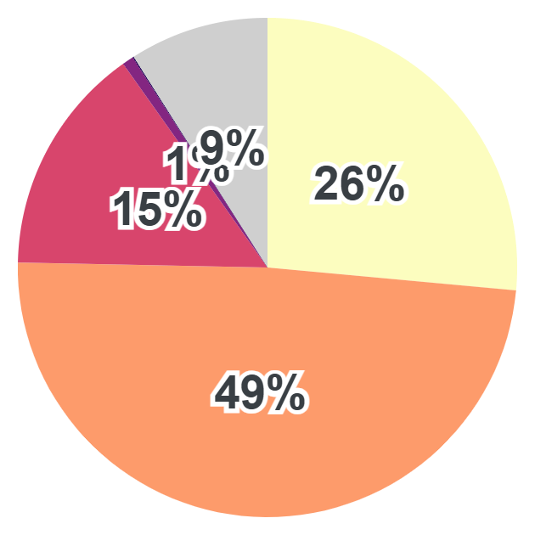
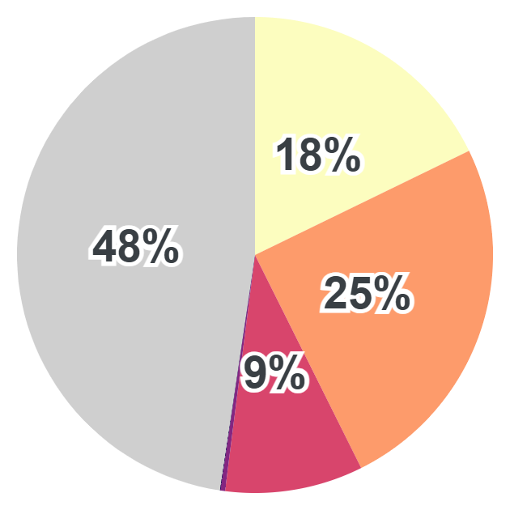
Supply Index
Supply Index Identifies areas with higher energy supply which are characterized with higher index values. It is an aggregated and weighted measure of all selected data sets under Resource Availability and Infrastructure.
Approximate amount of people living within 1km of an electricity line | 31,841,017
Average Global Horizontal Irradiation (kWh/m²) | 2,038
Low | Medium | High
Population Share (people)
Area Share (km²)
High
12,188,037
High
43,287
Medium-High
22,495,962
Medium-High
60,456
Medium
6,846,734
Medium
22,806
Low-Medium
340,398
Low-Medium
760
Low
30,774
Low
104
Outside the analysis
4,148,293
Outside the analysis
115,903
Showing supply index for areas affecting 46,050,198 people, of whom 12,188,037 people are situated in areas of high supply index.
Showing supply index for areas spanning 243,316 km², of which 43,287 km² has high supply index.
200 km / 124 mi
© Mapbox

Slide 12
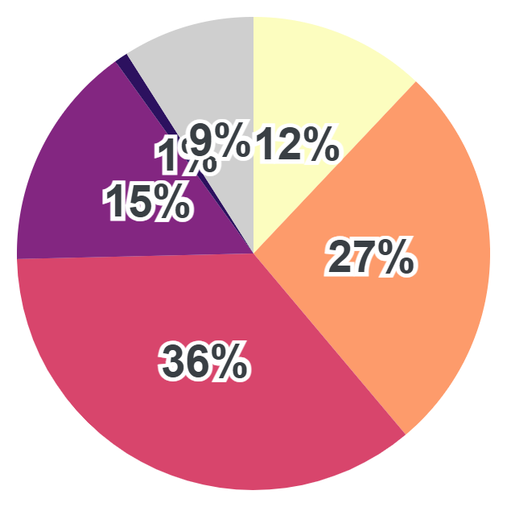
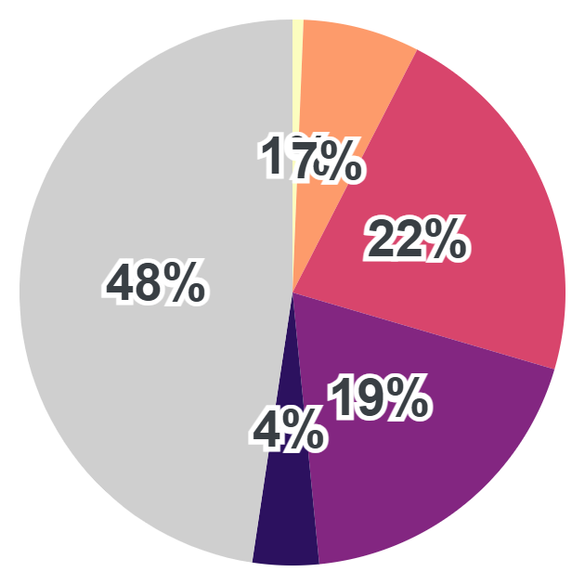
Energy Access Potential
Energy Access Potential Identifies areas with higher energy demand and supply which are characterized with higher index values. It is an aggregated measure of all selected data sets under both Demand and Supply categories.
Approximate amount of people living in the area covered by the analysis | 41,902,704
Approximate amount of people living within 1km of an electricity line | 31,841,017
Amounts on healthcare facilities in the area covered by the analysis | 4,055
Low | Medium | High
Population Share (people)
Area Share (km²)
High
5,544,542
High
1,573
Medium-High
12,354,881
Medium-High
16,791
Medium
16,466,930
Medium
53,512
Low-Medium
7,115,319
Low-Medium
45,974
Low
420,233
Low
9,563
Outside the analysis
4,148,293
Outside the analysis
115,903
Showing energy access potential for areas affecting 46,050,198 people, of whom 5,544,542 people are situated in areas of high energy access potential.
Showing energy access potential for areas spanning 243,316 km², of which 1,573 km² has high energy access potential.
200 km / 124 mi
© Mapbox

Slide 13
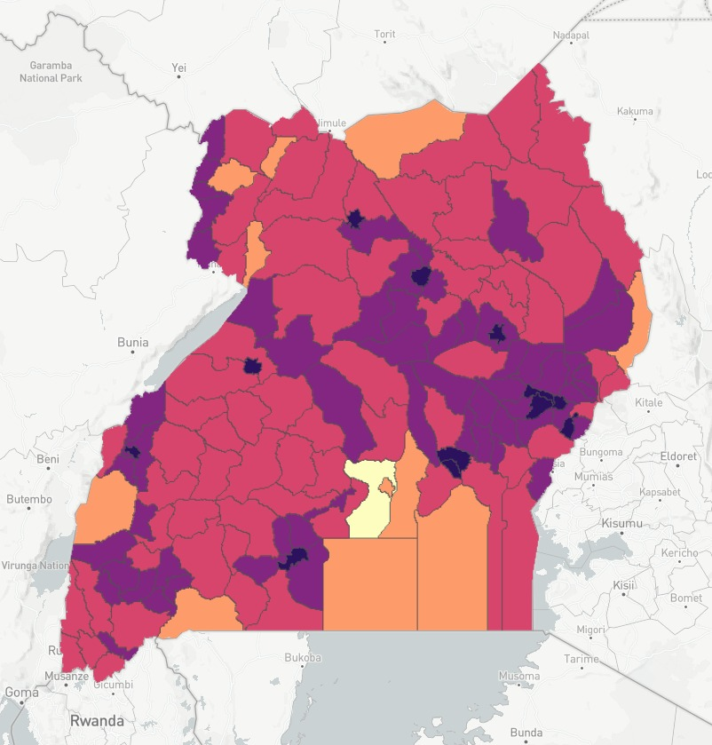
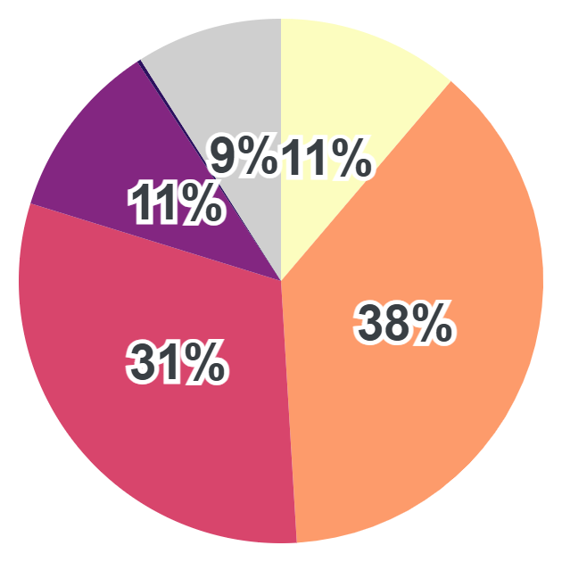
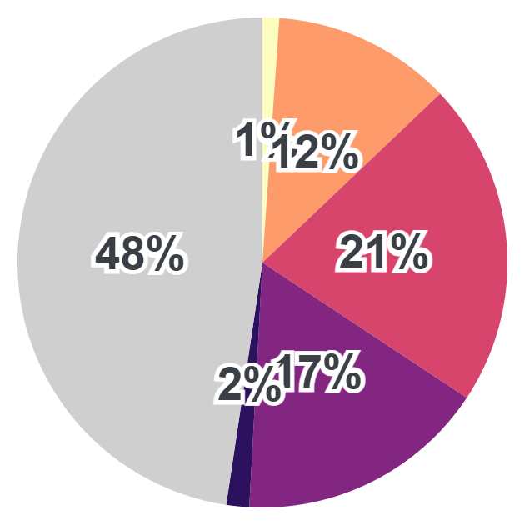
Assistance Need Index
Assistance Need Index Identifies areas where market assistance is needed the most which are characterized with higher index values. It is an aggregated and weighted measure of selected data sets under both Demand and Supply categories indicating high energy demand, low economic activity, and low access to infrastructure and resources.
Approximate amount of people living in the area covered by the analysis | 41,902,704
Approximate amount of people living within 1km of an electricity line | 31,841,017
Amounts on healthcare facilities in the area covered by the analysis | 4,055
Low | Medium | High
Population Share (people)
Area Share (km²)
High
5,162,302
High
2,674
Medium-High
17,420,556
Medium-High
28,736
Medium
14,156,540
Medium
52,058
Low-Medium
5,060,115
Low-Medium
40,271
Low
102,394
Low
3,674
Outside the analysis
4,148,293
Outside the analysis
115,903
Showing assistance need index for areas affecting 46,050,198 people, of whom 5,162,302 people are situated in areas of high assistance need index.
Showing assistance need index for areas spanning 243,316 km², of which 2,674 km² has high assistance need index.
200 km / 124 mi
© Mapbox

Slide 14
2
Top District

Slide 15
District with highest ANI Index
# | Priority Score | Assistance Need Index | District | Global Horizontal Irradiation - KWh/M² | Distribution Lines - Km (Proximity To) | Population Count - People | Relative Wealth Index - RWI | Health Facilities - Count
1 | 100.0% | High | Wakiso | 1951.81 | 0.92 | 3355779 | 0.32 | 258
2 | 59.5% | Medium-High | Kampala | 1936.14 | 0.02 | 1793038 | 1.37 | 372
3 | 58.1% | Medium-High | Amudat | 2232.82 | 12.55 | 58827 | -0.41 | 6
4 | 54.1% | Medium-High | Buvuma | 2116.83 | 11.28 | 124210 | -0.29 | 9
5 | 50.5% | Medium-High | Kasese | 1785.24 | 2.02 | 826299 | -0.18 | 101
6 | 47.4% | Medium-High | Lamwo | 2100.78 | 8.48 | 96610 | -0.37 | 21
7 | 46.3% | Medium-High | Obongi | 2145.03 | 10.41 | 17837 | -0.16 | 18
8 | 44.6% | Medium-High | Kalangala | 1968.78 | 8.84 | 52649 | -0.16 | 17
9 | 41.6% | Medium-High | Pakwach | 2152.52 | 7.34 | 187502 | -0.33 | 15
10 | 41.3% | Medium-High | Terego | 2130.22 | 6.57 | 317754 | -0.22 | 32
11 | 40.8% | Medium-High | Isingiro | 1861.39 | 1.89 | 628525 | -0.22 | 71
12 | 39.5% | Medium-High | Mukono | 1982.13 | 2.8 | 764302 | 0.01 | 79
13 | 37.5% | Medium | Mubende | 1918.39 | 2.08 | 560761 | -0.29 | 49
14 | 35.1% | Medium | Madi-Okollo | 2125.5 | 5.56 | 145083 | -0.33 | 19
15 | 34.5% | Medium | Amuru | 2124.2 | 4.92 | 176554 | -0.32 | 27
16 | 34.0% | Medium | Namayingo | 2181.76 | 5.36 | 271599 | -0.18 | 34
17 | 33.2% | Medium | Luweero | 1993.47 | 1.25 | 552685 | -0.13 | 79
18 | 33.1% | Medium | Kiryandongo | 2085.94 | 3.89 | 284707 | -0.29 | 32
19 | 33.0% | Medium | Rukungiri | 1875.52 | 0.88 | 357938 | -0.21 | 79
20 | 32.5% | Medium | Kassanda | 1932.78 | 3.33 | 302704 | -0.22 | 30

