Slide 1
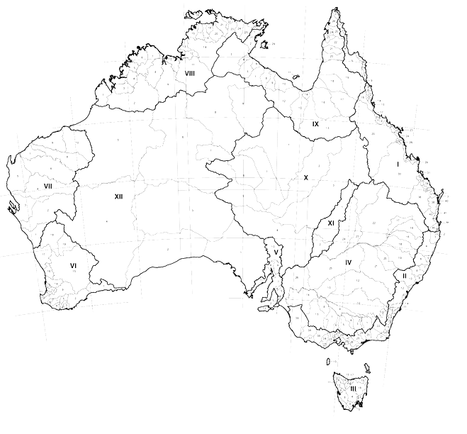
State of the Art:
Data Completeness: captured data may be incomplete or missing – how to approximate/aggregate missing data using related or hierarchical data at different levels?
Data Granularity: jurisdictions may collect data according to different boundary definitions or at different levels – how to enable cross theme data analysis?
Evolution: By the time the data was leveraged, potential uses cases may not be known - how to reuse and apply existing data to new, emerging scenarios?
…
education
WA
transport
spending across different local government areas?
LGA 2’97
Analyse
health
LGA 1
NSW
Available Data
Historical
comparison
SPATIAL DATA FOUNDATION
Available Data
LGA 2’87

Slide 2
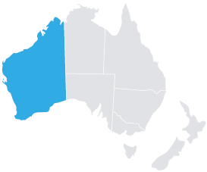
Datasets
Statistical Units
Approxima
Postal Code
Spatial
Relationship
Statistical Units
Postal Codes
LGA
Local Government Areas
Spatial + Hierarchical
Relationship
Jurisdictional Boundaries
Hierarchical
Relationship
State
Locality

Slide 3
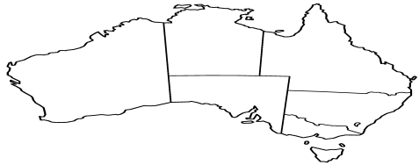
Hierarchical Relationship
Jurisdictional Units
Topology
+
Spatial Relationship
+
Approximations
Spatial Relationship (inter-datasets)
Local Government Units
Approximations
Spatial
Relationship (intra-datasets)
Statistical Units
Geographical
Representation
Geographical Data

Slide 4
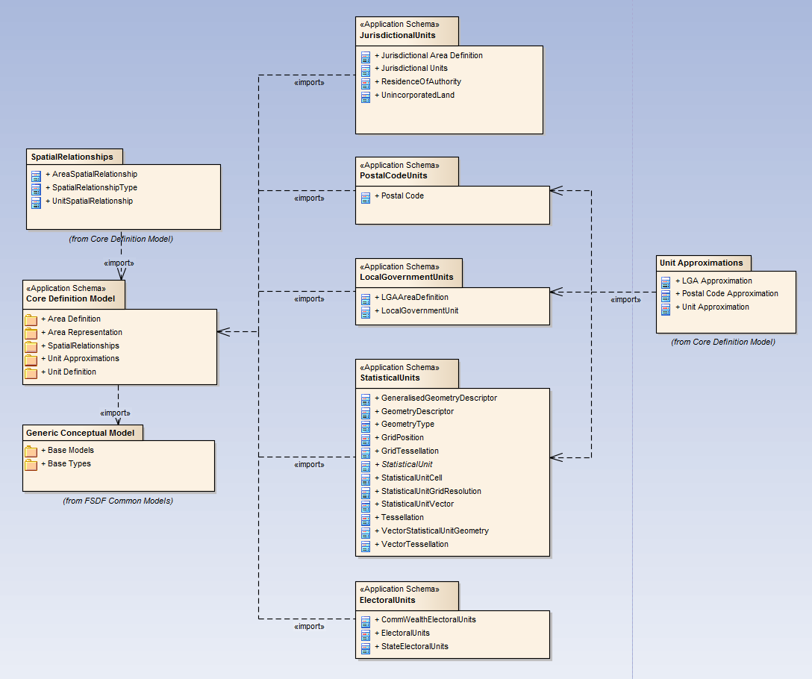
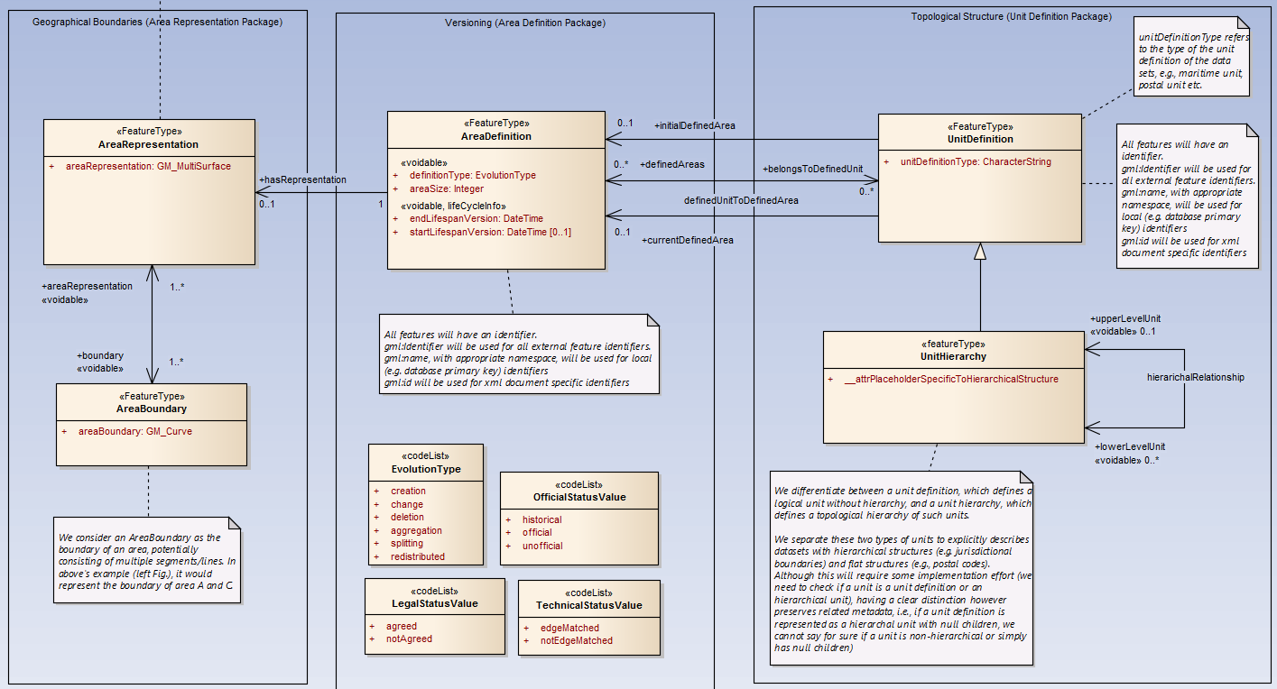
Administrative Boundaries
Conceptual Model
Core Definition Model
Representation
Versioning
Topology

