Slide 1

The SpatioTemporal Asset Catalog
Geosoftware II
Julia Rotert

Slide 2
Outline
Introduction
Overview
What
Why
How
Core components
STAC Extensions
eo
mlm
Conclusion and discussion
Sources

Slide 3
Introduction
"The STAC Specification is a common language to describe geospatial information, so it can more easily be worked with, indexed, and discovered.“
https://stacspec.org/en/

Slide 4
Introduction
STAC STAC Specification
SpatioTemporal Assets + Catalogs
Base: JSON files
Origin: Satellite imagery
Presence: variety of spatiotemporal uses

Slide 5
Overview
Common metadata
For data providers, developers and users
Four core components:
Item, Catalog, Collection, (API)
Data examples:
Imagery, SAR. LiDAR, data cubes, full motion videos

Slide 6
Overview
What is STAC?
standard
structure
describing
cataloging
queryable
accessable
interoperable
customizable
flexible
extensible
persistent
reliable

Slide 7
Overview
Why is STAC relevant?
Makes data queryable and searchable
Due to standards for common metadata
More reuse of code
Less new code must be written
Easy implementable and customizable
accessible for many providers, developers and users

Slide 8
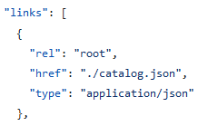
Overview
How does STAC work?
Metadata in standardized structure
Network of JSON files (links)
Four core components
specifications

Slide 9
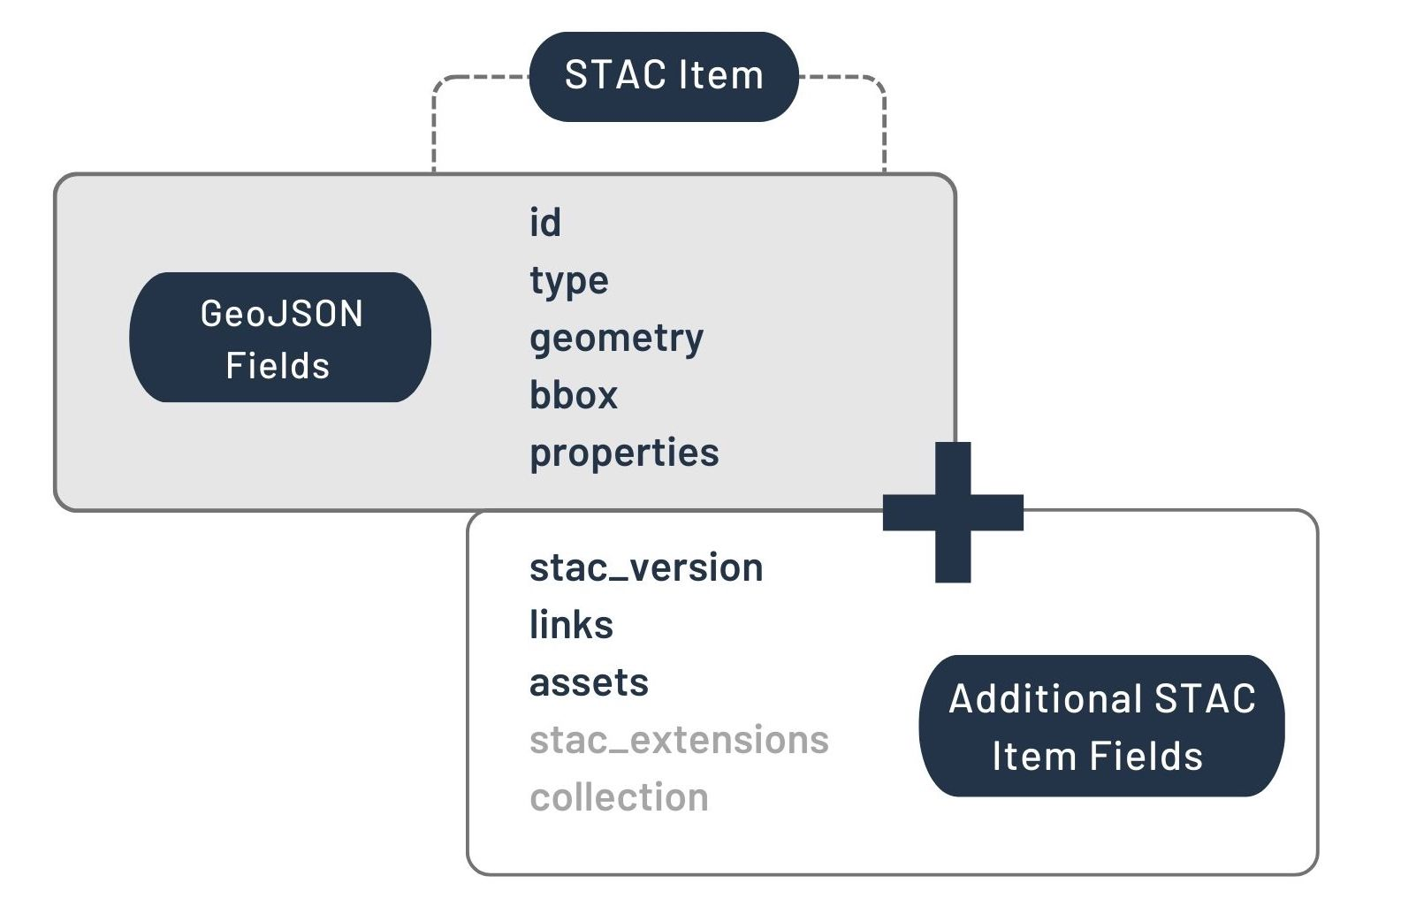
Overview
Core Components: Item
Fundamental, core atomic unit
GeoJSON
One ore more spetiotemporal asset(s)
Fields:
GeoJSON fields: id, type, geometry, bbox
STAC item fields: stac_version, links, assets, collections

Slide 10
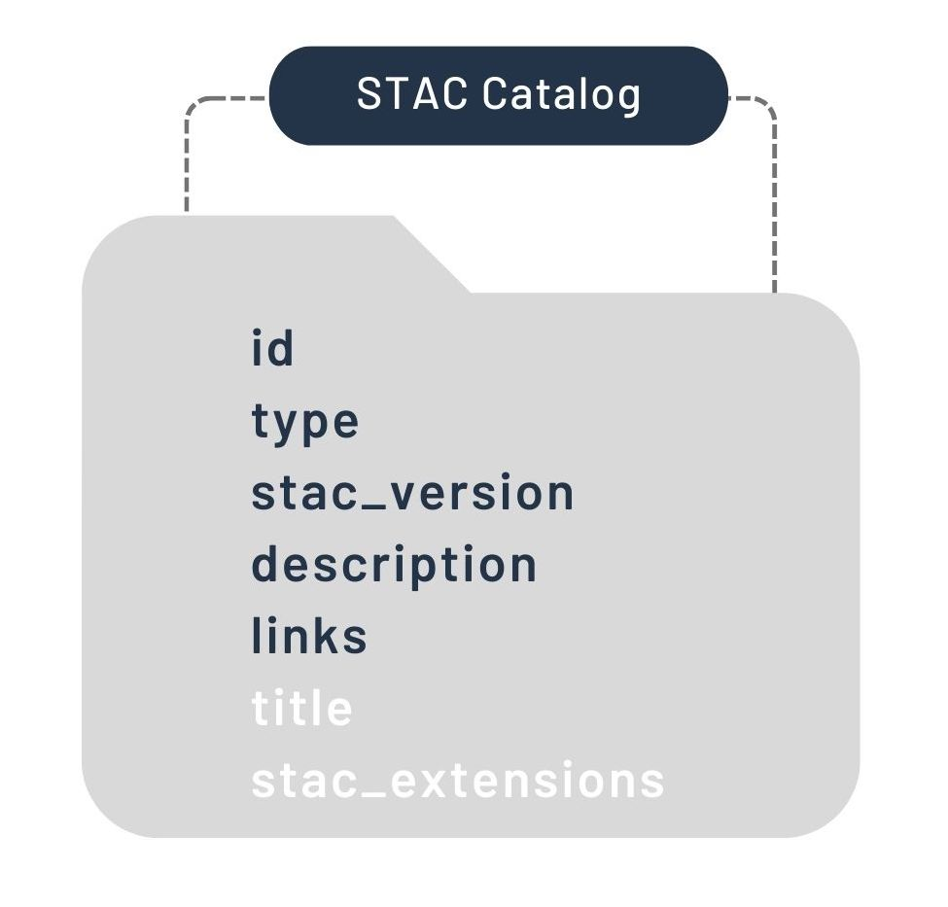
Overview
Core Components: Catalog
Links various STAC items together
Contains lists of:
STAC items
Child STAC catalogs
Can be linked with items, collections and other catalogs

Slide 11
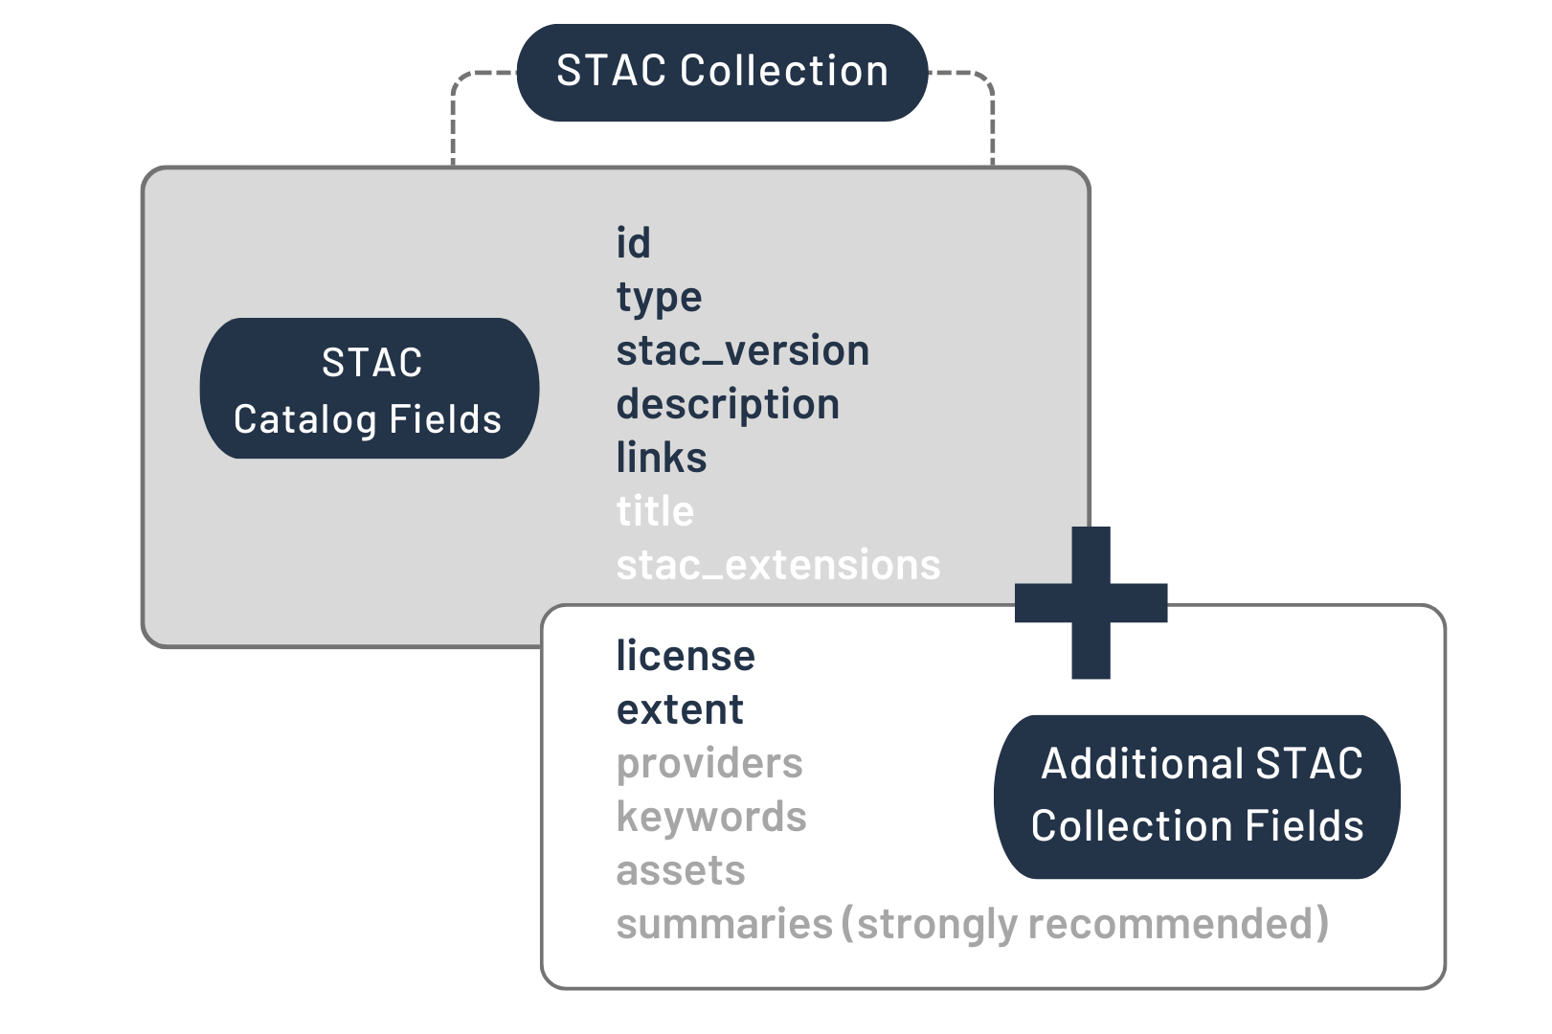
Overview
Core Components: Collection
Common additional information
Consists of assets
Same properties on higher level
Additional fields
As standalone: describing data holdings

Slide 12
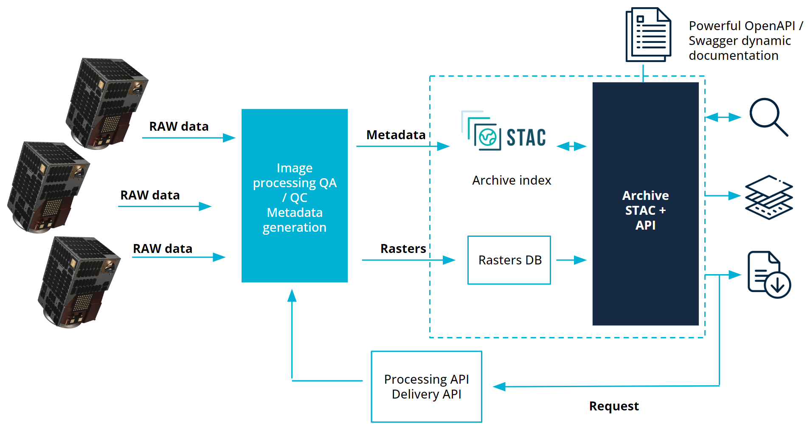
Overview
Core Components: API
Service interface for search
Dynamic system
Access to STAC objects stored in a database
Processes requests
Delivers results

Slide 13
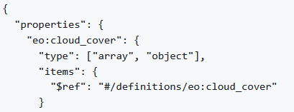
STAC Extensions
Add specific metadata
Use cases
More detail
Mostly hosted on GitHub
Base: JSON shema with properties and definitions for extensions

Slide 14
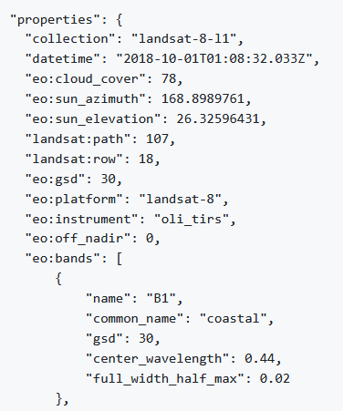
STAC Extensions
eo: Electro-optical Extension
For EO data
Specified on the electro-optical field
Platform, physical conditions, bands

Slide 15
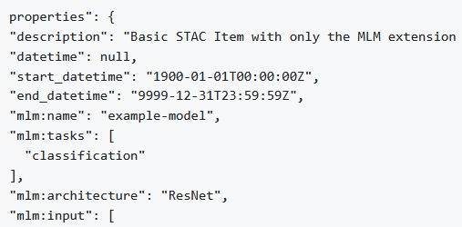
STAC Extensions
mlm: Machine Learning Model Extension
To describe:
ML models
Training details
Inference runtime requirements
Mostly combined with other extensions

Slide 16
Conclusion and discussion
Advantages
Improves providing, developing and using
Enables increased accessibility and interoperability
Many examples and use cases are already covered
Core is simple
Concept is flexible and customizable

Slide 17
Conclusion and discussion
Disadvantages
Much work to make all data STAC compliant
Spatiotemporal data is only one special type of data
Limited by available libraries and tools

Slide 18
Conclusion and discussion
Discussion
How to get the community bigger, how far can it grow with voluntary work and the OS base?
How to expand to more disciplines? Is it even compatible?
How to generalize or automatize to get faster steps forward for more availabilities?

Slide 19
Sources
stacspec
https://stacspec.org/en/
https://stacspec.org/en/about/
https://stacspec.org/en/about/stac-spec/
https://stacspec.org/en/tutorials/intro-to-stac/
GitHub
https://stac-extensions.github.io/
https://github.com/radiantearth/stac-spec/
https://github.com/radiantearth/stac-api-spec/
https://github.com/radiantearth/stac-spec/tree/master/extensions
https://github.com/stac-extensions/eo
https://github.com/stac-extensions/eo/blob/main/examples/item.json
https://github.com/radiantearth/stac-spec/blob/master/overview.md
https://github.com/radiantearth/stac-spec/tree/v0.8.1/extensions/eo
https://github.com/stac-extensions/mlm
https://github.com/stac-extensions/mlm/blob/main/examples/item_eo_bands.json
Others
https://gogeomatics.ca/spatiotemporal-asset-catalogs-enabling-online-search-and-discovery-of-geospatial-assets/
https://learn.microsoft.com/de-de/azure/orbital/organize-stac-data
https://developers.satellogic.com/archive-service/introduction.html
https://www.earthdata.nasa.gov/esdis/esco/standards-and-practices/stac

