Slide 1
Overview of Modeling Method

Slide 2
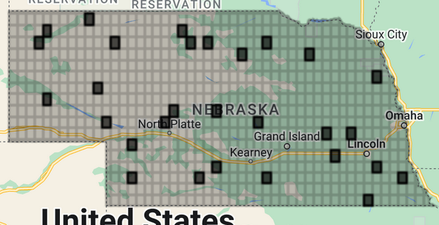
Random selection within grid

Slide 3
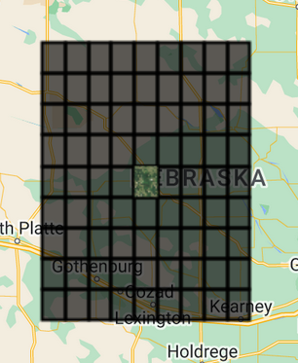
Gather around the nearest 72 grids

Slide 4
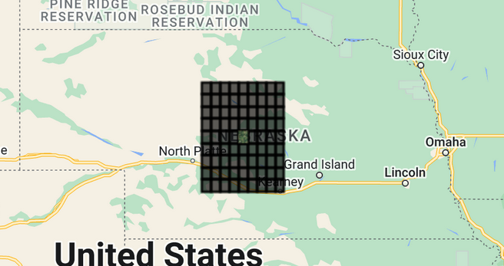
Gather around the nearest 72 grids ~10,000 sq miles or 12% of the state

Slide 5
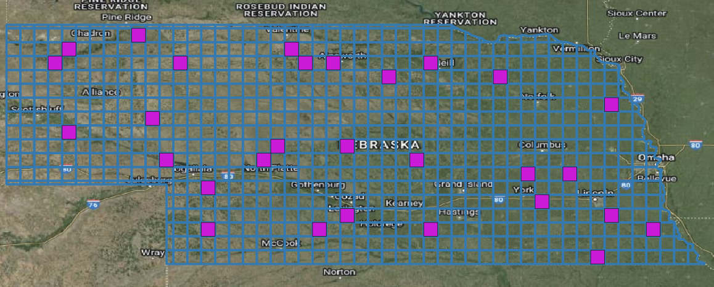
Random selection within grid

Slide 6
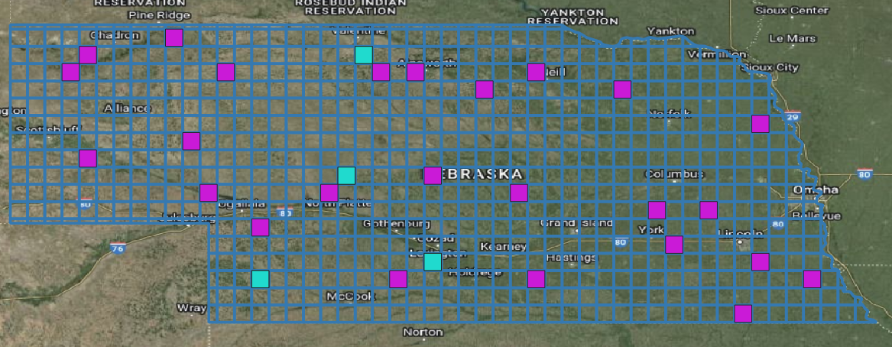
Best preforming models

Slide 7
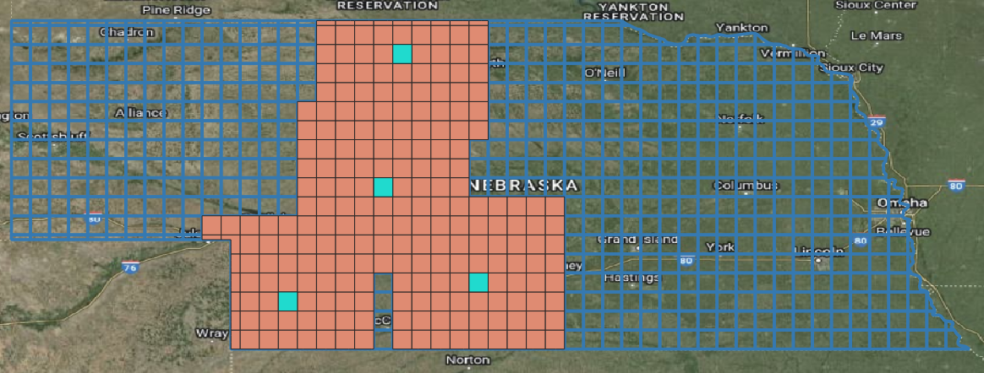
Best preforming models (5)

Slide 8
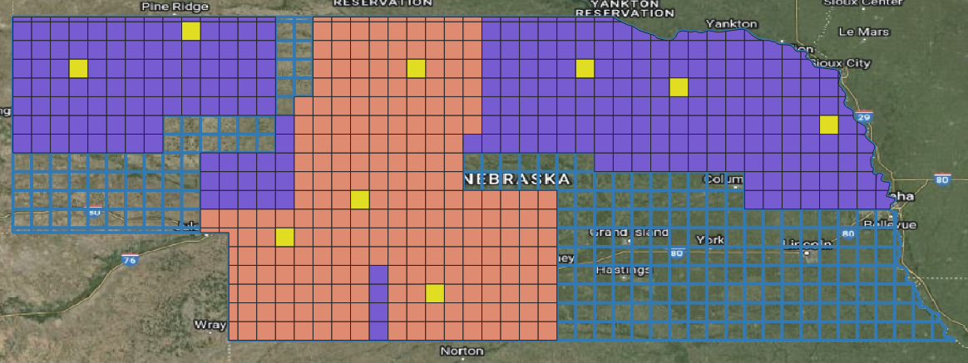
Next best models (4)

Slide 9
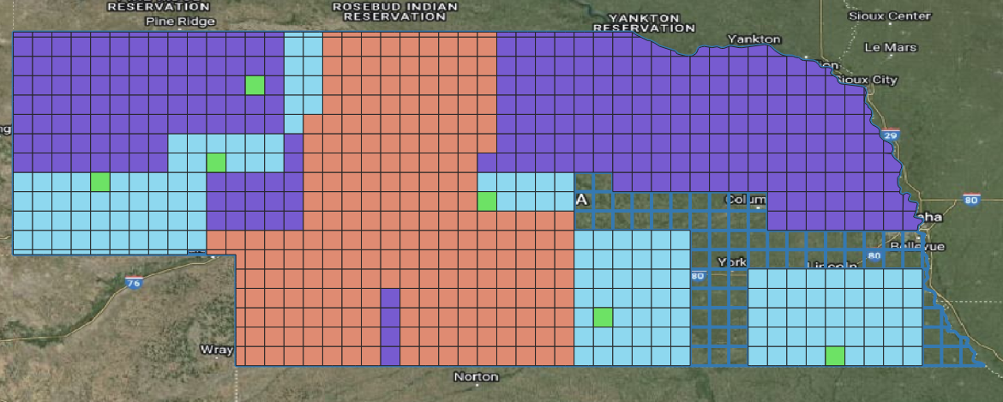
Next best models (3)

Slide 10
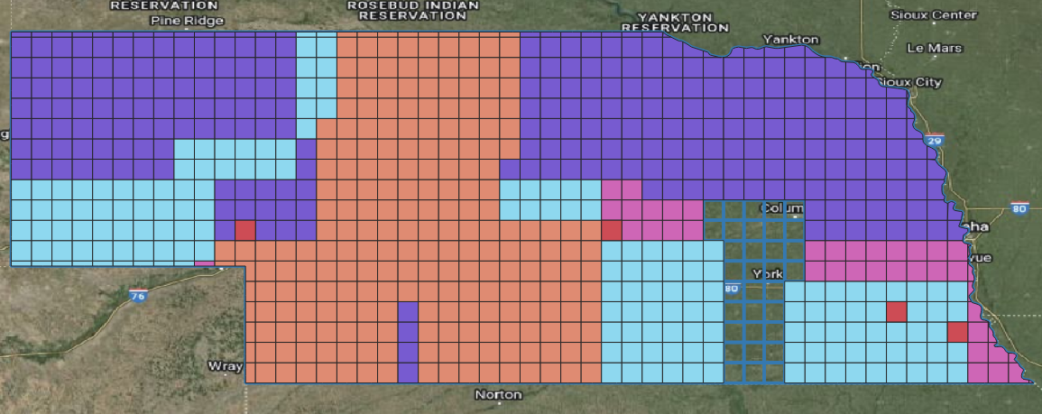
Next best models (2)

Slide 11
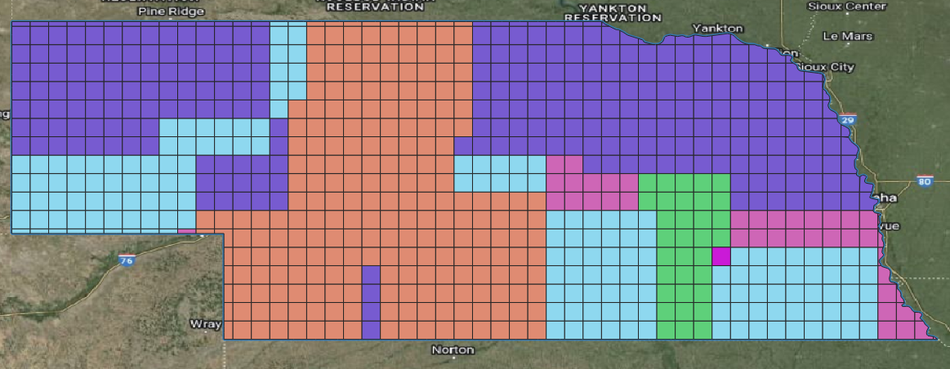
Next best models (1)

Slide 12


Result

Slide 13
Validation Effort

