Slide 1
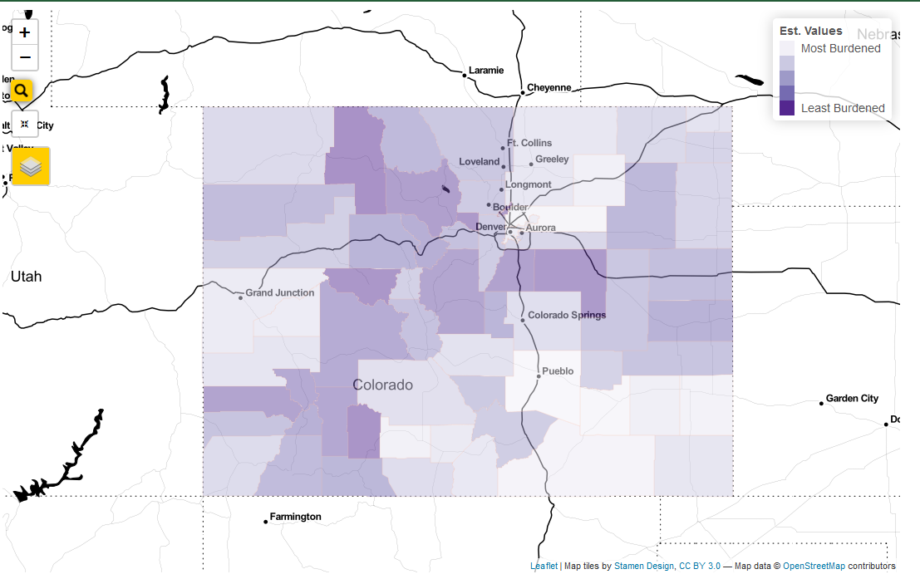
Map Zoom
Legend
Address Search
Add or Remove Map Layers
Reset Map View

Slide 2
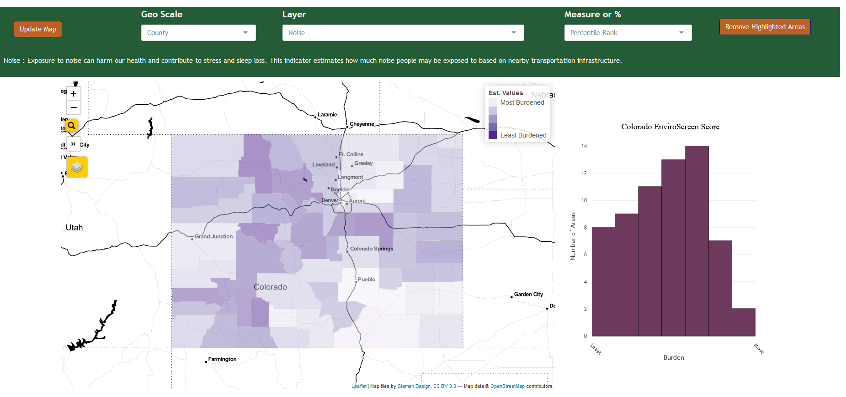
Select Geography Displayed on Map
Choose Measure or Percentile Values
Update Map
Select Layer to Display
Map Zoom
Legend
Remove Highlight Features that were added from the table below
Address Search
Add or Remove Map Layers
Reset Map View

