Slide 1
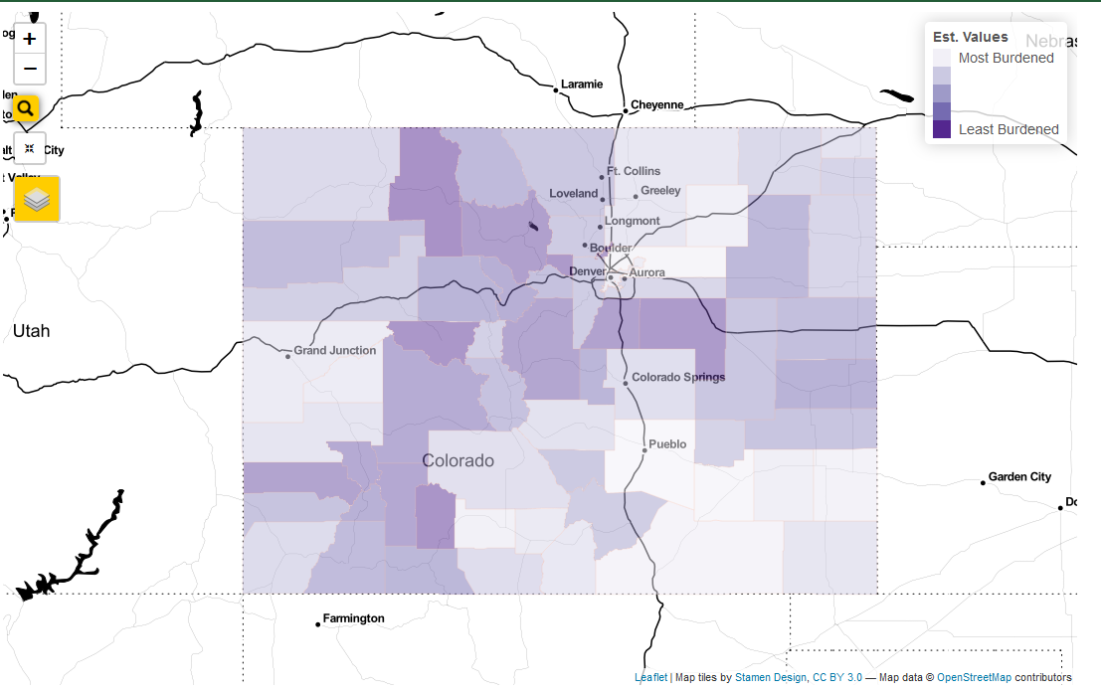
Map Zoom
Legend
Address Search
Add or Remove Map Layers
Reset Map View

Slide 2
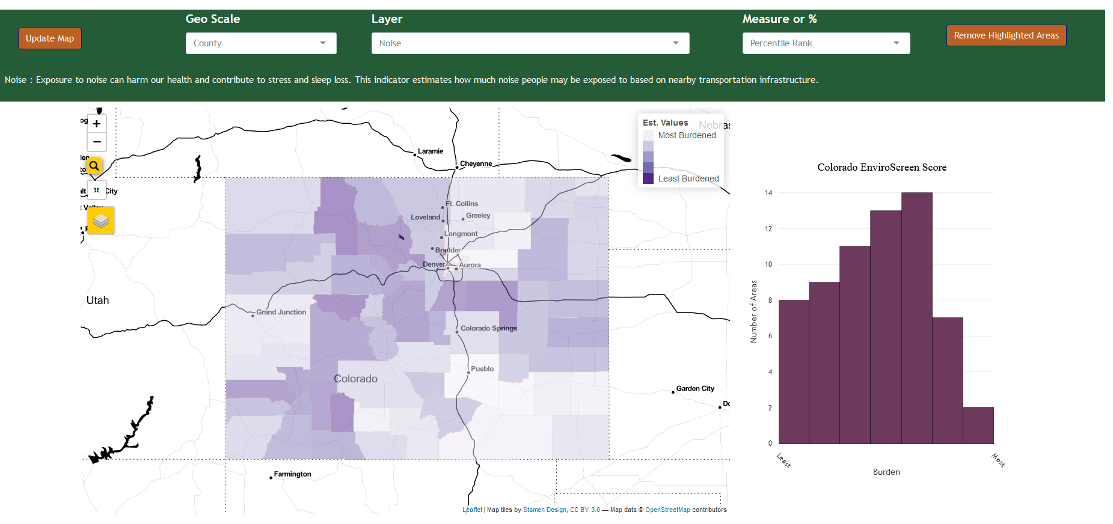
After changing the geography, layer, and measure or %, please click here to Update Map
Select Geography Displayed on Map
Choose Measure or Percentile Values
Select Indicator Layer to Display
Map Zoom
Legend
Address Search
Remove Highlighted Features added from table below
Reset Map View
Add or Remove Map Layers

