Slide 1
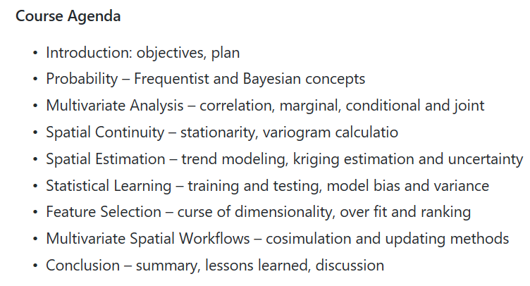
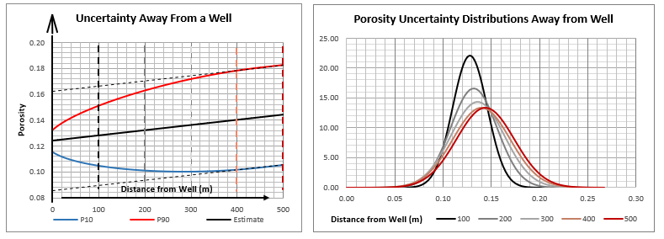
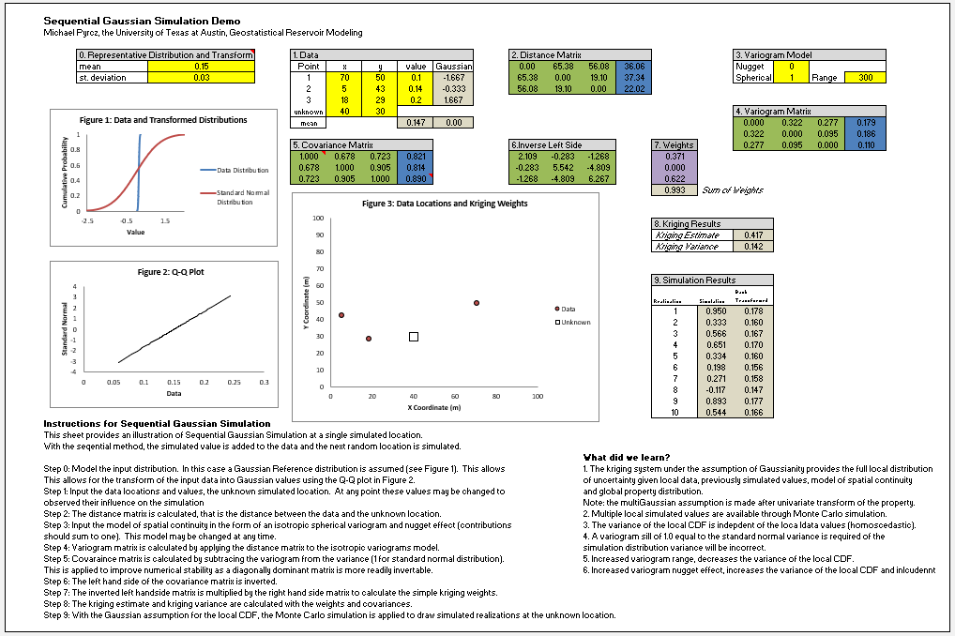
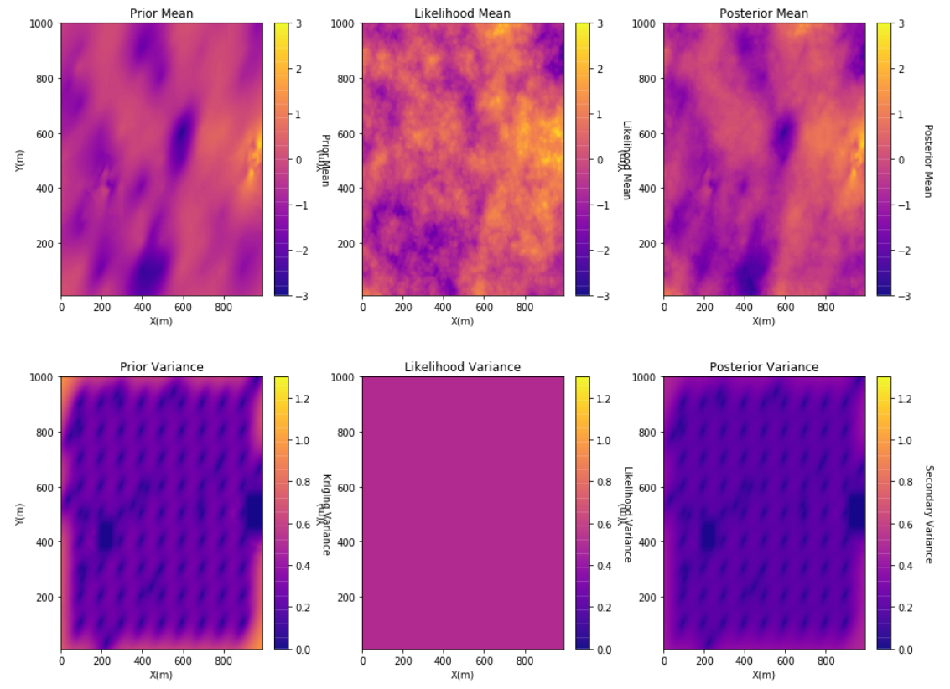
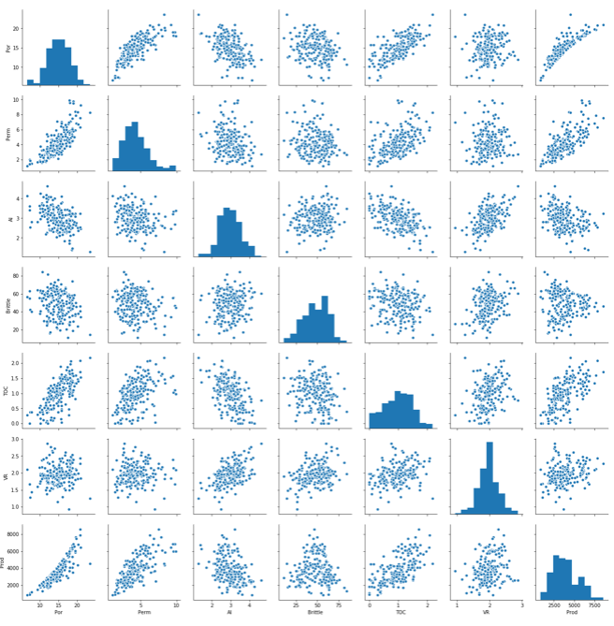
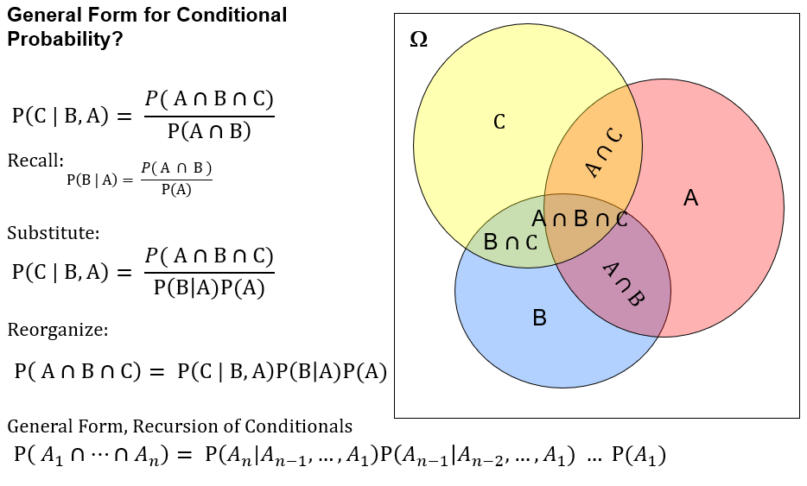
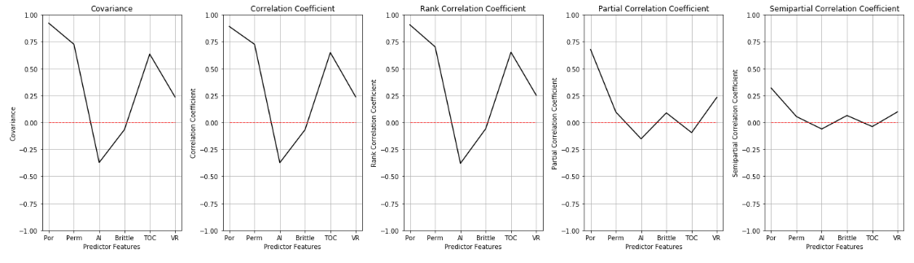
2 Day Short Course: Multivariate Spatial Modeling
For Geoscientists, Data Scientists and Engineers
Michael Pyrcz, University of Texas at Austin (@GeostatsGuy)
The University of Texas at Austin
Texas Center for Geostatistics
Lectures, theory, workflows, demonstrations and hands-on exercises with open-source in Python: NumPy, Pandas, MatPlotLib, seaborn, and GeostatsPy packages. Based on my 17 years of experience in consulting and leading research on subsurface modeling, uncertainty management and decision making, I have high graded and made accessible multivariate, spatial geostatistics to geoscientists, data scientists and engineers in a manner that will immediately impact your capabilities for solving subsurface modeling problems. All lectures, and documented workflows, demonstrations, and hands-on exercises are available on GitHub at https://git.io/fhb8a.
Topics and Applications
Spatial Modeling
Excel and Python Documented Workflows for Hands-on
Multivariate Analysis
(Geo)Statistical / Probability Theory
Multivariate Feature Selection

