Slide 1
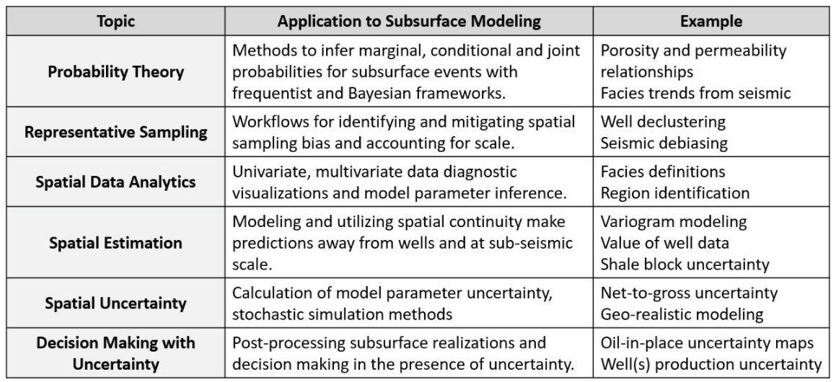
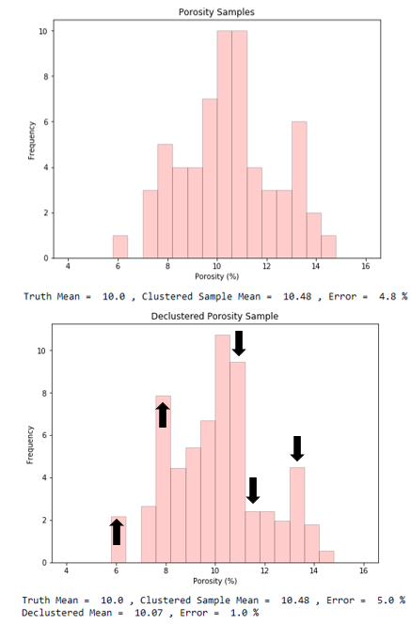
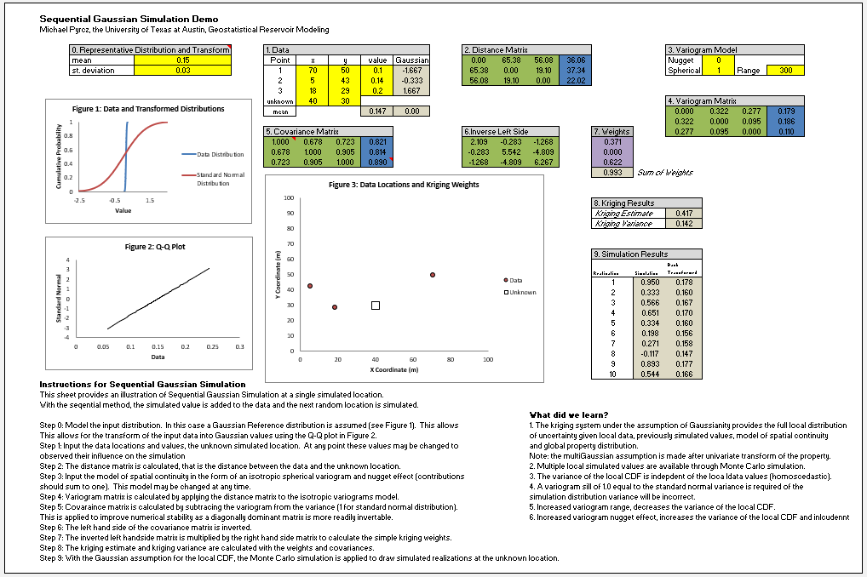
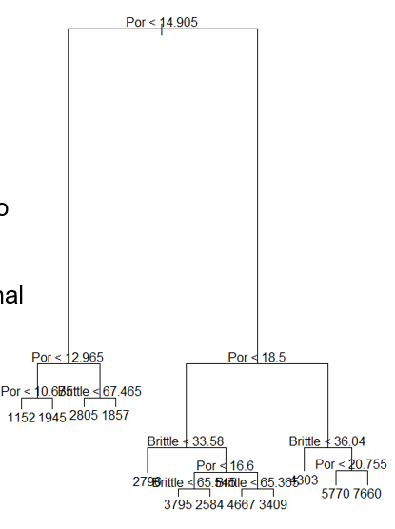
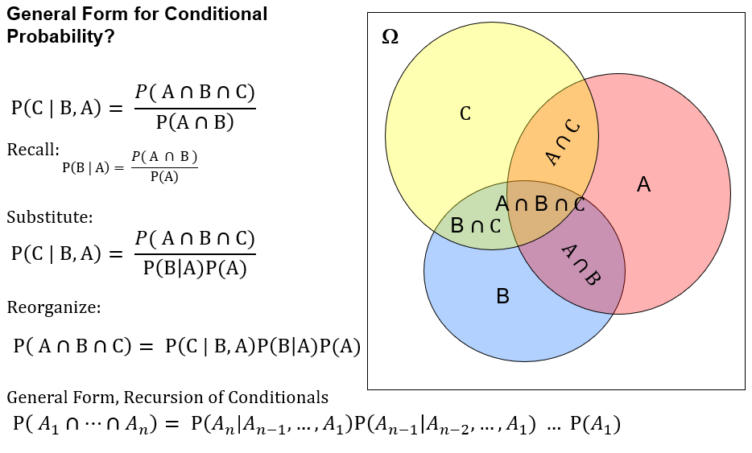
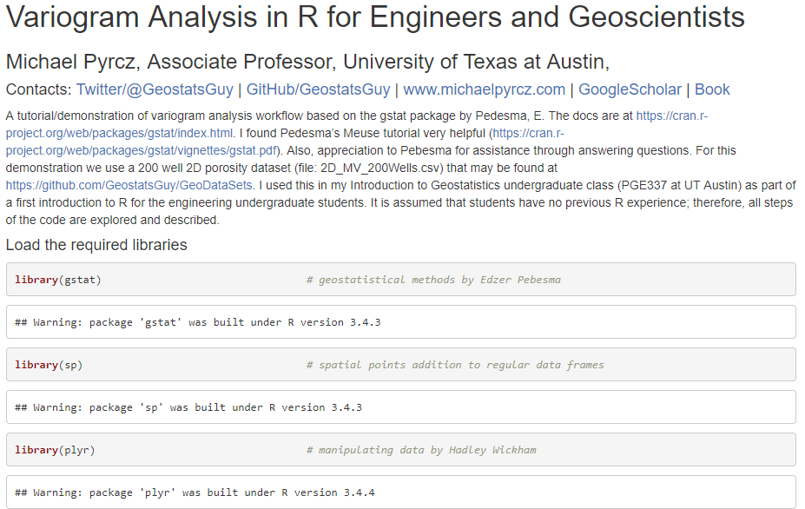
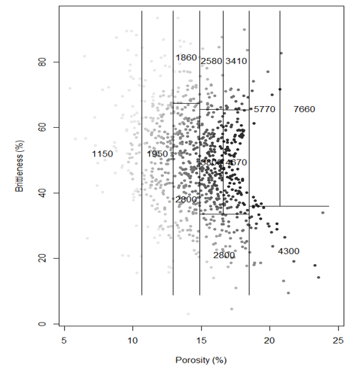
2 Day Short Course: Everything Geoscientists and Data Scientists Need to Know About Geostatistics
Michael Pyrcz, University of Texas at Austin (@GeostatsGuy)
The University of Texas at Austin
Texas Center for Geostatistics
Theory, workflows, demonstrations and hands-on exercises with open-source in R, Python and Geostatistical Library (GSLIB). Based on my 17 years of experience in consulting and leading research on subsurface modeling, uncertainty management and decision making, I have high graded and made accessible geostatistics to geoscientists and data scientists in a manner that will immediately impact your capabilities for solving subsurface modeling problems. All lectures, and documented workflows, demonstrations, and hands-on exercises are available at https://git.io/fNBqz and https://git.io/fNBqr.
Topics and Applications
Python / GSLIB Demonstration
Excel Hands-on
Machine Learning for Subsurface
(Geo)Statistical / Probability Theory
R / Rstudio Hands-on

