Slide 1
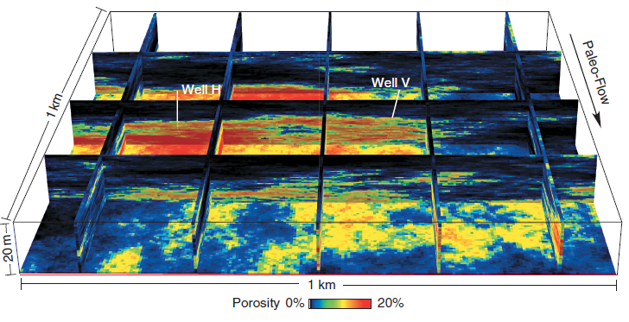
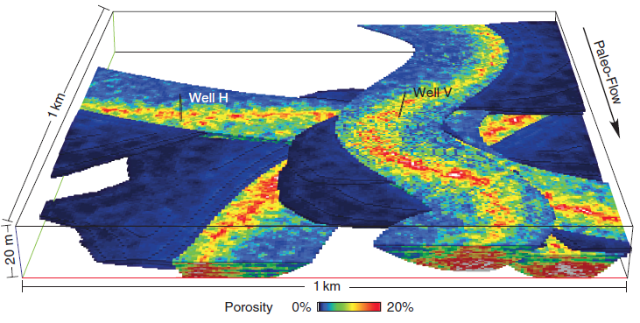
More on Bias: Automation Bias in Subsurface Modeling?
Michael Pyrcz, University of Texas at Austin (@GeostatsGuy)
The University of Texas at Austin
Texas Center for Geostatistics
Automation Bias: The tendency to focus on automated systems. We can calculate distributions, trends and variograms from well and seismic data, facies from cluster analysis, but so much is missing when we neglect geological concepts. Compare these models:
Geomodeling is much more than a statistical exercise, it is the integration of all data and all concepts. We need good geological mapping!
Reservoir model without geological interpretation and mapping.
Reservoir model with geological interpretation and mapping.

