Slide 1
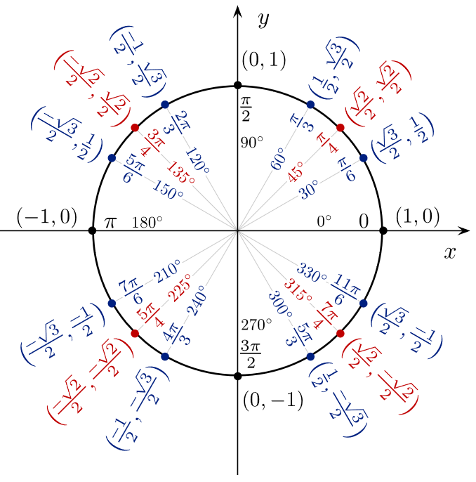
Unit Vector from Azimuth
000
330
030
315
045
300
060
270
090
240
120
135
225
210
150
180
Modified from https://upload.wikimedia.org/wikipedia/commons/4/4c/Unit_circle_angles_color.svg
Michael Pyrcz, University of Texas at Austin

