Slide 1


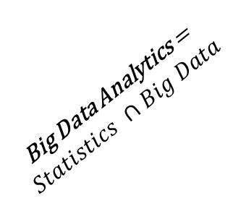

Spatial Big Data Analytics and Geostatistics
Michael Pyrcz, University of Texas at Austin (@GeostatsGuy)
The University of Texas at Austin
Texas Center for Geostatistics
Statistics is concerned with mathematical methods for collecting, organizing, and interpreting data, as well as drawing conclusions and making reasonable decisions on the basis of such analysis.
Geostatistics is a branch of applied statistics that emphasizes: (1) the spatial (geological) context of the data, (2) the spatial relationship between data, (3) the different volumetric support and precision of the data, and (4) spatial and data uncertainty. For decades, geostatistics has been dealing with big data from the perspective of volume, variety, variability, veracity and velocity (relative to decision cycles).
Big Data Analytics is the process of examining large and varied data sets (big data) to discover patterns and make decisions.
Given this it seems to me that:
and geostatistics has already been doing some of this. Of course there is a lot geostatistics is learning about big data concerning the computer science and software engineering (data science) including efficient curation, interrogation, manipulation, summarization and big data analytics concerning visualization and machine learning and other elements.
$$Statistics$$
$$Geostatistics$$
Spatial Big
Data Analytics
Spatial Big Data Analytics = $Geostatistics ∩Big Data$
Big Data Analytics =
$$Statistics ∩Big Data$$
$$Big Data$$
Proposed Venn diagram.

