Slide 1
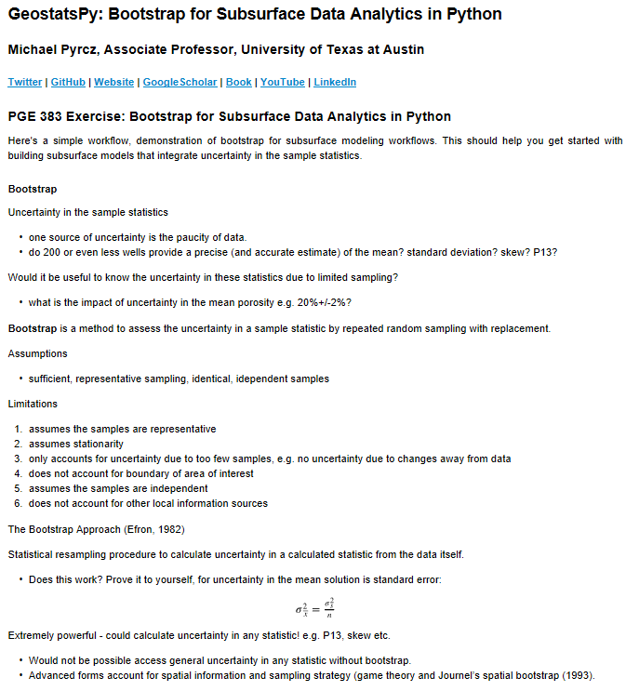
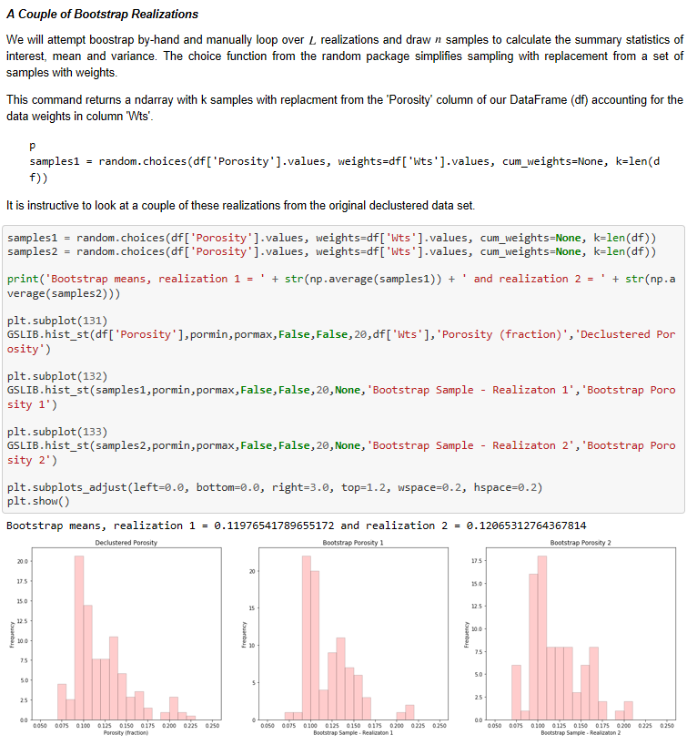
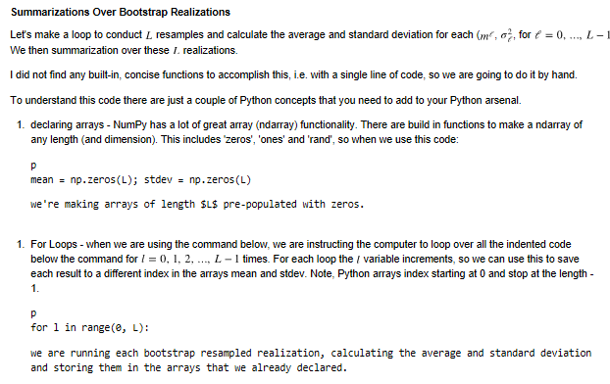

The University of Texas at Austin
An explanation of Bootstrap for geoscientists, data scientists and geo-engineers.
Michael Pyrcz, University of Texas at Austin, @GeostatsGuy
Texas Center for Geostatistics
A demonstration of bootstrap essential to subsurface data collection, uncertainty modeling and decision making.
General Description of Bootstrap
Example Bootstrap Realizations
Example Bootstrap Summarization
Available here, Python workflow in Jupyter notebook: https://git.io/fhgUW
Using the GeostatsPy Package available here:

