Slide 1
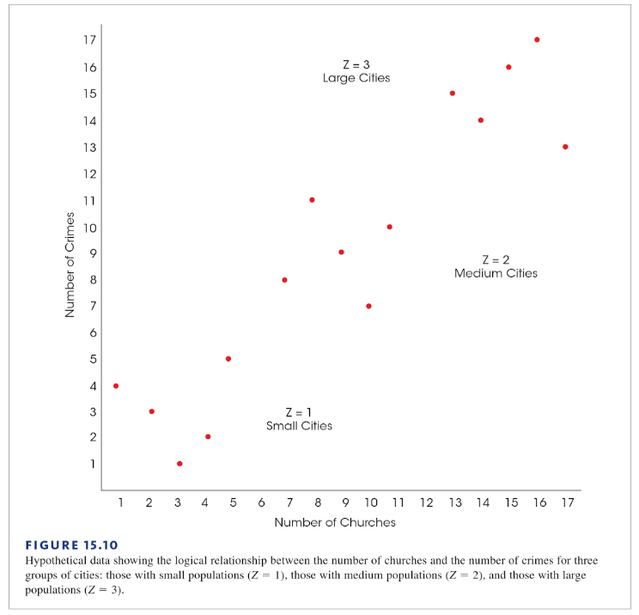
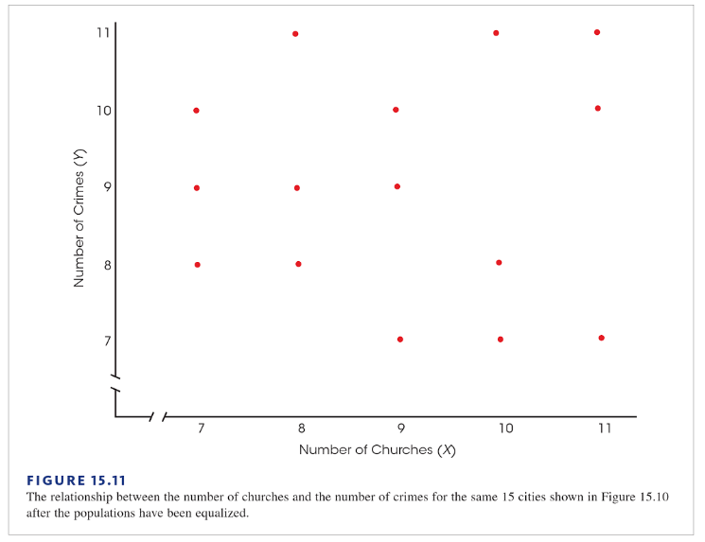
Correlation Does Not Imply Causation: The Churches and Crime Example
Michael Pyrcz, University of Texas at Austin, @GeostatsGuy
We have all heard “correlation does not necessarily imply causation”. Here is a famous demonstration. From Figure 15.10 one can see strong correlation between number of churches and number of crimes. Do churches cause crime? We require a “true experiment” where one variable is manipulated and others are rigorously controlled! By mixing cities of different sizes the population variable has influenced the result. Larger populations cause more churches and also cause more crime.
Large Cities
Medium Cities
Small Cities
Figures from Gravetter, F.,J., and Wallnau, L.B., 2017, Statistics for The Behavioral Sciences, Cengage Learning, p. 732. Note circles and red labels added to Figure 15.10.

