Slide 1


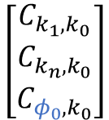

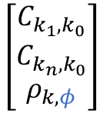



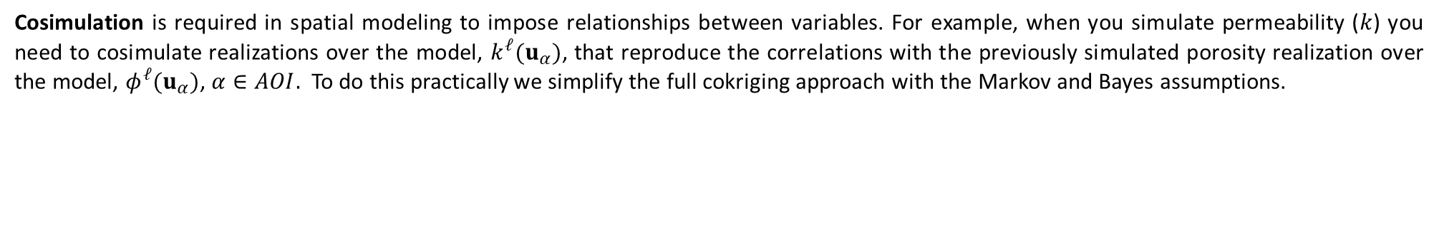
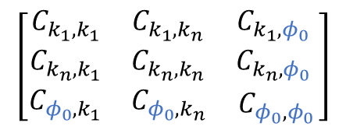

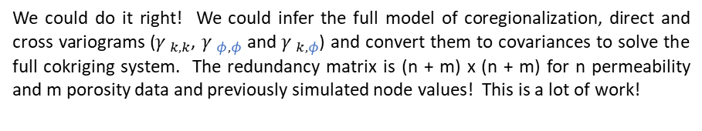

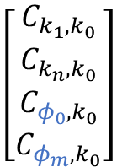

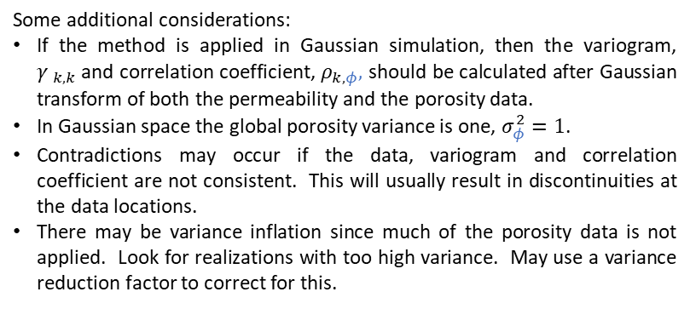

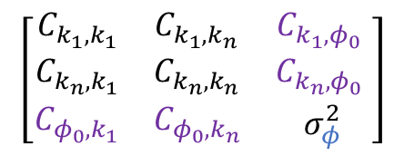



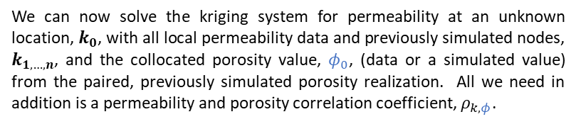
Collocated Cokriging Explanation for Geoscientists and Geo-engineers
Michael Pyrcz, University of Texas at Austin (@GeostatsGuy)
Cosimulation is required in spatial modeling to impose relationships between variables. For example, when you simulate permeability ($k$) you need to cosimulate realizations over the model, $k^{ℓ}(u_{α})$, that reproduce the correlations with the previously simulated porosity realization over the model, $φ^{ℓ}(u_{α})$, $α∈AOI.$ To do this practically we simplify the full cokriging approach with the Markov and Bayes assumptions.
The Cokriging Approach
$$k_{1}$$
$$k_{3}$$
The Collocated Cokriging Method
We could do it right! We could infer the full model of coregionalization, direct and cross variograms (${γ }_{k,k}$, ${γ }_{φ,φ}$ and ${γ }_{k,φ}$) and convert them to covariances to solve the full cokriging system. The redundancy matrix is (n + m) x (n + m) for n permeability and m porosity data and previously simulated node values! This is a lot of work!
$$φ_{1}$$
$$φ_{3}$$
We can now solve the kriging system for permeability at an unknown location, $k_{0}$, with all local permeability data and previously simulated nodes, $k_{1,…,n}$, and the collocated porosity value, $φ_{0}$, (data or a simulated value) from the paired, previously simulated porosity realization. All we need in addition is a permeability and porosity correlation coefficient, $ρ_{k,φ}$.
$$k_{0}?$$
Primary Direct
Cross
$$φ_{0}$$
$$\left[\begin{matrix}\begin{matrix}C_{k_{1},k_{1}} & C_{k_{1},k_{n}} \\ C_{k_{n},k_{1}} & C_{k_{n},k_{n}}\end{matrix} & \begin{matrix}C_{k_{1},φ_{0}} & C_{k_{1},φ_{m}} \\ C_{k_{n},φ_{0}} & C_{k_{n},φ_{m}}\end{matrix} \\ \begin{matrix}C_{φ_{0},k_{1}} & C_{φ_{0},k_{n}} \\ C_{φ_{m},k_{1}} & C_{φ_{m},k_{n}}\end{matrix} & \begin{matrix}C_{φ_{0},φ_{0}} & C_{φ_{0},φ_{m}} \\ C_{φ_{m},φ_{0}} & C_{φ_{m},φ_{m}}\end{matrix}\end{matrix}\right]$$
$$\left[\begin{matrix}\begin{matrix}λ_{k_{1}} \\ λ_{k_{n}}\end{matrix} \\ \begin{matrix}λ_{φ_{1}} \\ λ_{φ_{m}}\end{matrix}\end{matrix}\right]$$
$$\left[\begin{matrix}\begin{matrix}C_{k_{1},k_{0}} \\ C_{k_{n},k_{0}}\end{matrix} \\ \begin{matrix}C_{φ_{0},k_{0}} \\ C_{φ_{m},k_{0}}\end{matrix}\end{matrix}\right]$$
$$k_{2}$$
=
$$\left[\begin{matrix}\begin{matrix}C_{k_{1},k_{1}} & C_{k_{1},k_{n}} \\ C_{k_{n},k_{1}} & C_{k_{n},k_{n}}\end{matrix} & \begin{matrix}C_{k_{1},φ_{0}} \\ C_{k_{n},φ_{0}}\end{matrix} \\ \begin{matrix}C_{φ_{0},k_{1}} & C_{φ_{0},k_{n}}\end{matrix} & σ_{φ}^{2}\end{matrix}\right]$$
$$\left[\begin{matrix}\begin{matrix}λ_{k_{1}} \\ λ_{k_{n}}\end{matrix} \\ λ_{φ_{0}}\end{matrix}\right]$$
$$\left[\begin{matrix}\begin{matrix}C_{k_{1},k_{0}} \\ C_{k_{n},k_{0}}\end{matrix} \\ ρ_{k,φ}\end{matrix}\right]$$
Cross
Secondary Direct
$$φ_{2}$$
=
The Markov Assumption
To simplify the problem we assume Markov screening, that is the collocated porosity realizations and data, $φ_{1,…,m}$, are screened by the collocated porosity value, $φ_{0}$.
We still need the cross covariances between the retained collocated porosity, $φ_{0}$, and all the permeability data, $C_{φ_{0},k_{n}}$,…, $C_{φ_{m},k_{n}}$. To do this we assume Bayesian updating to estimate the cross variogram ${γ }_{k,φ}\left(h\right)$ from the permeability variogram updated with the correlation coefficient, ${γ }_{k,φ}\left(h\right)$ = ${ρ_{k,φ}∙γ }_{k,k}\left(h\right)$.
Additional Considerations
$$\left[\begin{matrix}\begin{matrix}C_{k_{1},k_{1}} & C_{k_{1},k_{n}} \\ C_{k_{n},k_{1}} & C_{k_{n},k_{n}}\end{matrix} & \begin{matrix}C_{k_{1},φ_{0}} \\ C_{k_{n},φ_{0}}\end{matrix} \\ \begin{matrix}C_{φ_{0},k_{1}} & C_{φ_{0},k_{n}}\end{matrix} & C_{φ_{0},φ_{0}}\end{matrix}\right]$$
Some additional considerations:
If the method is applied in Gaussian simulation, then the variogram, ${γ }_{k,k}$and correlation coefficient, $ρ_{k,φ},$ should be calculated after Gaussian transform of both the permeability and the porosity data.
In Gaussian space the global porosity variance is one, $σ_{φ}^{2}=1$.
Contradictions may occur if the data, variogram and correlation coefficient are not consistent. This will usually result in discontinuities at the data locations.
There may be variance inflation since much of the porosity data is not applied. Look for realizations with too high variance. May use a variance reduction factor to correct for this.
$$\left[\begin{matrix}\begin{matrix}λ_{k_{1}} \\ λ_{k_{n}}\end{matrix} \\ λ_{φ_{0}}\end{matrix}\right]$$
$$\left[\begin{matrix}\begin{matrix}C_{k_{1},k_{0}} \\ C_{k_{n},k_{0}}\end{matrix} \\ C_{φ_{0},k_{0}}\end{matrix}\right]$$
=
The Bayes Assumption

