Slide 1
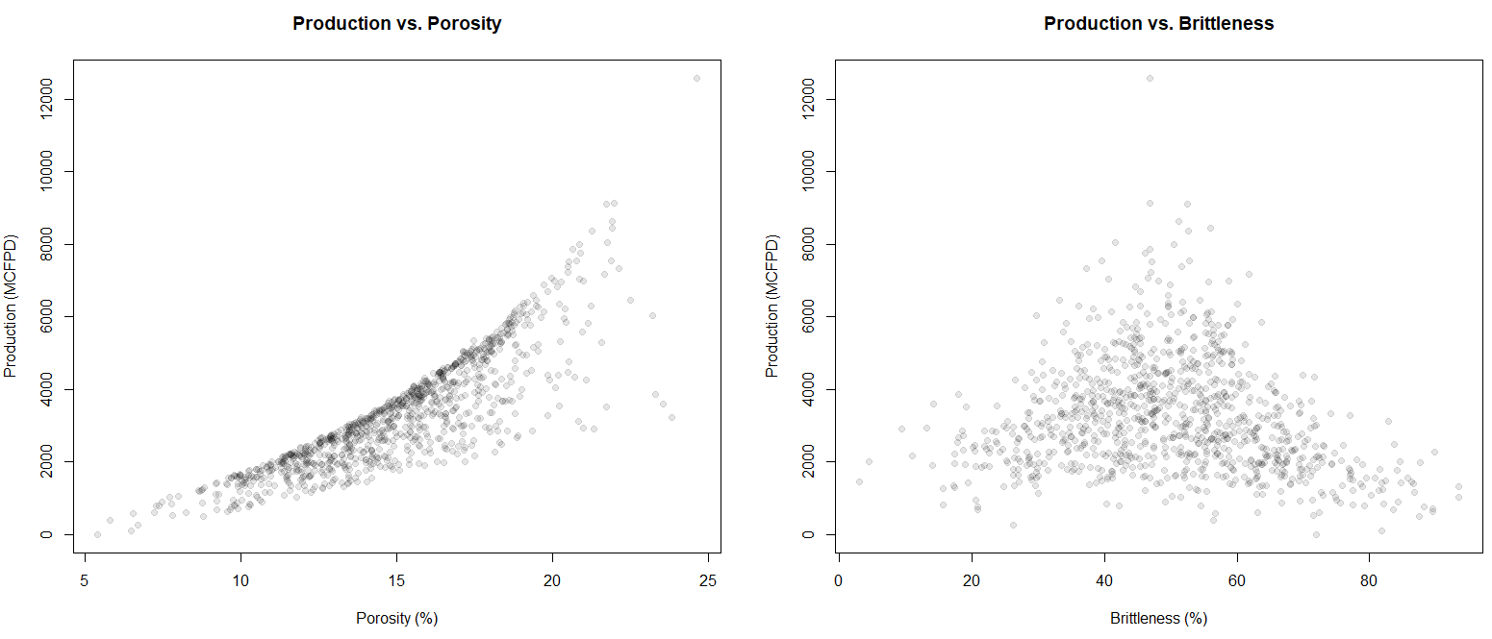
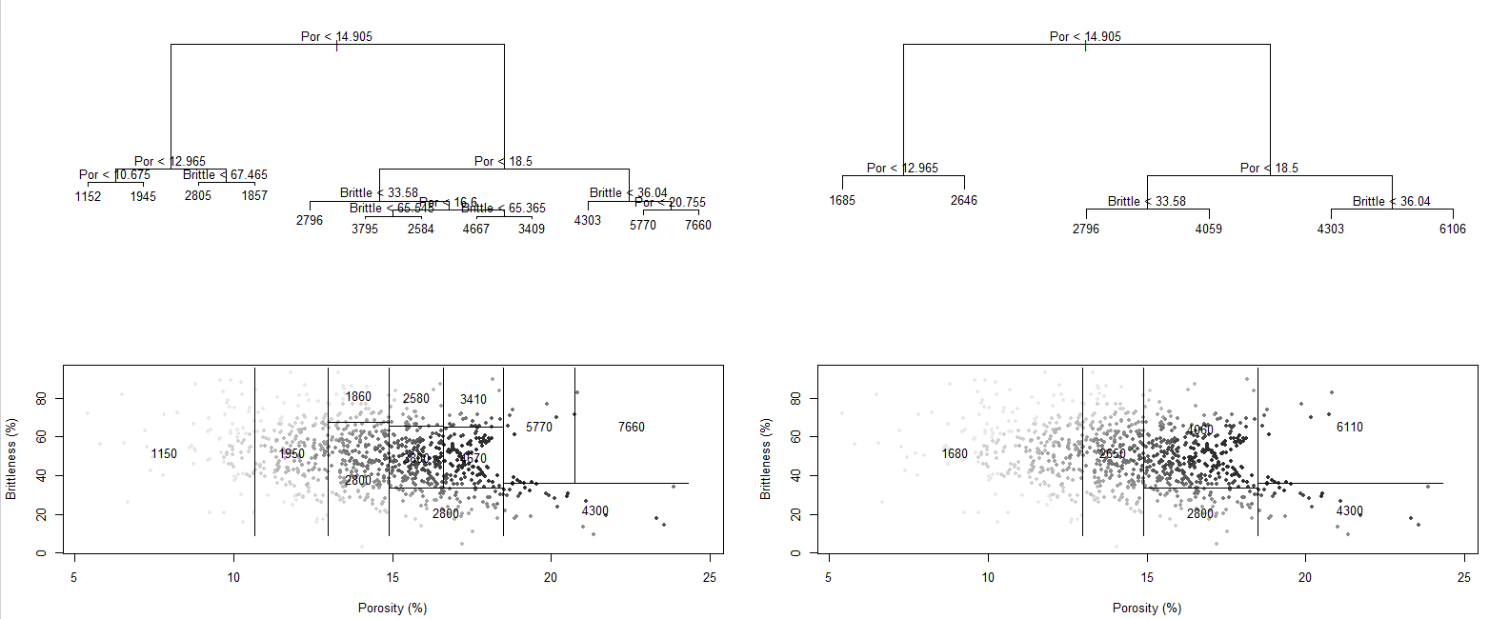
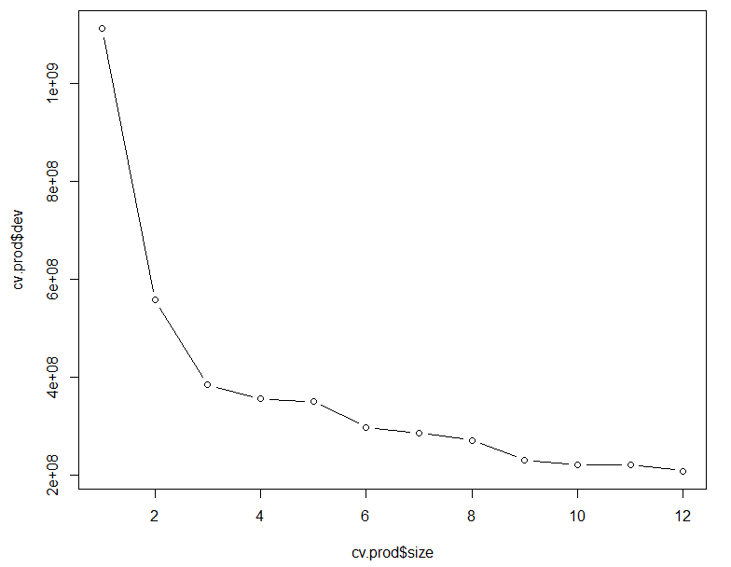
Decision Tree Tutorial with Subsurface Demonstration in R for Geoscientists and Geo-engineers
Michael Pyrcz, University of Texas at Austin (@GeostatsGuy)
Decision Tree is one of the most simple, explainable and interpretable predictive models in machine learning; therefore, it is a great introduction to regression and classification with machine learning. In addition, the recursive binary segmentation is analogous to human decision making. The resulting trees and segmentation of the feature space may be interrogated and there are very good options for cross validation and pruning to improve robustness. Finally, understanding a decision tree is a prerequisite for more powerful bagging, random forest and boosting.
Production from Porosity and Brittleness
Decision Tree for Production
Pruned Decision Tree for Production
Decision Tree for Production from Porosity and Brittleness
Decision Tree for Production from Porosity and Brittleness
Cross Validation Results for Pruning
Training Data and Solution for Production from Porosity and Brittleness
Training Data and Solution Production from Porosity and Brittleness

