Slide 1
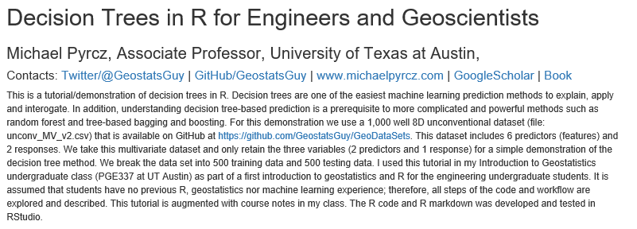
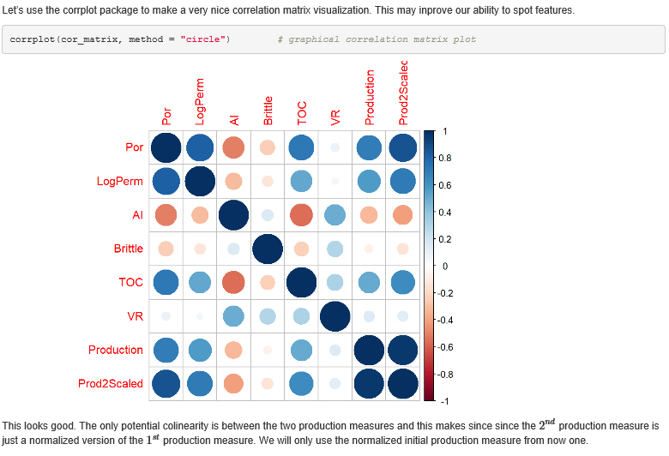
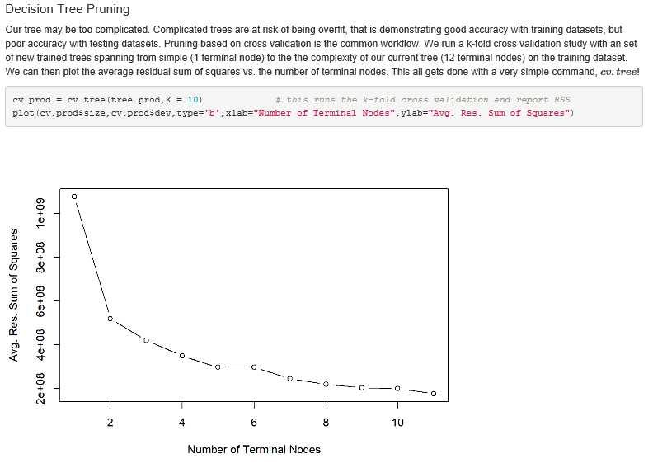
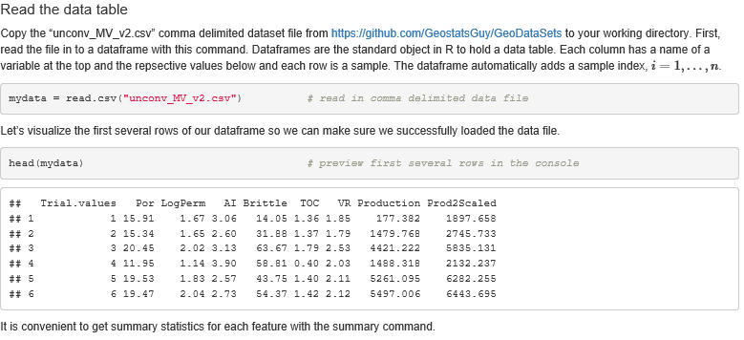
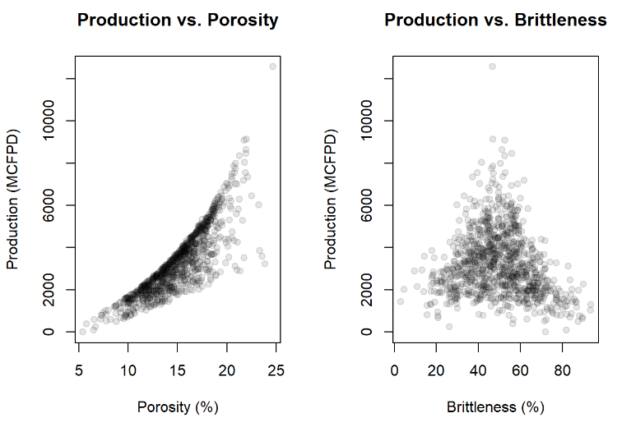
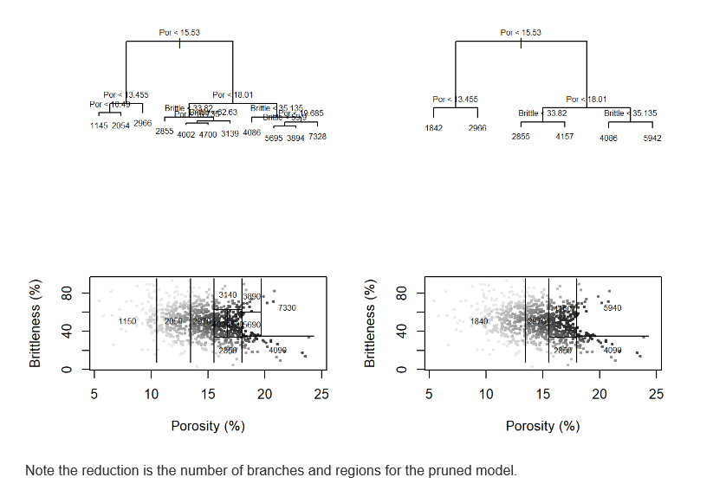
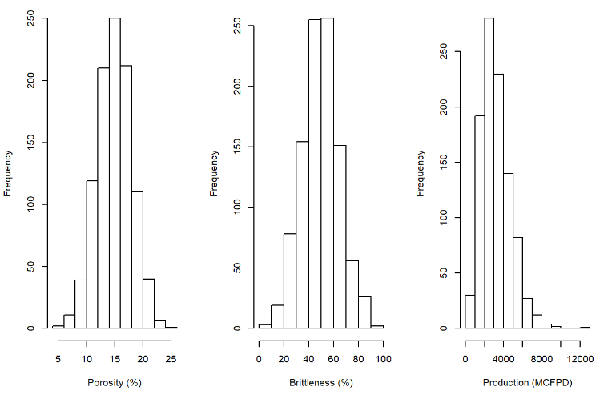
Decision Tree Tutorial with Subsurface Demonstration in R Markdown for Geoscientists and Geo-engineers
Michael Pyrcz, University of Texas at Austin (@GeostatsGuy)
Decision Tree is one of the most simple, explainable and interpretable predictive models in machine learning; therefore, it is a great introduction to regression and classification with machine learning. In addition, the recursive binary segmentation is analogous to human decision making. Finally, understanding a decision tree is a prerequisite for more powerful bagging, random forest and boosting. This tutorial includes R Markdown, R code and a realistic unconventional dataset. There is enough documentation that any geoscientists or engineer should be able to try out machine learning.

