Slide 1
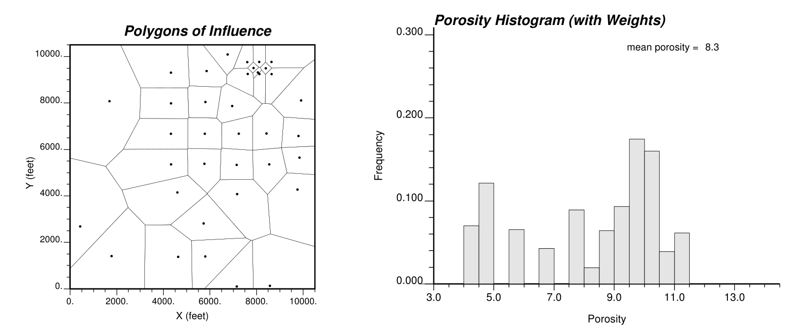
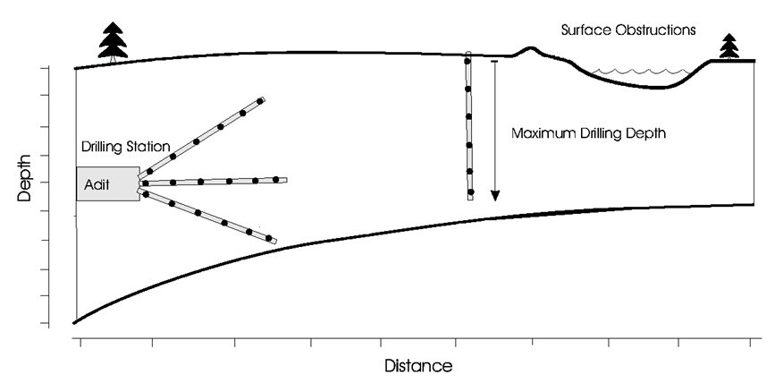
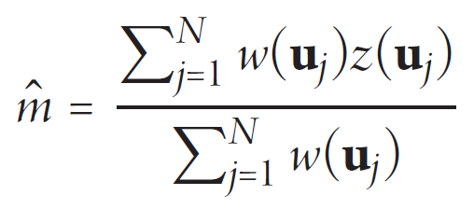
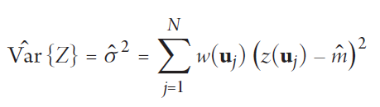
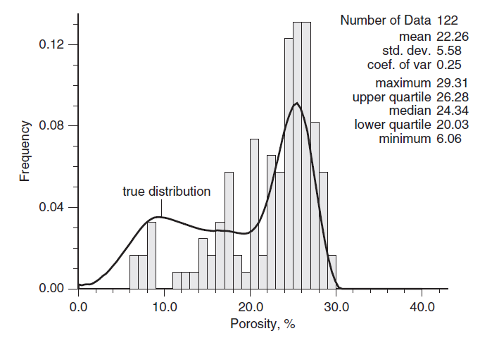
The University of Texas at Austin
Sample Data Bias for Geoscientists, Data Scientists and Engineers
Michael Pyrcz, University of Texas at Austin, @GeostatsGuy
Texas Center for Geostatistics
Most spatial data is sampled in a biased manner. This sampling practice won’t change as it results in the best economics! Never use raw sample data-derived statistics to estimate the population parameters without checking for sample bias and apply a correction as needed.
1. Spatial Data Sampling
Spatial data is collected to answer important questions:
how far does the contaminant plume extend?
where is the fault?
what is the highest mineral grade?
who fas does the reservoir extend?
2. Representative Sampling?
Representative sampling would require random sampling or regular sampling (with care to not align with data periodicity). While this sampling would support collection of representative statistics, this would not maximize profitability, nor is it often possible:
obstruction and accessibility constraints, more samples in the shallow part of a reservoir
extraction limits, may not be able to recover a shale core without damage
measurement limits, may not be able to measure permeability in the shale over the time allowed for data collection
3. Mitigating Sample Bias
Data declustering: One correction method is to use information about the data spacing to assign data weights. Here’s an example of polygonal declustering.
Use the weights to estimate any sample statistics:
It is our job to best reveal the true population parameters from the sample.
Porosity Samples and Polygons
Porosity Corrected Distribution
Mean
Variance
Images from Pyrcz, M.J. and Deutsch, C.V., 2003, Declustering and Debiasing: in Searston, S. (eds.) Geostatistical Association of Australasia, Newsletter 19, October.

