Slide 1

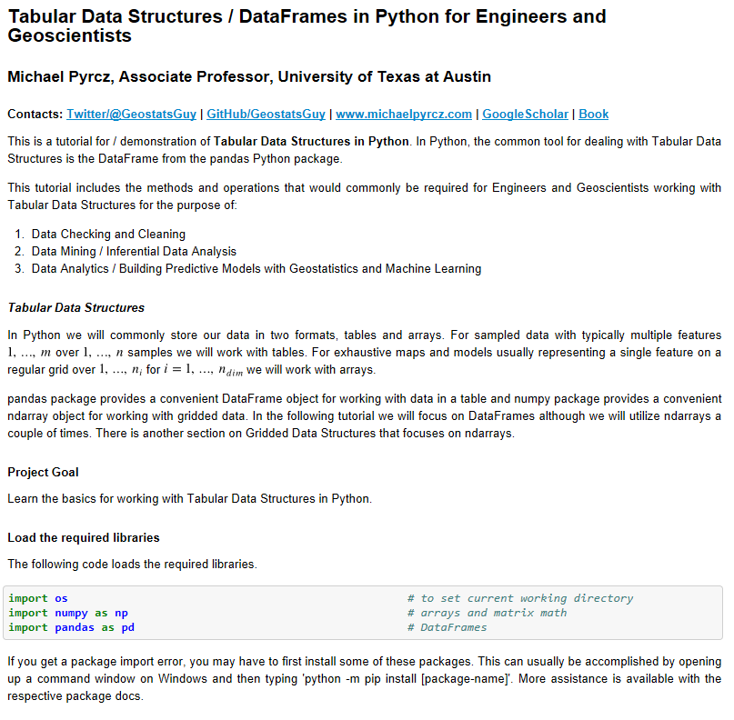
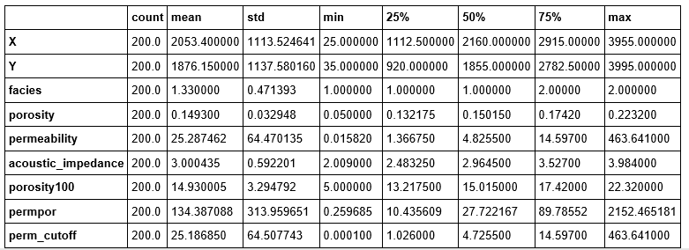
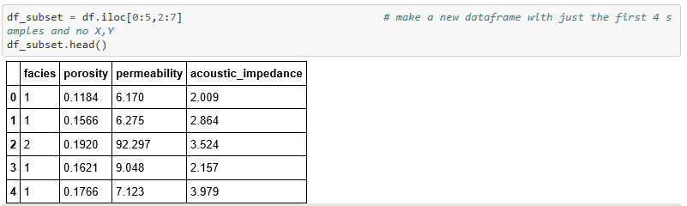
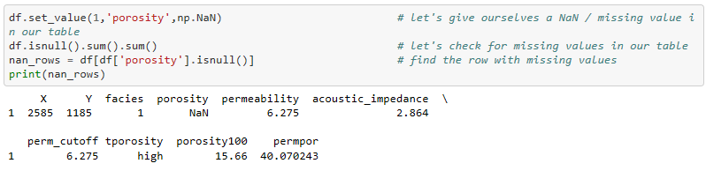
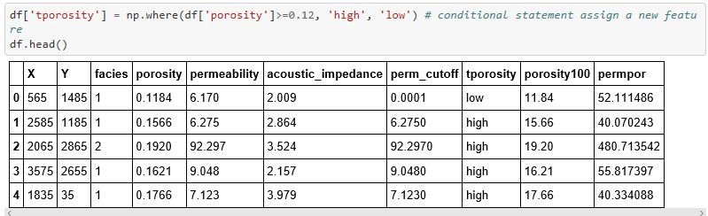
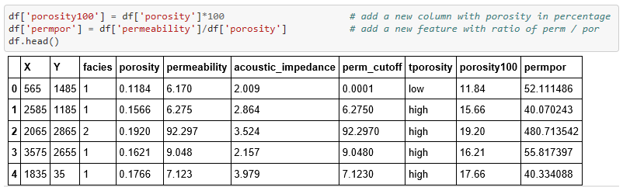
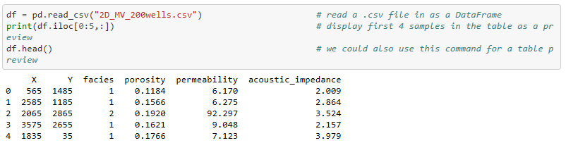
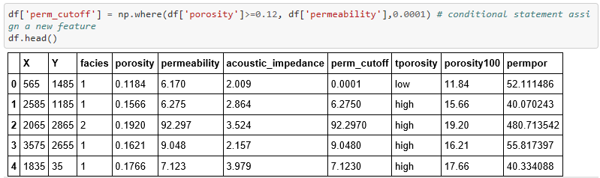
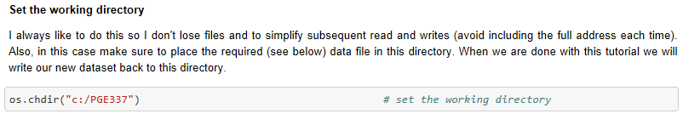
Tabular Data with DataFrames in Python for Geoscientists and Geo-engineers
Michael Pyrcz, University of Texas at Austin (@GeostatsGuy)
Many geoscientists and engineers struggle with getting started with data analytics, machine learning and geostatistics in Python, because they do not know how to handle their data. DataFrames from the pandas package, by Wes McKinney and current core team, is designed for high performance, easy to use tabular data structures. Here’s a tutorial in Jupyter with Markdown with all the tabular structured data operations needed to build most subsurface modeling workflows. Check it out here: https://git.io/fNgRW.
Jupyter Notebook Tutorial with Markdown
Summary Statistics / Data Checking
Data Extraction
Data Transformations
Data Manipulation / Data Formatting
Data Read / Write
Also check out this tutorial for ndarrays: https://git.io/fNgRu

