Slide 1

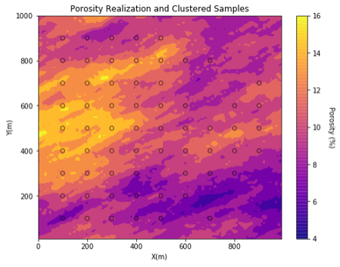
GSLIB: Geostatistical Software Library, Data Debiasing in Python for Geoscientists and Geo-engineers
Michael Pyrcz, University of Texas at Austin (@GeostatsGuy)
GSLIB: Geostatistical Software Library by Deutsch and Journel is commonly applied to build geostatistical workflows. We have started to wrap and reimplement GSLIB in Python using the strength of improved data management and visualization from numpy, pandas and matplotlib while retaining the conventions from GSLIB that are so familiar to the community. This early work was applied to demonstrate stochastic simulation of a 2D truth Porosity model, clustered sampling and cell-based declustering to improve sample statistic representativity. Sample debiasing is essential in geoscience datasets!

