Slide 1
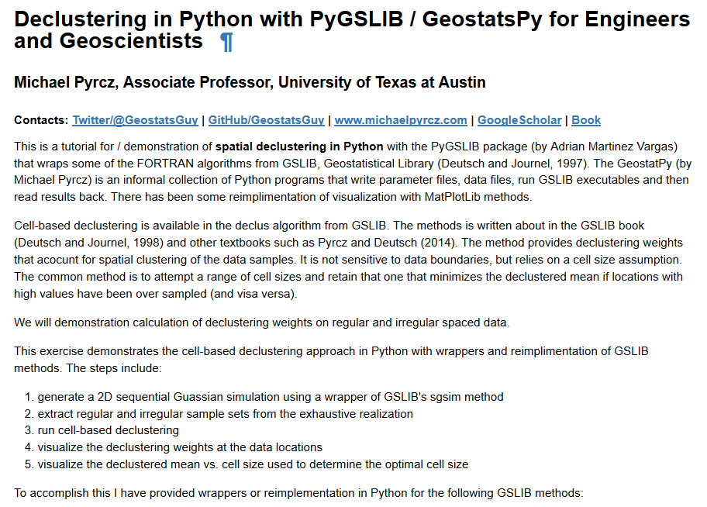
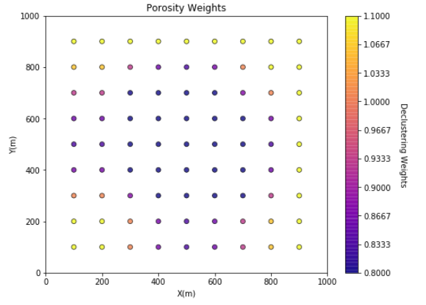
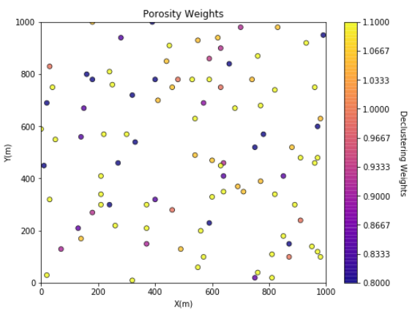
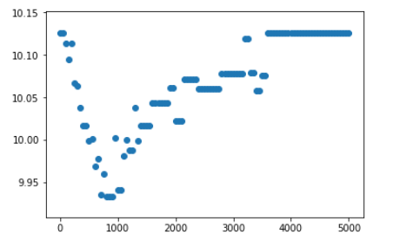
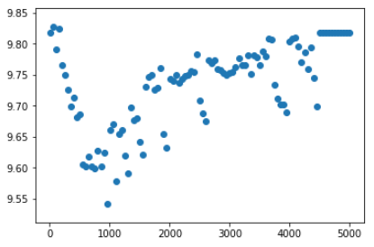
Spatial Debiasing / Declustering with Subsurface Demonstration in Python for Geoscientists and Geo-engineers
Michael Pyrcz, University of Texas at Austin (@GeostatsGuy)
The University of Texas at Austin
Texas Center for Geostatistics
GSLIB: Geostatistical Software Library by Deutsch and Journel (1998) is commonly applied to build geostatistical workflows. I tried out the PyGSLIB package (by Andrian Martinez Vargas) that wraps GSLIB for Python and built a workflow by including some of my GeostatPy reimplementations. Sample debiasing is essential in geoscience datasets as most sampling is biased! Here’s how to do it https://git.io/fxwEP
Example 1
Example 2
Declustering Weights
Declustered Mean vs. Cell Size

