Slide 1
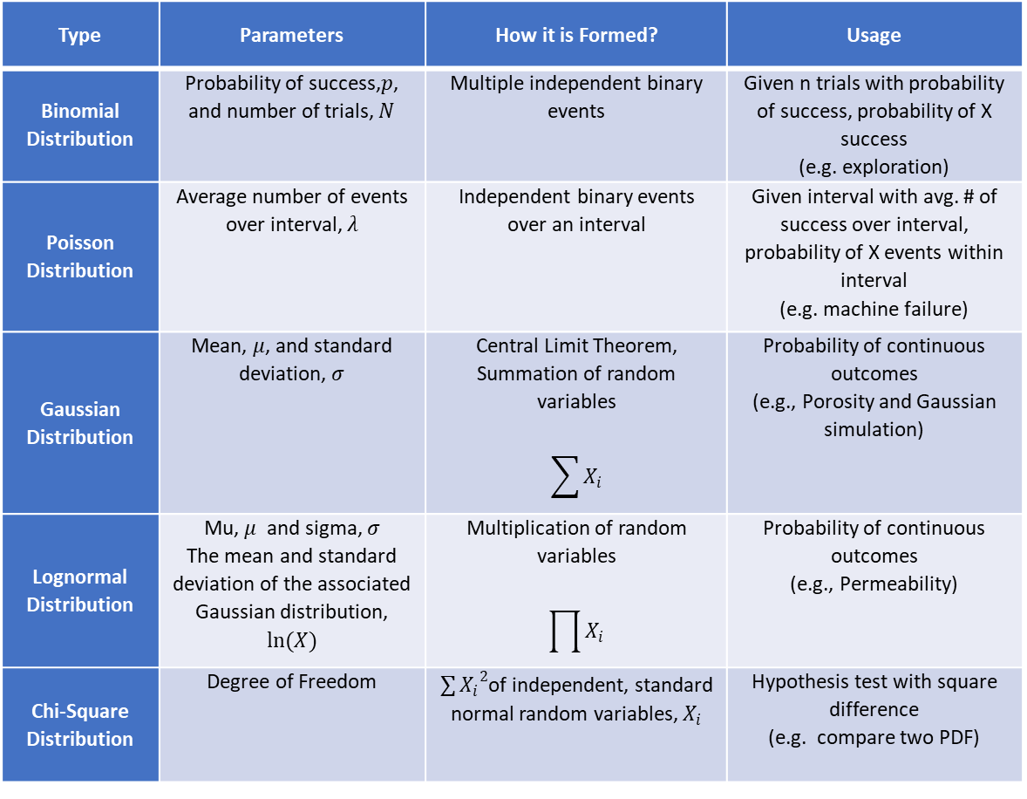
Summary of Common Distributions Applied in Subsurface Data Analytics and Geostatistics
Honggeun Jo, University of Texas at Austin
The University of Texas at Austin
Texas Center for Geostatistics
Type | Parameters | How it is Formed? | Usage
Binomial Distribution | Probability of success,$p$, and number of trials, $N$ | Multiple independent binary events | Given n trials with probability of success, probability of X success (e.g. exploration)
Poisson Distribution | Average number of events over interval, $λ$ | Independent binary events over an interval | Given interval with avg. # of success over interval, probability of X events within interval (e.g. machine failure)
Gaussian Distribution | Mean, $μ$, and standard deviation, $σ$ | Central Limit Theorem, Summation of random variables $$\sum{X_{i}}$$ | Probability of continuous outcomes (e.g., Porosity and Gaussian simulation)
Lognormal Distribution | Mu, $μ$ and sigma, $σ$ The mean and standard deviation of the associated Gaussian distribution, $ln(X)$ | Multiplication of random variables $$\prod{X_{i}}$$ | Probability of continuous outcomes (e.g., Permeability)
Chi-Square Distribution | Degree of Freedom | ${\sum{X_{i}}}^{2}$of independent, standard normal random variables, $X_{i}$ | Hypothesis test with square difference (e.g. compare two PDF)

