Slide 1
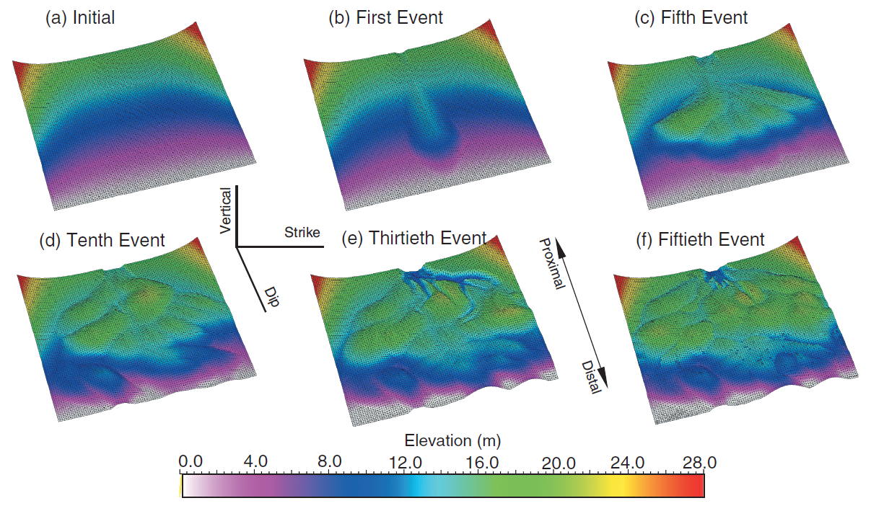
The University of Texas at Austin
Texas Center for Geostatistics
Large-Scale Emergent Features from Small-scale Processes
Michael Pyrcz, University of Texas at Austin (@GeostatsGuy)
Large-scale emergent features can result from small-scale processes. For example, high-frequency compensation or avulsion may result in large-scale patterns in the system. In other words, are we interpreting allogeneic forcing as products of autogenic processes? Can we predict large-scale emergent features? Here’s a simple numerical surface-based, rules-based model. The only rules: (1) flow goes downhill, and (2) channels switch to lobes when there is a significant break in slope.
Event
Lobe 1
Hiatus
Hiatus
Hiatus
Lobe 3
Lobe 1
Lobe 1
Lobe 2
Lobe 2
Surface-based, rules-based model to demonstrate emergent large-scale features. Composite surface shown at steps 0, 1, 5, 10, 30 and 50.

