Slide 1
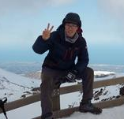
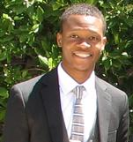
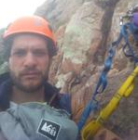
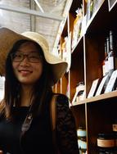
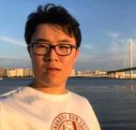
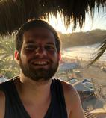
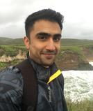
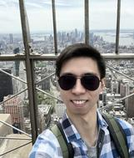
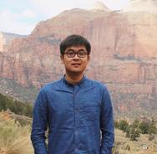
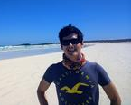
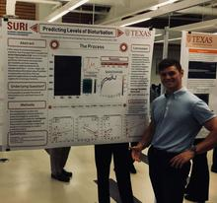
Promoting Some of the Students I Work With
Michael Pyrcz, University of Texas at Austin (@GeostatsGuy)
The University of Texas at Austin
Texas Center for Geostatistics
I promote students during my frequent visits with companies and other stakeholders. I was inspired by Kate Potter (@kcp45) and Fernando Ziegler (@feziegler) to promote my students through social media. To do this I had to gather written permissions, so I did that. Let me introduce you to some of the excellent early career engineers and geoscientists that work with me on geostatistics, machine learning etc. and tell you a little about their work. I would be happy to share more information on their work, or make an introduction.
Supervised Students
Honggeun Jo (Ph.D. Student)
​​​​​​​Geological modeling, New subsurface modeling methods, Data Integration ​Started Ph.D. Fall, 2017.
Azor Nwachukwu (Ph.D. student, cosupervised with Dr. Lake) ​​Machine learning, Reservoir modeling, Geostatistics
Javier Santos (Ph.D. student) Upscaling, Geostatistics, Shale HP flow simulations, Machine learning
​Started Ph.D. Fall, 2018.
Wendi Lui (new Ph.D. student) Reservoir modeling, machine learning, unconventional modeling with multi-scale, multivariate, and spatial.
​Started Ph.D. Fall, 2018.
Jack Xiao (new Ph.D. student, cosupervised with John Foster) Geostatistical modeling, Multivariate, Spatiotemporal modeling, Machine learning
Started Ph.D. Fall, 2018.
Other Students
Cesar Soares (Ph.D. Student) Drilling optimization, Rate of penetration modeling, Real-time model fitting, Real-time operational parameter selection, Machine learning, Optimization (member of Ph.D. committee, Dr. Ken Gray supervising, completed Q3, 2018)
Chiranth Hedge (Ph.D. Student) Machine Learning, Deep Learning, Bayesian Statistics, Computational Statistics, Drilling Analytics, Optimization, Data Science, Predictive Analytics, Statistical Learning, Non-parametric statistics, Bayesian Modeling (member of Ph.D. committee, Dr. Ken Gray supervising, completed Q3, 2018)
Chao Gao (Ph.D. Student) Coupled geomechanics and reservoir simulator (member of Ph.D. committee, Supervised by Dr. Ken Gray)
Peidong Zhao (Ph.D. Student) Reservoir Geomechanics, Hydraulic Fracturing Simulation, Completion and Productivity Enhancement (member of Ph.D. committee, Supervised by Dr. Ken Gray)
Jose Julian Salazar Neira (M.Sc. student) Reservoir engineering, enhanced oil recovery, reservoir simulation (reader on M.Sc., Supervised by Dr. Larry Lake)
Jonathon Crammer (undergraduate summer intern, joint with George Pemberton, University of Alberta, Canada and Erin Pemberton, ConocoPhillips) ​Data analysis, Statistics, Neurology, Biochemistry, Geology, Artificial intelligence, Cybernetics, Geospatial, Education psychology
Project on Modeling Degree of Bioturbation by Quantifying Spatial Features

