Slide 1
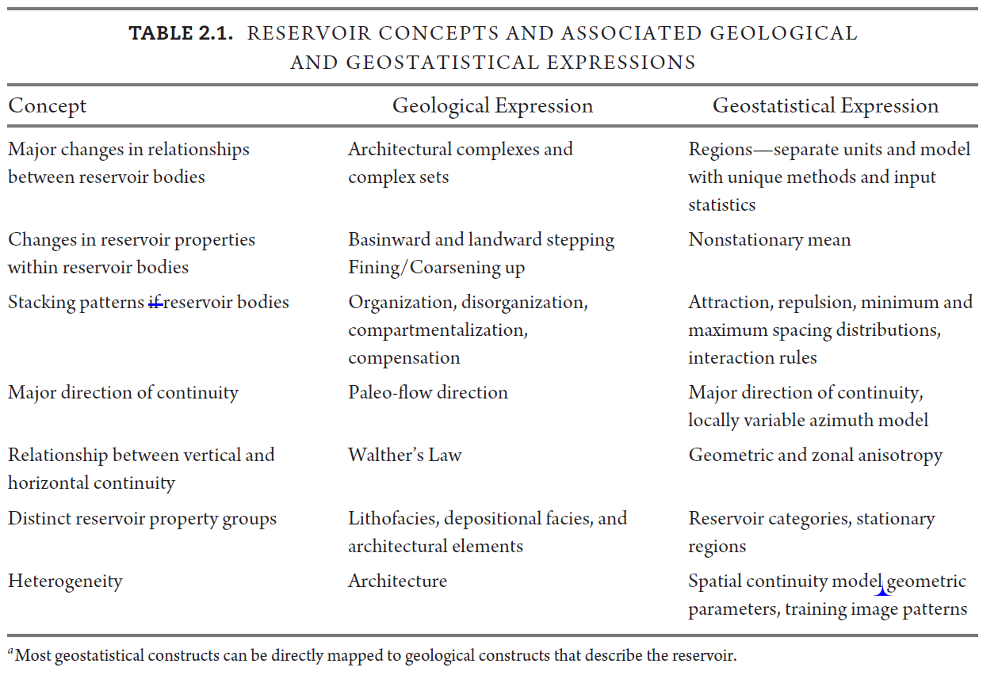
Shared Concepts Between Geology and Geostatistics
Michael Pyrcz, University of Texas at Austin (@GeostatsGuy)

