Slide 1
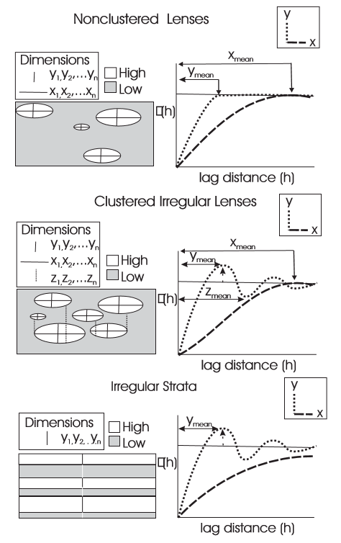

Interpreting the Hole Effect Variogram
Michael Pyrcz (@GeostatsGuy, Univ. Texas at Austin)
Lag Distance (h)
Lag Distance (h)
Lag Distance (h)

