Slide 1
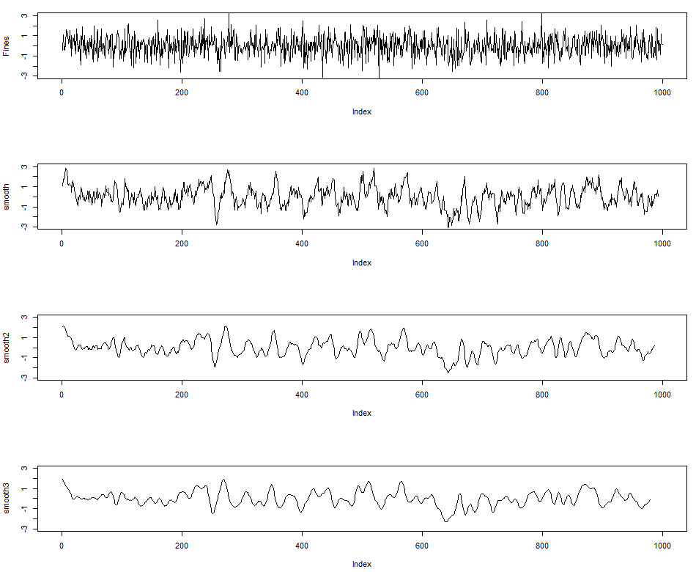
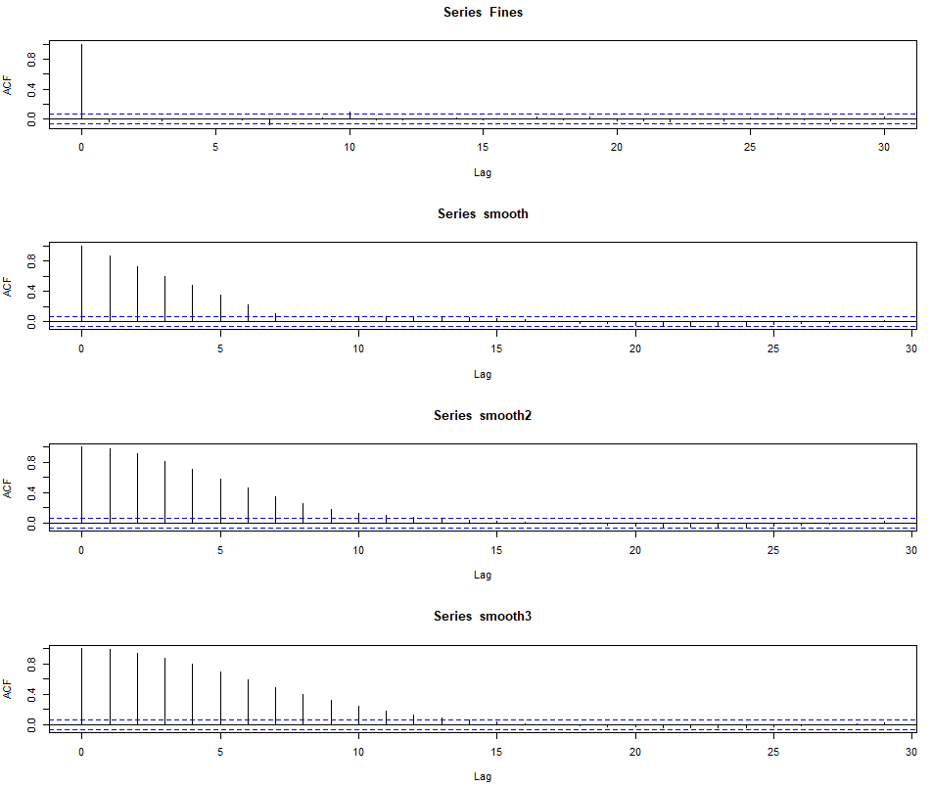
Hurst Exponent for Time Series Analysis
The University of Texas at Austin
Texas Center for Geostatistics
Try out calculating the Hurst exponent to quantify the long-term memory of a time series. Commonly used for modeling financial markets. The Hurst exponent is related to both autocorrelation and fractal dimension. Try out the “pracma” package in R by Borchers. Compare the results to the autocorrelation with the “zoo” package by Zeileis and others.
Time Series
Autocorrelation
Hurst (R/S)
0.54
0.69
0.71
0.73
0.0 < Hurst < 0.5 – long-term switching between high and low, 0.5 < Hurst < 1.0 – long-term correlation.
Hurst coefficient Workflow in R available at https://git.io/fNg0d.

