Slide 1

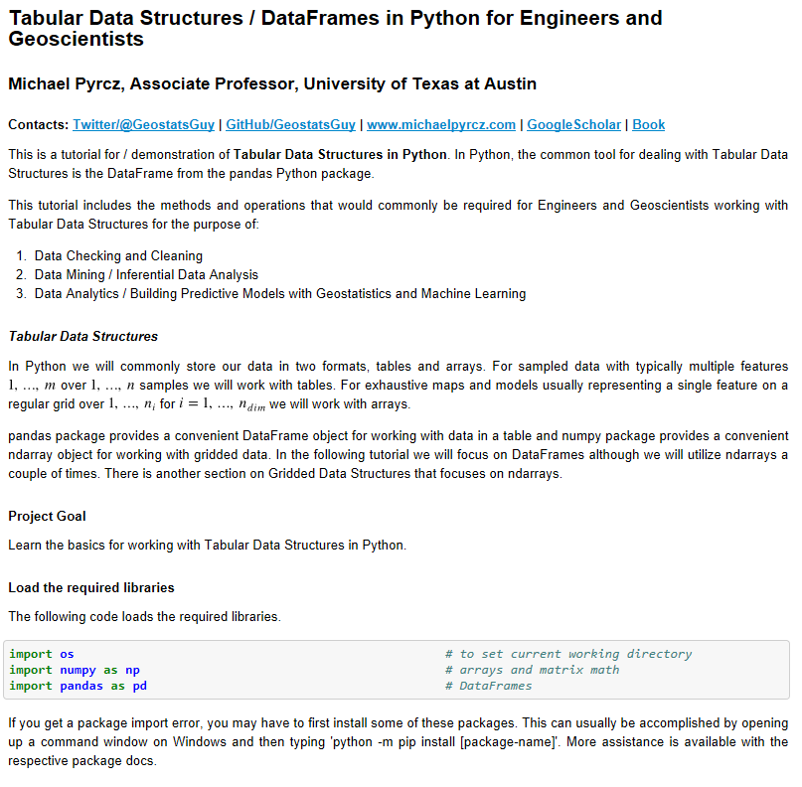
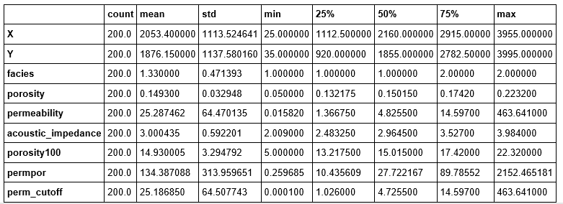
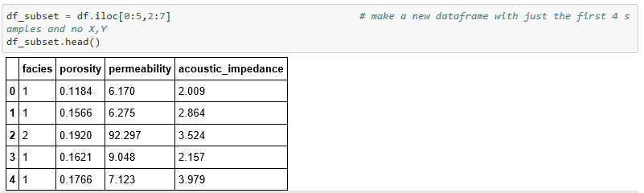
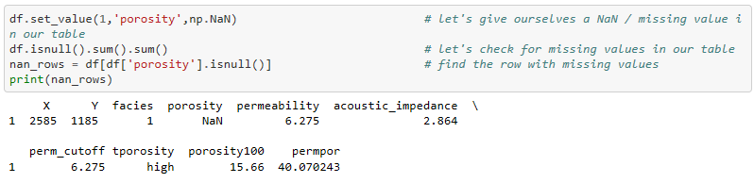
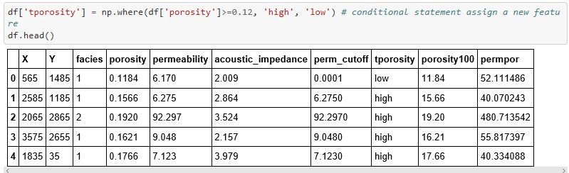
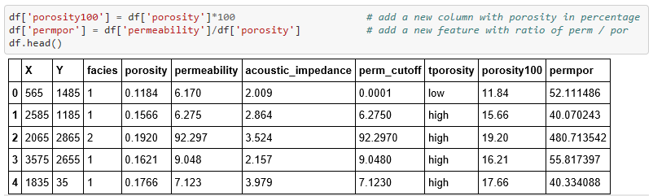
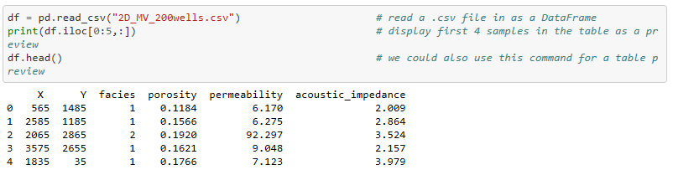
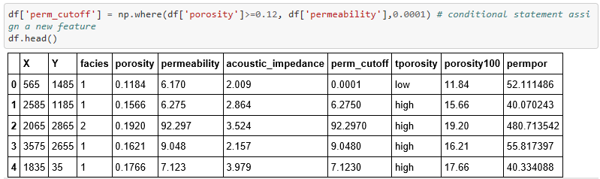
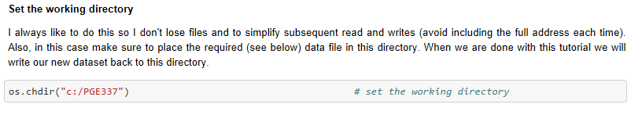
Hypothesis Testing for Geoscientists and Geo-engineers
Michael Pyrcz, University of Texas at Austin (@GeostatsGuy)
Demonstration of common hypothesis tested Check it out here: https://git.io/fNgRW.
Jupyter Notebook Tutorial with Markdown
Summary Statistics / Data Checking
Data Extraction
Data Transformations
Data Manipulation / Data Formatting
Data Read / Write
Also check out this tutorial for ndarrays: https://git.io/fNgRu

