Slide 1

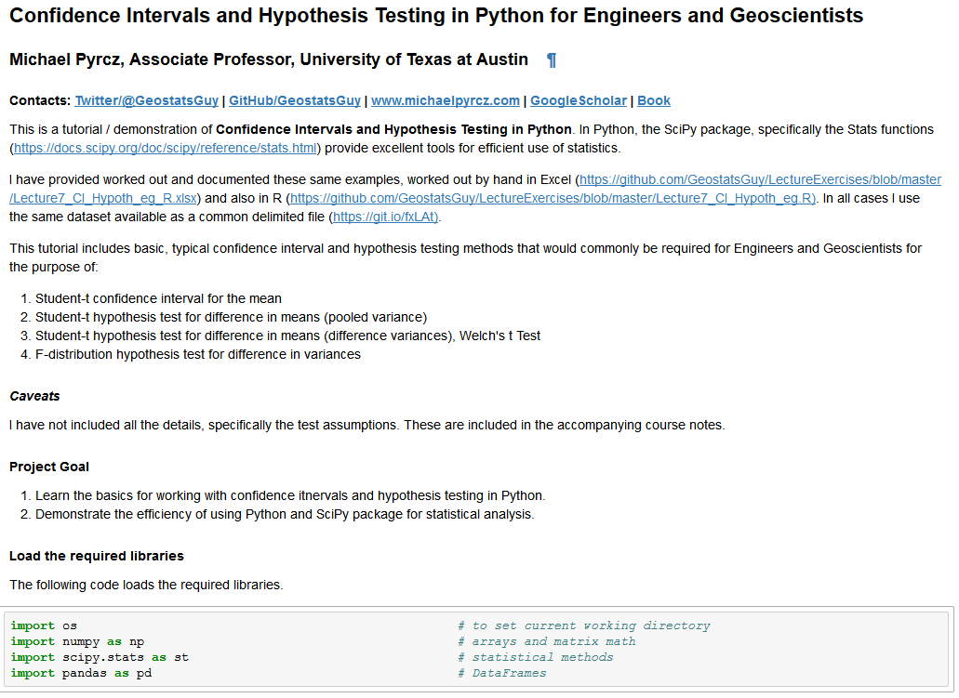
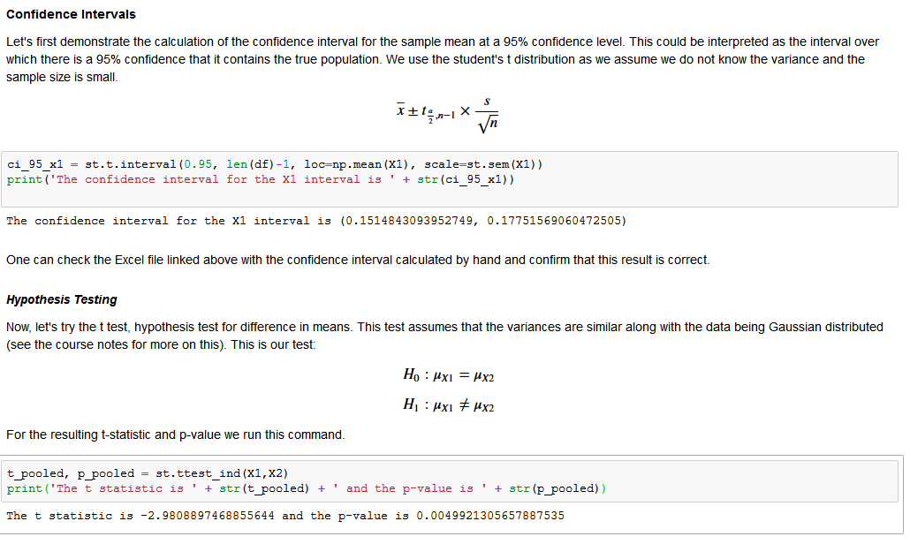
Confidence Intervals and Hypothesis Testing Demonstration in Python for Geoscientists and Geo-engineers
Michael Pyrcz, University of Texas at Austin (@GeostatsGuy)
Confidence intervals and hypothesis testing are essential parts of data analytics. We can distinguish statistically significant difference vs. random effect, protect ourselves from cognitive biases such as the ‘belief in the law of small numbers’ (Tversky and Kahneman, 1971), and integrate uncertainty into our reports. Try these out with a realistic dataset & well documented Python / Markdown Jupyter Notebook at https://git.io/fxsOx.

