Slide 1

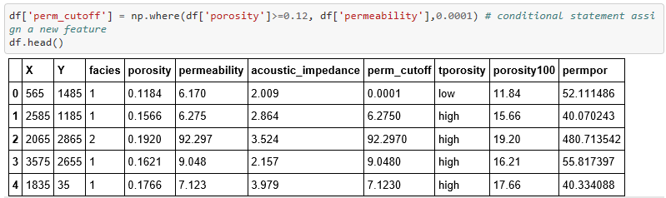
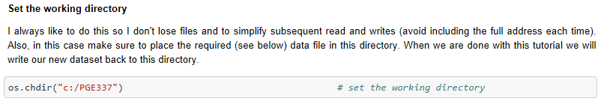

Hypothesis Testing in Excel, R and Python for Geoscientists and Geo-engineers
Michael Pyrcz, University of Texas at Austin (@GeostatsGuy)
Confidence intervals and hypothesis testing is essential. We can distinguish statistically significant difference vs. random effect, protect ourselves from the belief of small numbers and integrate uncertainty into our reports.
Excel
R
Python
1. Calculate sample mean, $\overline{x}$
Average (data_range)
Data Transformations
Data Manipulation / Data Formatting
Data Read / Write
Also check out this tutorial for ndarrays: https://git.io/fNgRu

