Slide 1
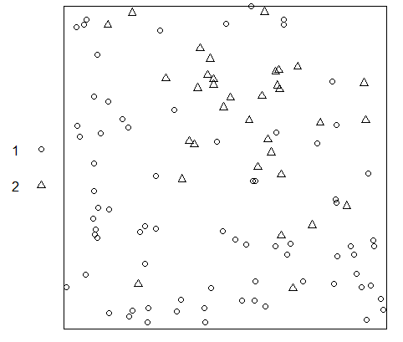
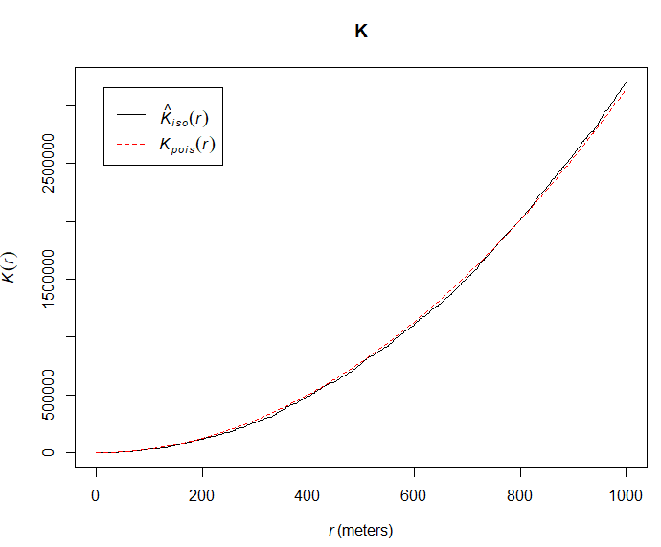
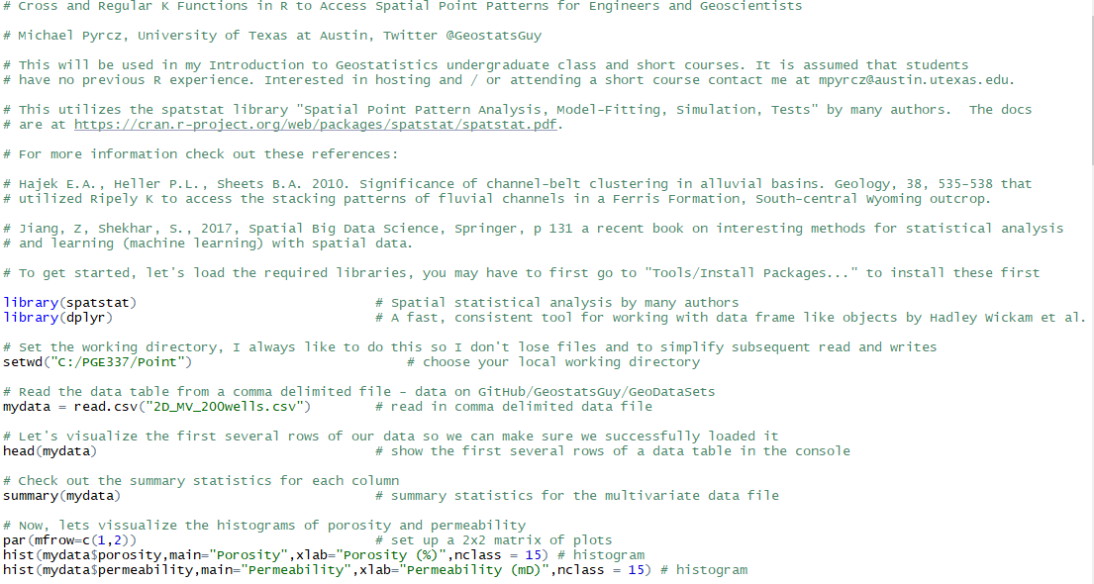
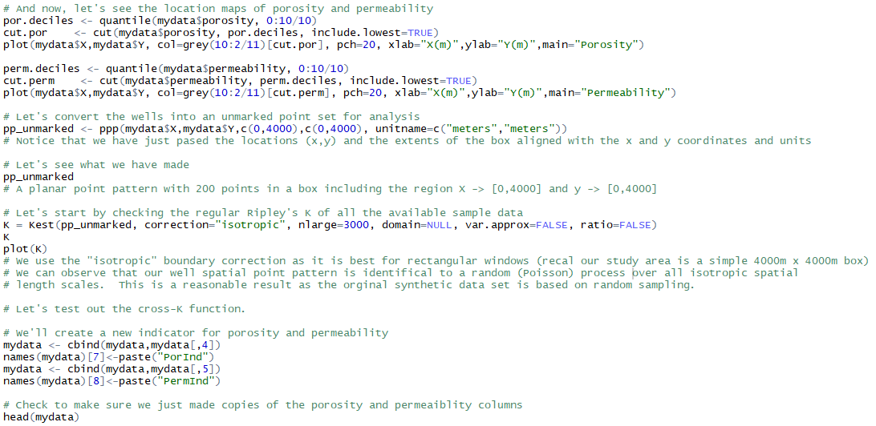
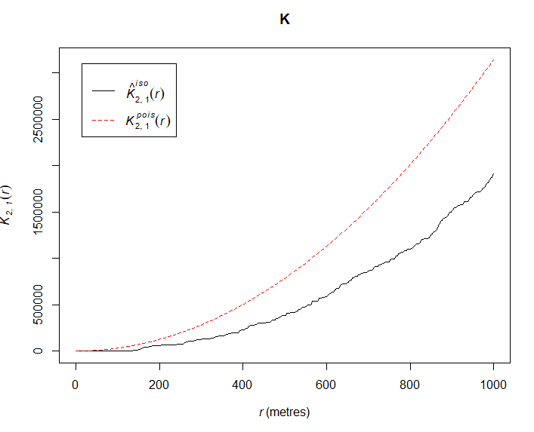
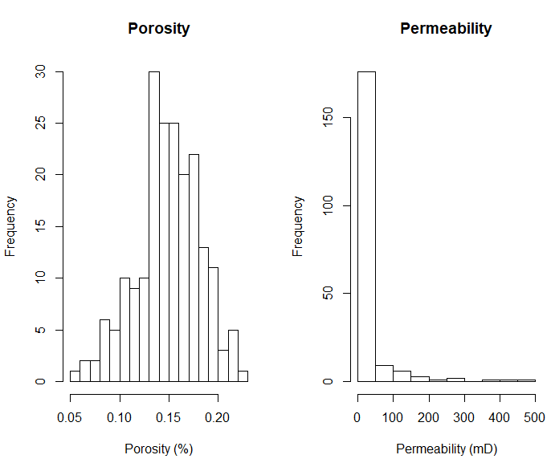
Analysis of Spatial Point Data in R for Geoscientists and Geo-engineers
Michael Pyrcz, University of Texas at Austin (@GeostatsGuy)
The University of Texas at Austin
Texas Center for Geostatistics
Spatial point data is common in geoscience, data science and geo-engineering. Spatial point analysis offers unique tools to analyze this data for inference and prediction. Here’s a demonstration of the Ripley K function, used by Hajek, Heller and Sheets (2010) for fluvial channels in a Ferris Formation, for a South-central Wyoming outcrop, and the cross-K function discussed recently in the Jiang and Shekhar (2017) book, Spatial Big Data Science. The documented demonstration with a well-based dataset is here on GitHub https://git.io/fNSMx.
Documented R Workflow
Well-based Dataset
Ripley K Function and Cross-K Function
Data Manipulation and Visualization

