Slide 1
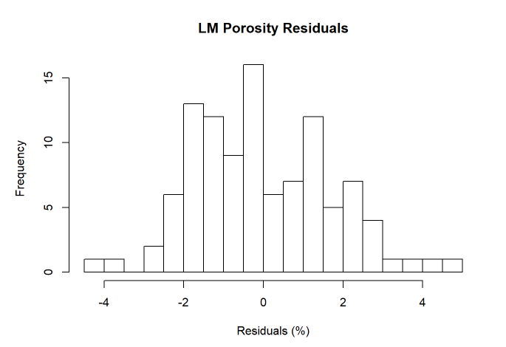
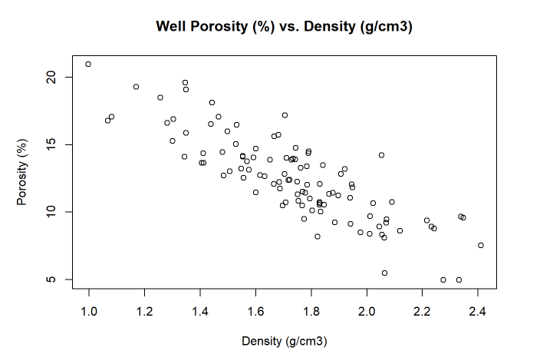
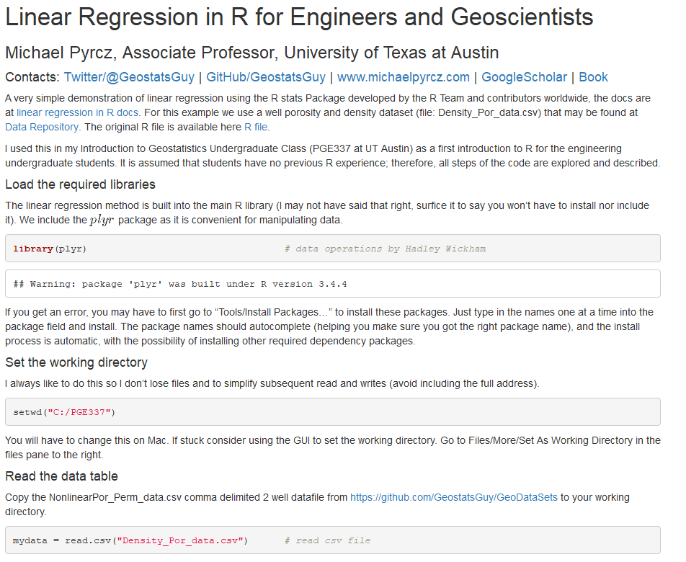
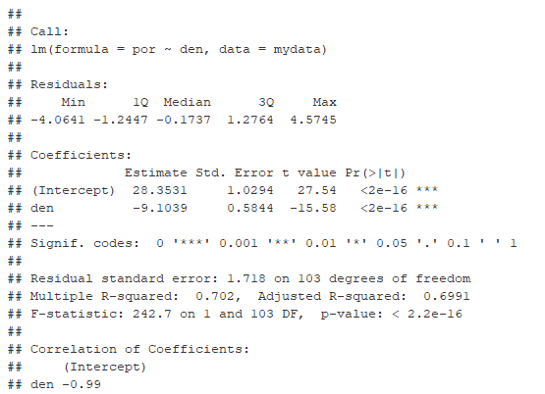
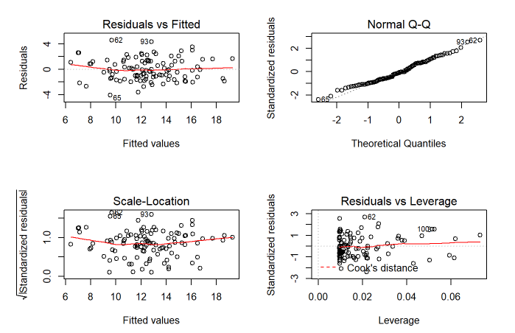
Linear Regression with Subsurface Demonstration in R for Geoscientists and Geo-engineers
Michael Pyrcz, University of Texas at Austin (@GeostatsGuy)
The University of Texas at Austin
Texas Center for Geostatistics
Linear Regression is one of the simplest, and most explainable and interpretable modeling methods in machine learning; therefore, it is a great introduction to inference and prediction with machine learning. By utilizing a low complexity model we improve interpretability and minimize model variance, but at the cost of potentially higher model bias. This tutorial is in Jupyter with Markdown includes a realistic unconventional dataset. There should be enough documentation that any geoscientists or engineer should be able to try out linear regression and to explore the various diagnostic and model checking methods in R. https://git.io/fxuO1
Example Dataset
Model Checking
Model Summary

