Slide 1
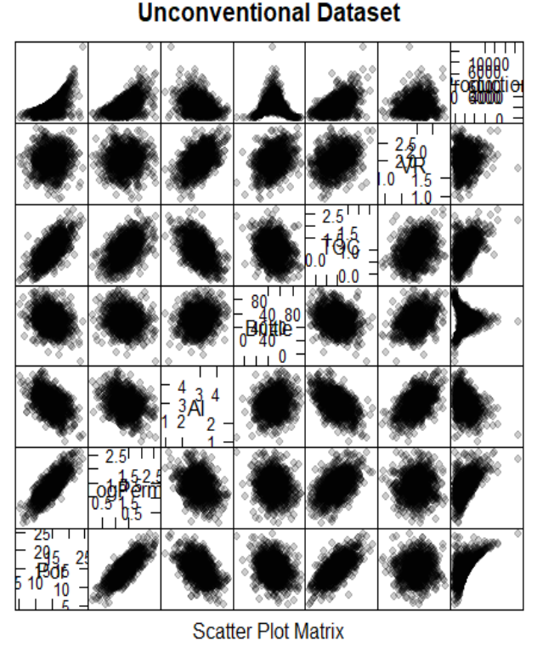
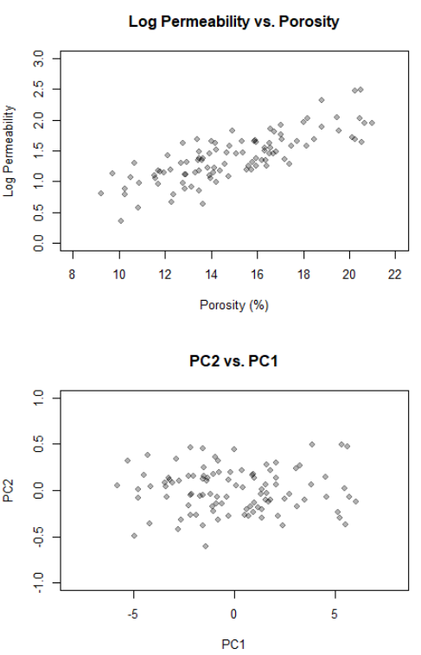
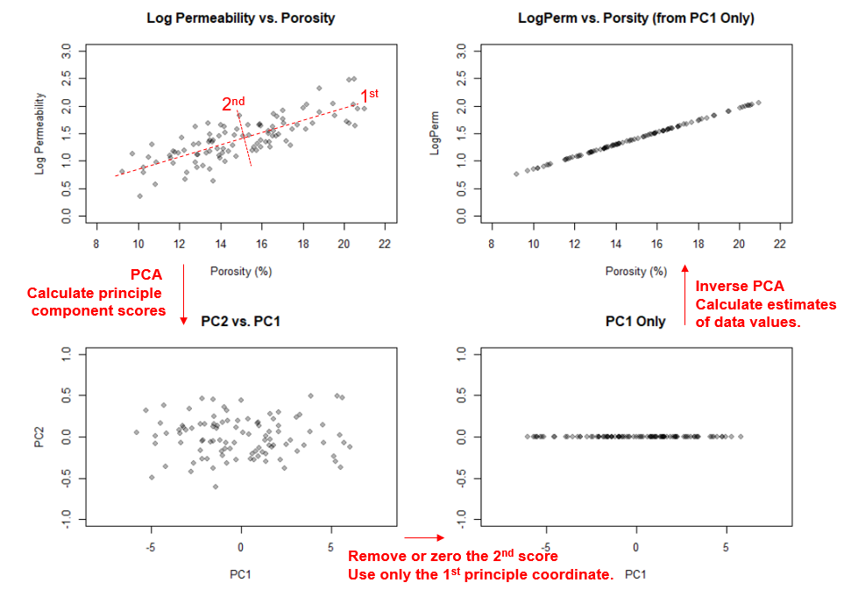
Principal Component Analysis (PCA) Tutorial with Subsurface Demonstration in R for Geoscientists and Geo-engineers
Michael Pyrcz, University of Texas at Austin (@GeostatsGuy)
Principal component analysis (PCA) is a common tool applied in machine learning workflows. It is applied widely for data analysis / exploration, dimensional reduction and directly in regression. The result of PCA is a set of orthogonal principal components and principle component scores for each data sample. These components are ordered from most variance described to least. Principal component coefficients (component loadings) reveal structures, dimensional reduction aids visualization and robust regression. Try it with a realistic dataset and annotated workflow.
7 Variate Realistic Dataset
PCA Demonstration
Dimensional Reduction Demonstration

