Slide 1
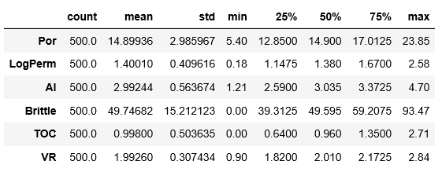
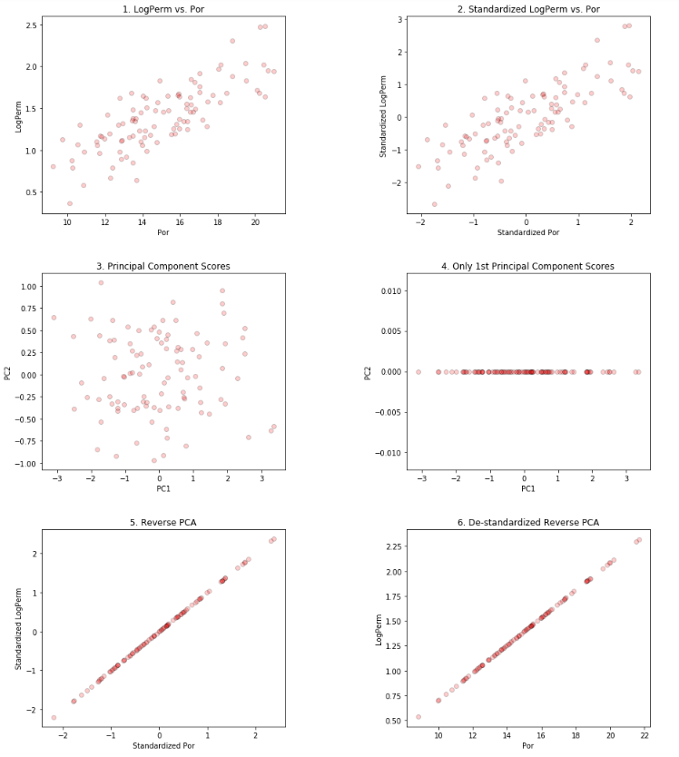
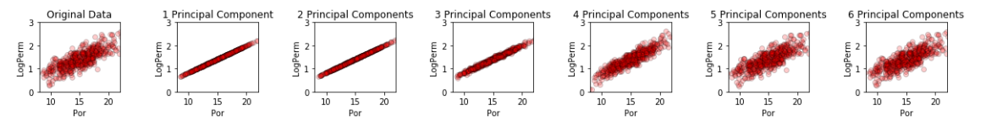
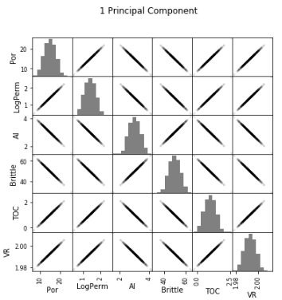
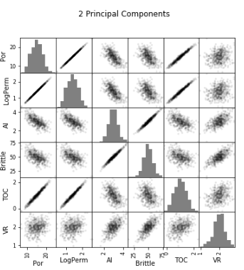
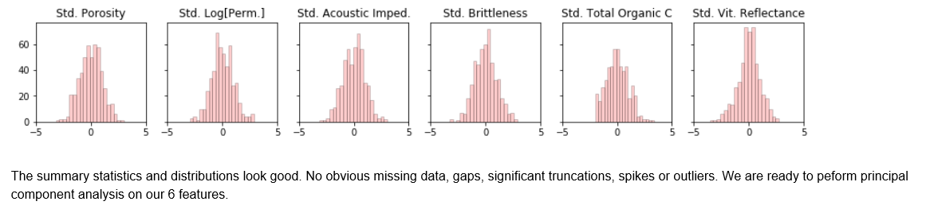
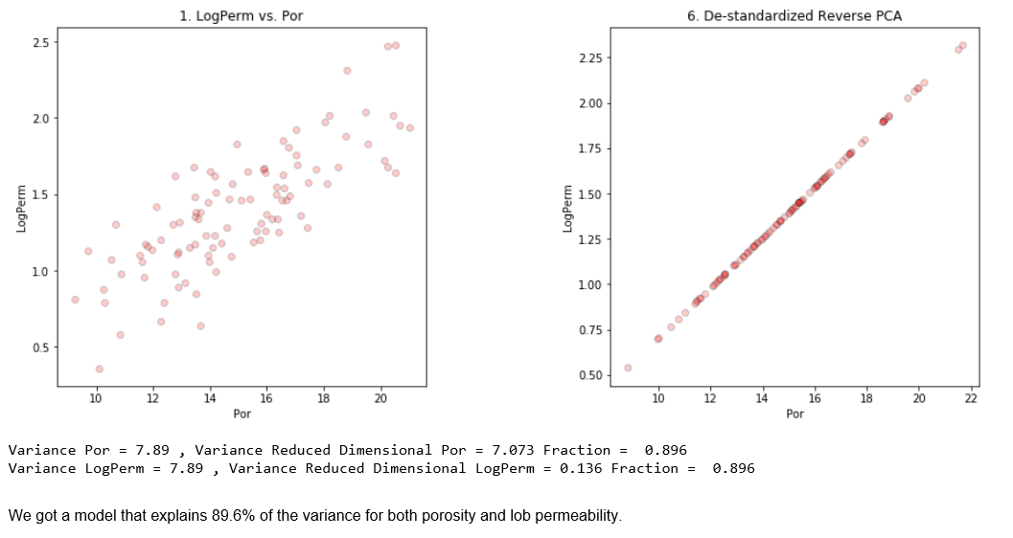
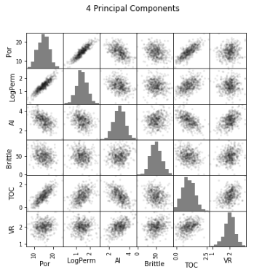
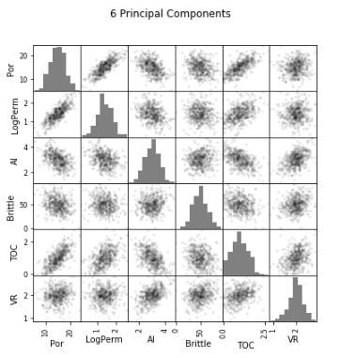
The University of Texas at Austin
Principal Component Analysis (PCA) Tutorial with Subsurface Demonstration in Python for Geoscientists, Data Scientists and Engineers
Michael Pyrcz, University of Texas at Austin (@GeostatsGuy)
Texas Center for Geostatistics
Principal component analysis (PCA) is a common tool applied in machine learning workflows. It is applied widely for data analysis / exploration, dimensional reduction and directly in regression. The result of PCA is a set of orthogonal principal components and principle component scores for each data sample. These components are ordered from most variance described to least. Principal component coefficients (component loadings) reveal structures, dimensional reduction aids visualization & robust regression. Try it with a realistic dataset in a well documented Python / Markdown Jupyter Notebook. https://git.io/fNgRK
Data Checking and Cleaning
Step-by-Step Dimensional Reduction
Variable Number of Principal Components
Multivariate Subsurface Example
Bivariate Example

