Slide 1
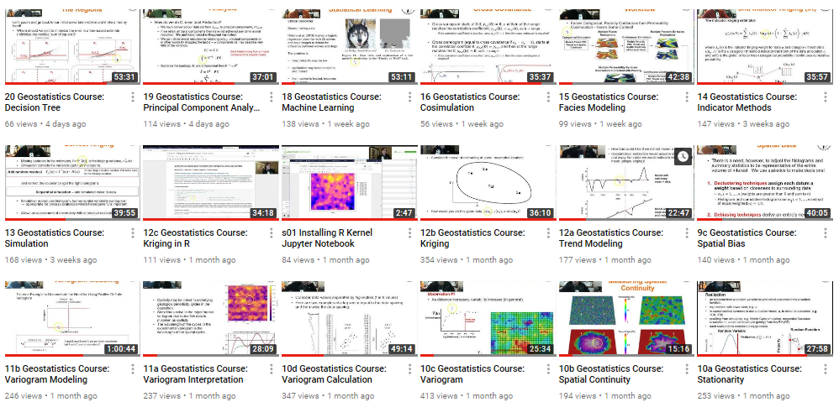
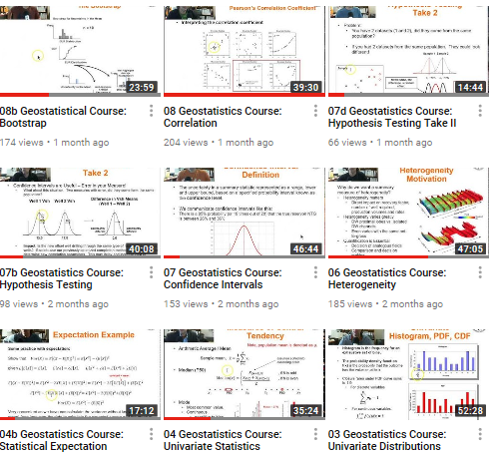
The University of Texas at Austin
Online Lectures from Introduction to Geostatistics, Data Analytics and Machine Learning for Geoscientists, Data Scientists and Engineers
Michael Pyrcz, University of Texas at Austin (@GeostatsGuy)
Texas Center for Geostatistics
Motivation: My Introduction to Geostatistics (including data analytics, statistics and machine learning) class asked for the lectures to be recorded and posted for review. Rather than record during the lecture with likely sound issues, including missing ½ the discussion, I spent the additional time to record my lectures from my office. I realized, if I was going to put the content online, I might as well broadcast it widely. I started the ‘GeostatsGuy Lectures’ channel on YouTube (https://www.youtube.com/channel/UCLqEr-xV-ceHdXXXrTId5ig/videos), posted the lectures as I recorded them. I supplemented these lectures with all the exercises and demonstrations materials posted on GitHub, user ‘GeostatsGuy’ (https://github.com/GeostatsGuy) so that anyone could follow along.
Result: What was the result of making my lectures available? (1) Recording prior to the in class lecture improved delivery, (2) Feedback from worldwide expert peers and students improved the course content, (3) I had more time in class for hands-on and demonstrations, and (4) Current and previous students appreciated this resource.
All Course Lectures Recorded in 40 Videos

