Slide 1

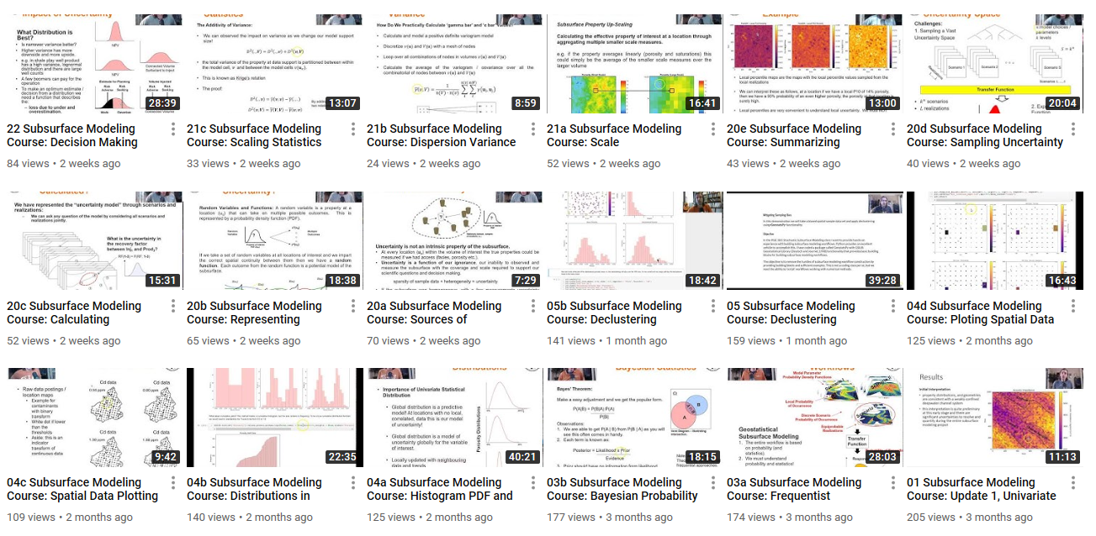
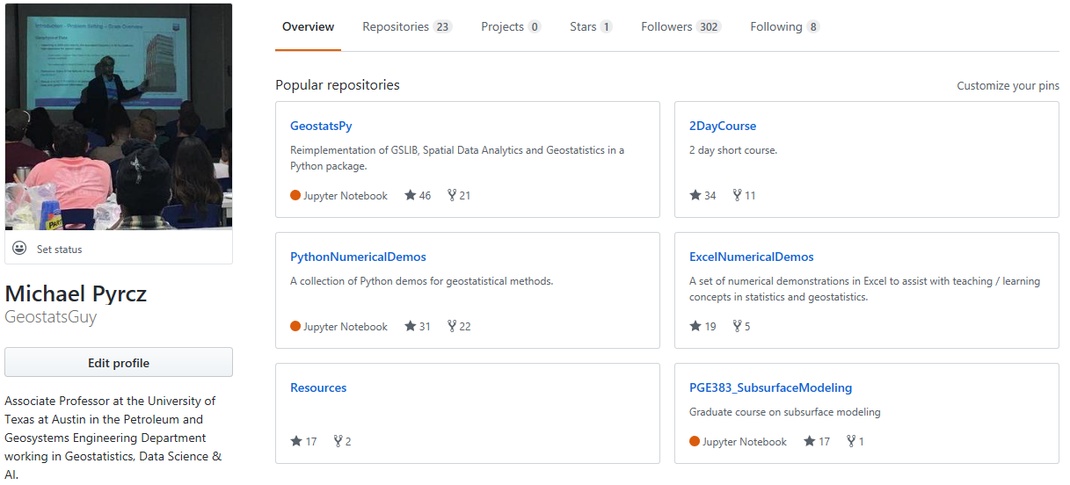
Online Lectures from Subsurface Modeling Course for Geoscientists, Data Scientists and Engineers
Michael Pyrcz, University of Texas at Austin (@GeostatsGuy)
Motivation: My Subsurface Modeling Course (including data analytics, statistics and machine learning) class asked for the lectures to be recorded and posted for review. Rather than record during the lecture with likely sound issues, including missing ½ the discussion, I spent the additional time to record my lectures from my office. I realized, if I was going to put the content online, I might as well broadcast it widely. I started the ‘GeostatsGuy Lectures’ channel on YouTube (https://www.youtube.com/channel/UCLqEr-xV-ceHdXXXrTId5ig/videos), posted the lectures as I recorded them. I supplemented these lectures with all the exercises and demonstrations materials posted on GitHub, user ‘GeostatsGuy’ (https://github.com/GeostatsGuy) so that anyone could follow along.
Result: What was the result of making my lectures available? (1) Recording prior to the in class lecture improved delivery, (2) Feedback from worldwide expert peers and students improved the course content, (3) I had more time in class for hands-on and demonstrations, and (4) Current and previous students appreciated this resource.
Course Lectures Recorded in 24 Videos and Posted on YouTube
Subsurface Modeling Workflows in Python on GitHub
Comments
This is part of our effort to support professional development and student education to to meet the challenge of the digital transformation in our industry.
Interested in working with us, collaborate on research, support students and our DIRECT consortium on Subsurface Data Analytics and Machine Learning? Contact: Michael for more information.
Note: some of the lectures are common with the PGE 337: Introduction to Data Analytics and Geostatistics, that are also avaible on the YouTube channel.

