Slide 1
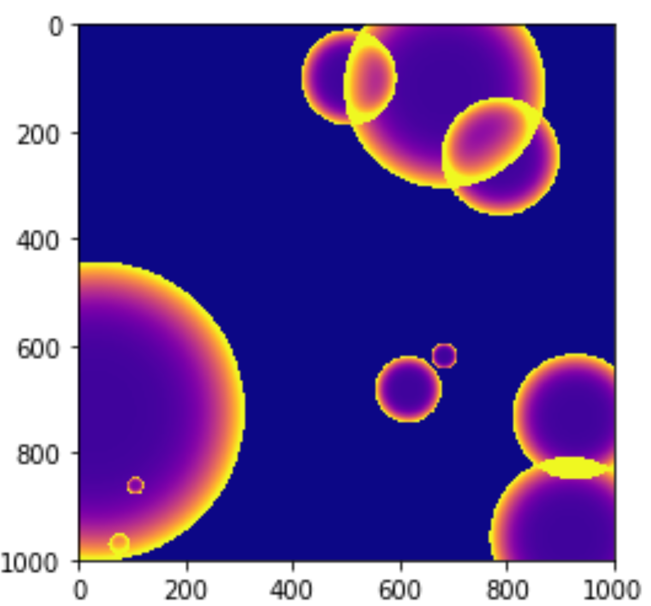
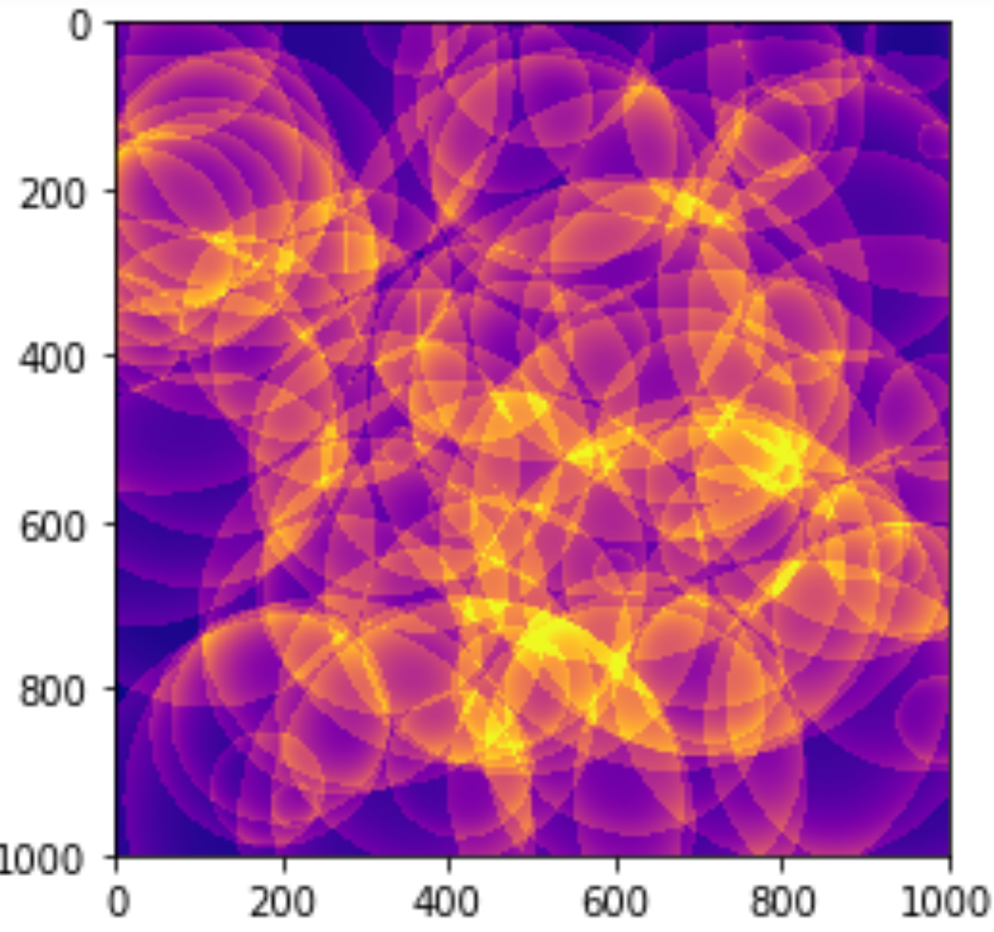
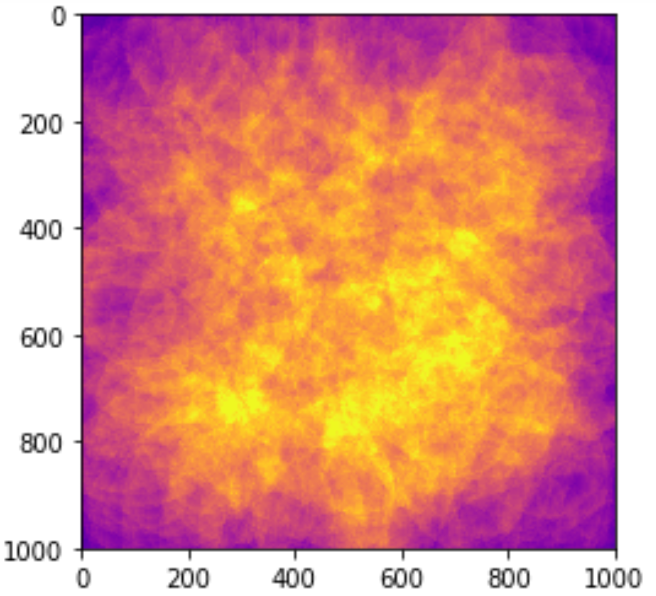
Emergent Features from Poisson Point Process Michael Pyrcz, University of Texas at Austin, @GeostatsGuy
N = 10
N = 100
N = 1,000
Observe the emergent texture and edge effects from Poisson point process with distance/radius ratio to power (=6) distance functions with random radii. Color bar in MatPlotLib set to Plasma.

