Slide 1
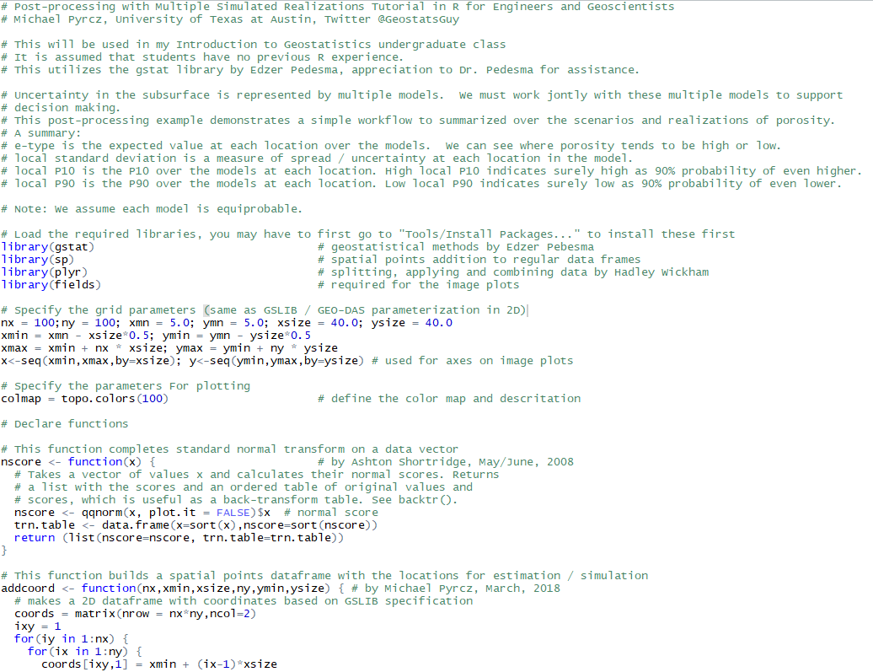
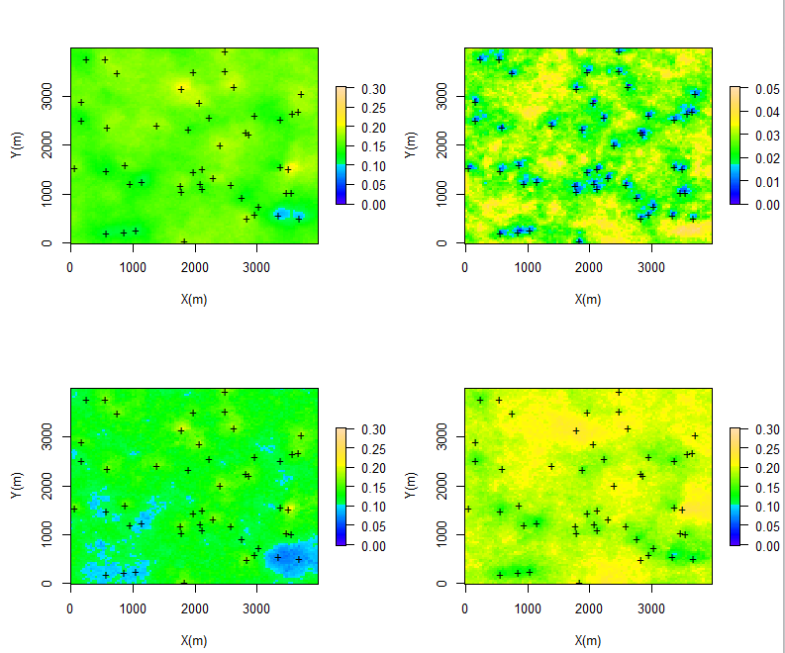
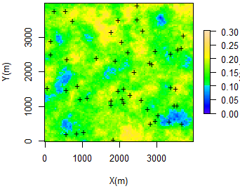
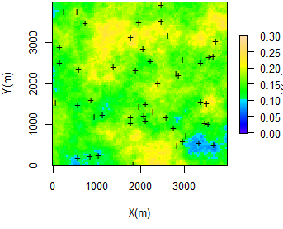
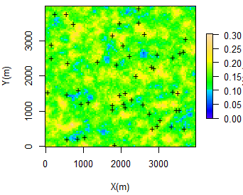
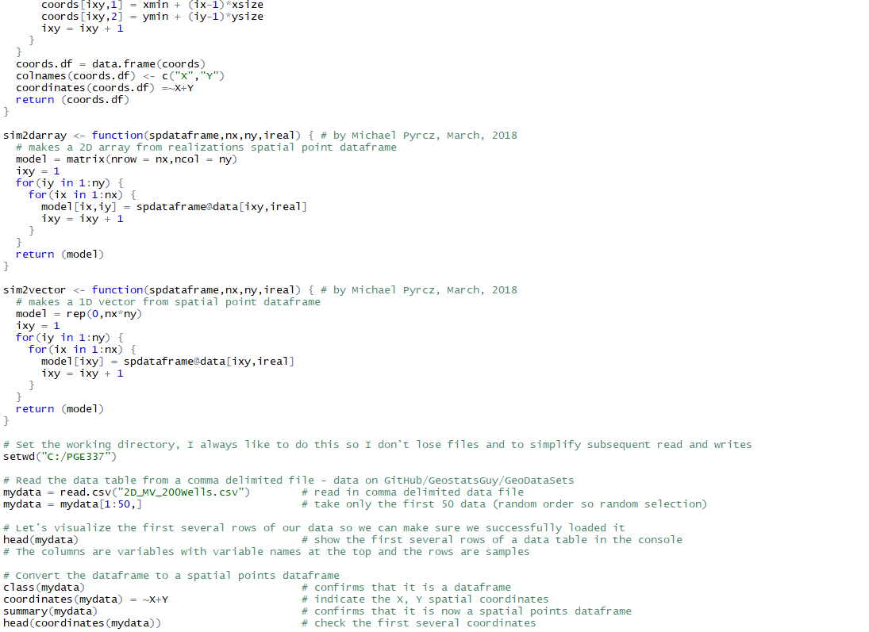
Spatial Uncertainty Management in R for Geoscientists and Geo-engineers
Michael Pyrcz, University of Texas at Austin (@GeostatsGuy)
The University of Texas at Austin
Texas Center for Geostatistics
Spatial distributions of properties such as density, porosity, facies, mineral grade are heterogeneous and sparsely sampled; therefore, they are uncertain. Spatial uncertainty is represented through a suite of models. Post-processing is a set of methods to take a suite of spatial models and to summarize to support decision making. This tutorial in R builds an uncertainty model with scenarios and realizations and then produces local e-type, standard deviation, P10 and P90 models. Suggestions are provided on their use in decision making. Find it here on GitHub https://git.io/fNITF.
R Functions and Workflow
Uncertainty Model – Scenarios and Realizations
Post-processing for Summarizing Uncertainty
Scenario 1
local e-type
local standard deviation
Scenario 2
Scenario 3
local P10
local P90

