Slide 1
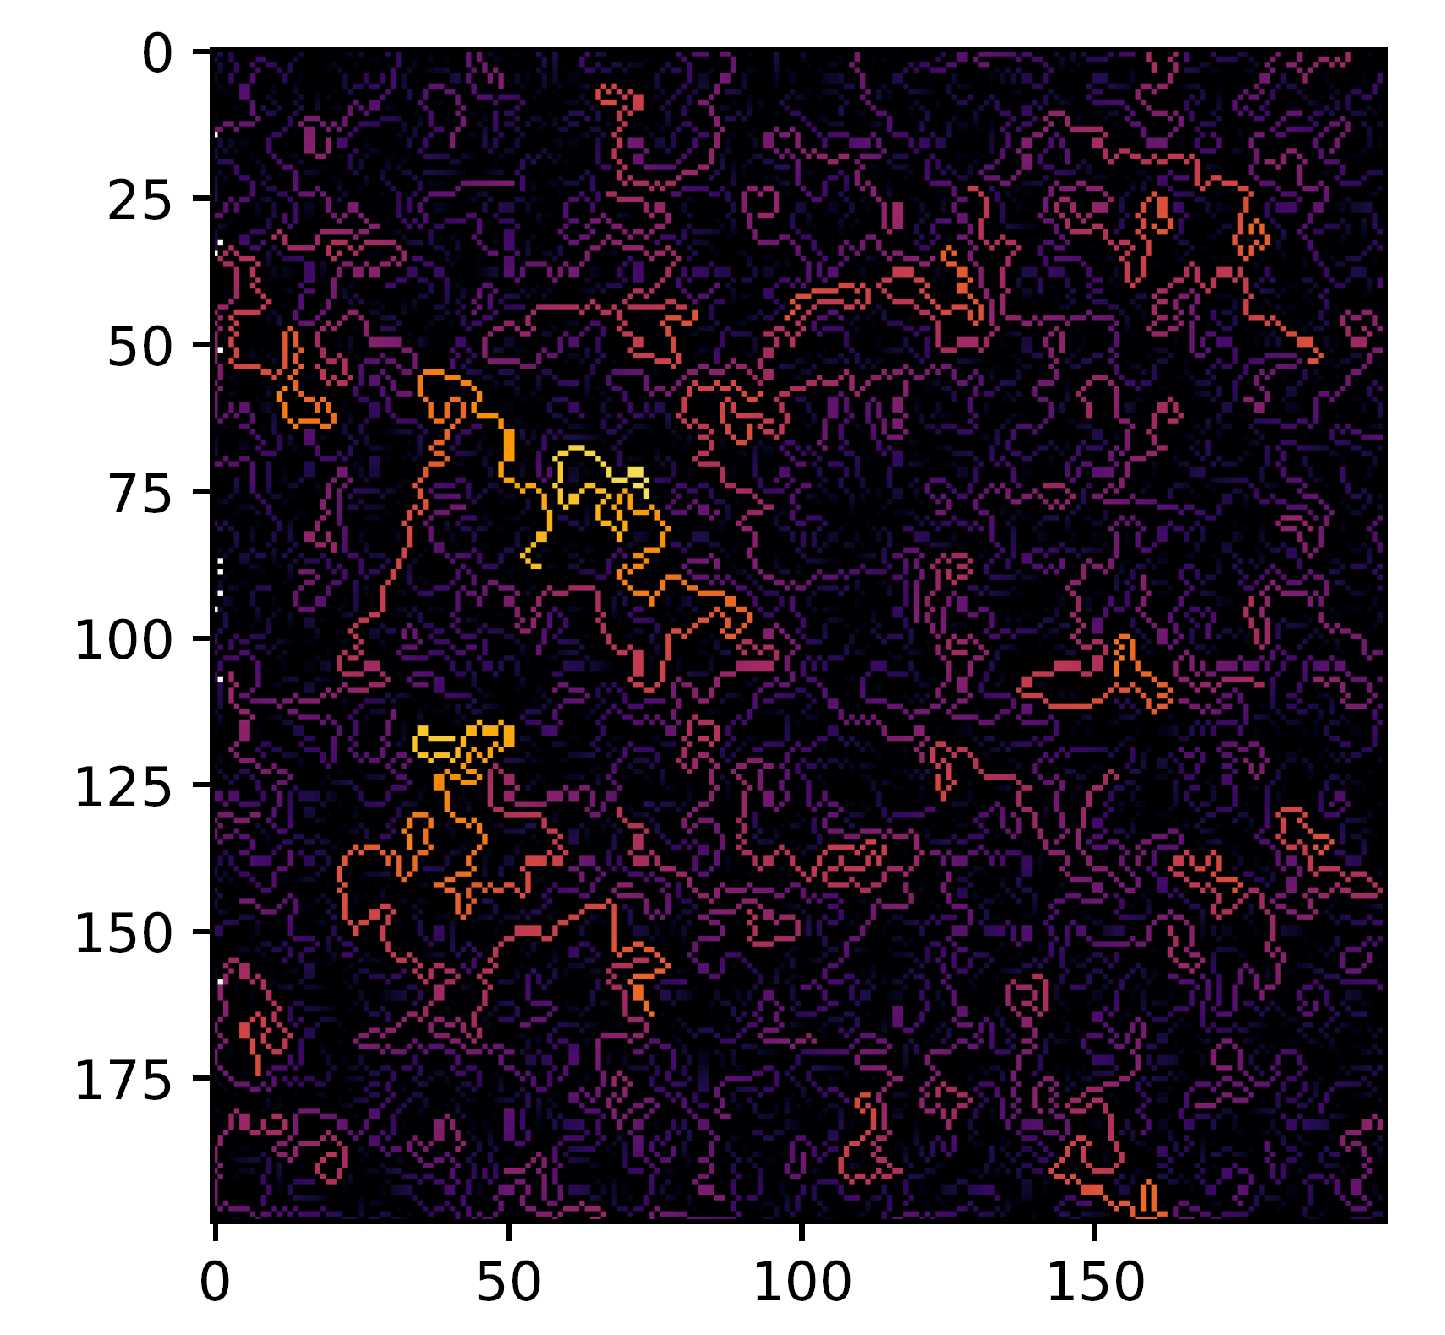
Random Walk from Poisson Points
Michael Pyrcz, University of Texas at Austin, @GeostatsGuy
Y (m)
X (m)
Up to 3 random walk paths from 100,000 random points
with walkers repulsed by each other. Inferno color scale
for index along random path.
Up to 10 random walk paths from 300 random points
with walkers repulsed by each other. Plasma color scale
for index along random path.

