Slide 1
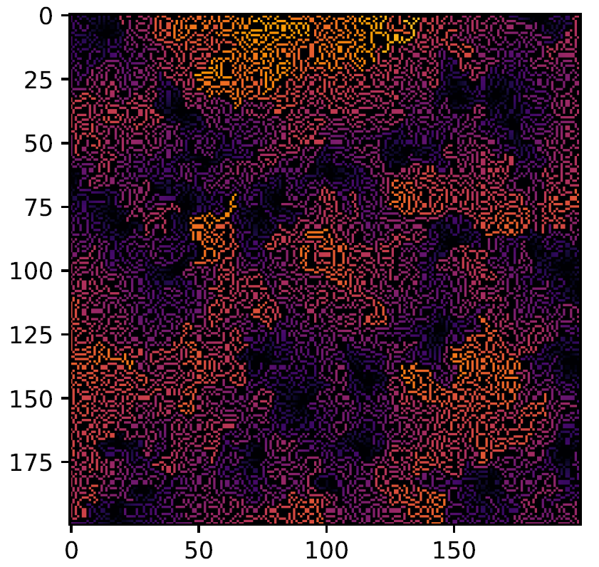
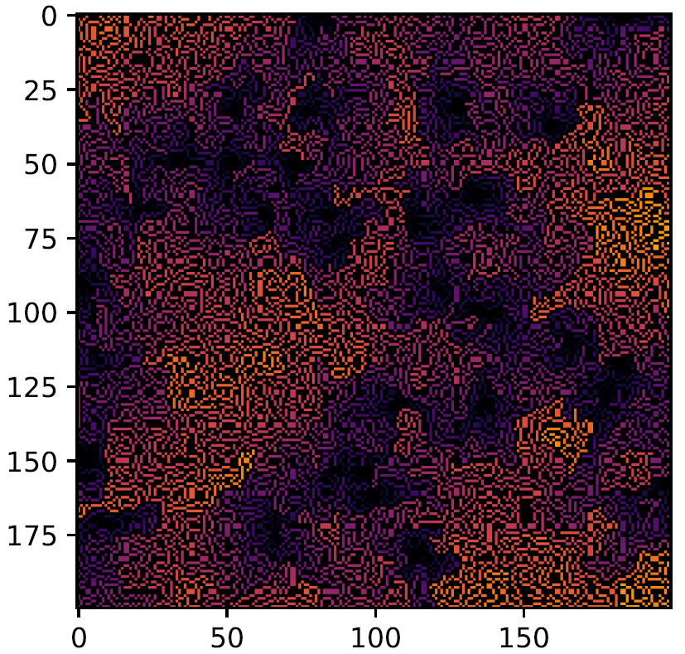
Random Walk Combined, Branching with Poisson Point Process
Michael Pyrcz, University of Texas at Austin, @GeostatsGuy
Y (m)
Y (m)
X (m)
X (m)
Two realizations of the combined random walk and Poisson point process model with spontaneous placement and branching.

