Slide 1

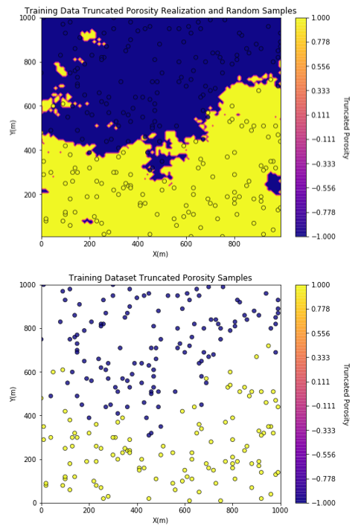
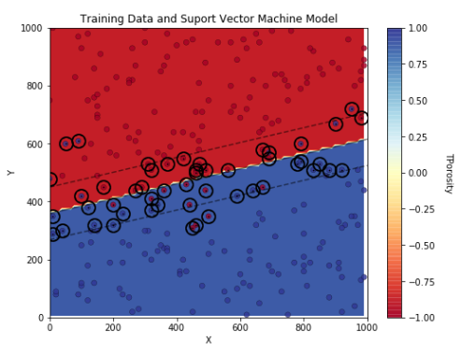
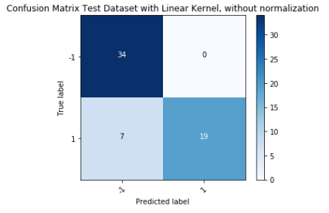
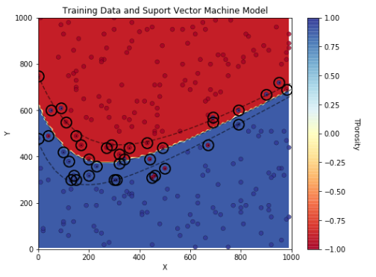
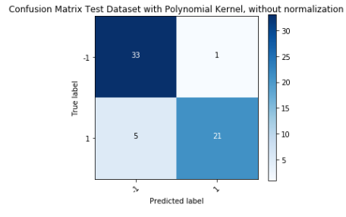
Machine Learning with Support Vector Machine in Python for Geoscientists and Geo-engineers
Michael Pyrcz, University of Texas at Austin (@GeostatsGuy)
Support Vector Machine is a powerful machine learning method for multivariate classification problems. Support Vector Machine provide flexible models that may be trained to data with nonlinear interfaces between categories. In addition, it is straightforward to trade out kernels to match specific problem settings. Various authors have previously demonstrated the use of Support Vector Machine for spatial problems (e.g Gilardi et al., 1999; Kanevski et al., 2002). This tutorial in Python Jupyter with Markdown demonstrates spatial modeling of low and high porosity zones of the subsurface.
Low and High Porosity Realization and 300 Random Samples
Support Vector Model Training
Support Vector Model Checking
Linear
Linear
Polynomial
Polynomial

