Slide 1
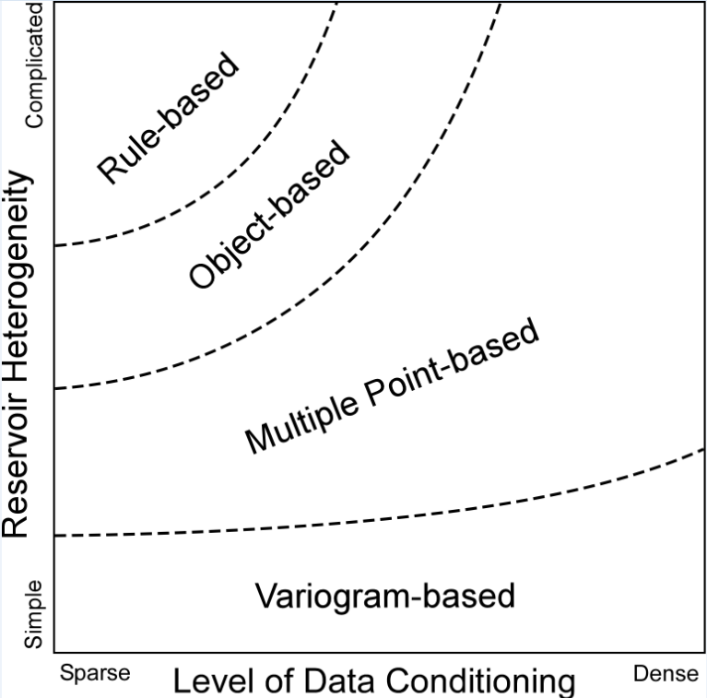
Scheme for Selecting a Geostatistical Simulation Method
Michael Pyrcz (@GeostatsGuy, Univ. Texas at Austin)

