Slide 1
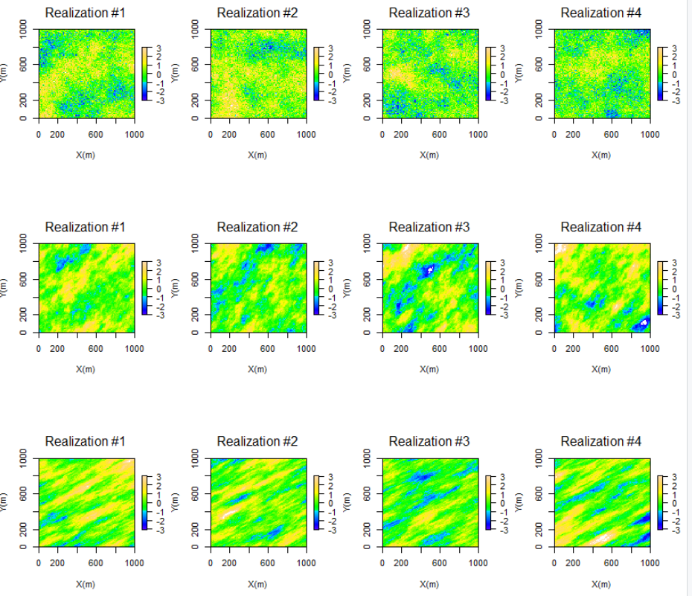
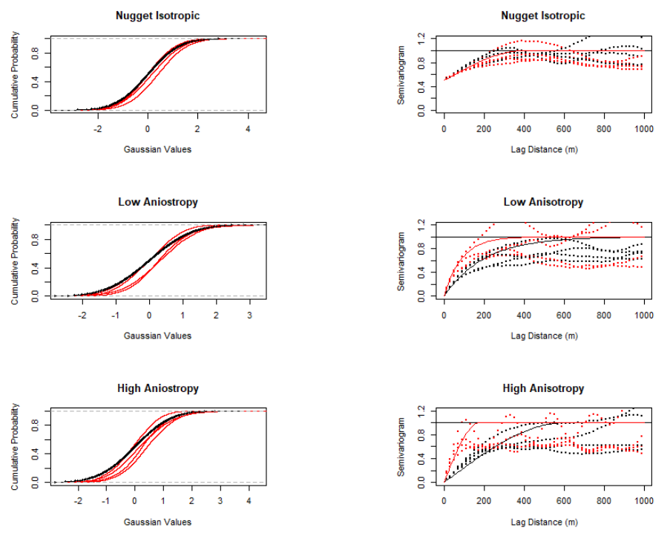

Geostatistical Workflow for Variogram-based Simulation in R with the gstat Package
Michael Pyrcz, University of Texas at Austin (@GeostatsGuy)
Building on the previous workflows, including data checking (univariate and bivariate statistics), spatial continuity modeling (variogram) and estimation (inverse distance and kriging) available @ GitHub/GeostatsGuy/geostatr, this R workflow covers geostatistical simulation with sequential Gaussian simulation with gstat (Pebesma, 2004). New functions are included to extract the realizations as 2D arrays for data management, analytics and visualization. The workflow includes minimum acceptance checks of the realizations’ distributions and variograms.
Stochastic Realizations
Minimum Acceptance Checks (Distribution, Variogram)
Gaussian
Values
Nugget
Isotropic
Input
Model 035
Realizations
Model 125
Realizations 035
Realizations 125
Gaussian
Values
Low
Anisotropy
Input
Model 035
Realizations
Model 125
Realizations 035
Realizations 125
Gaussian
Values
Model 060
High
Anisotropy
Input
Model 150
Realizations
Realizations 060
Realizations 150
Pebesma, E.J., 2004. Multivariable geostatistics in S: the gstat package. Computers & Geosciences 30 (7), 683-691

