Slide 1
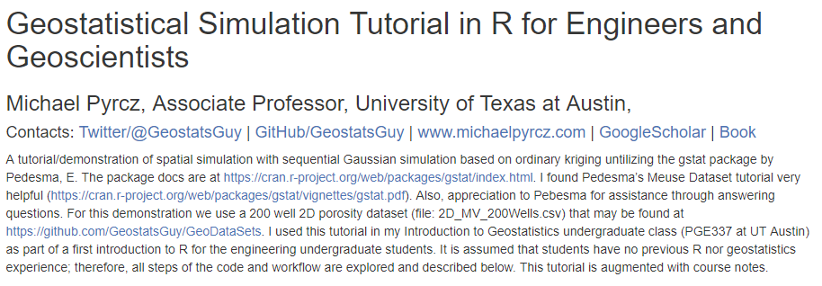
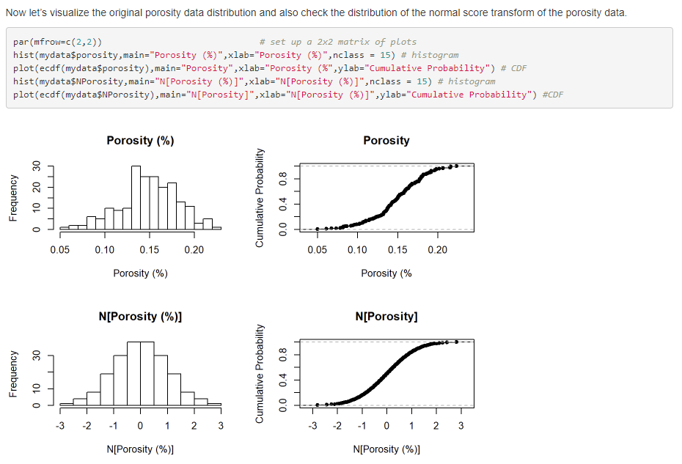
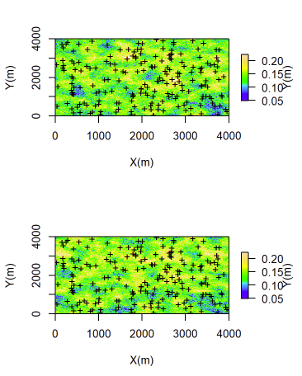
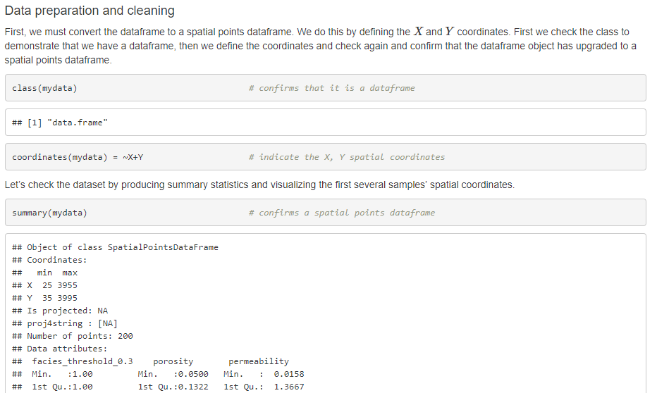
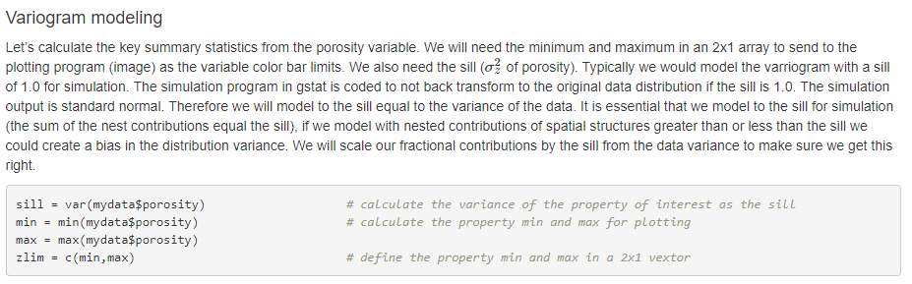
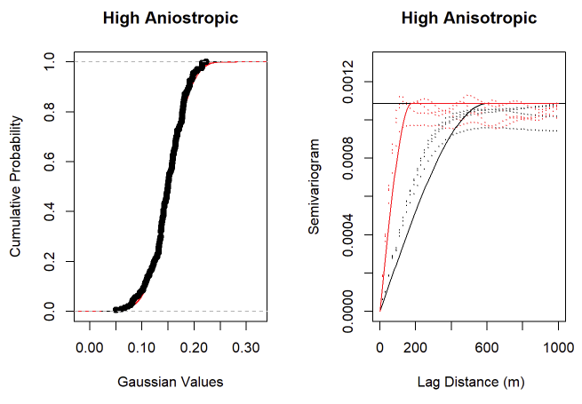
Tutorial in R Markdown Geostatistical Workflow for Variogram-based Simulation in R with the gstat Package
Michael Pyrcz, University of Texas at Austin (@GeostatsGuy)
Building on the previous workflows, including data checking (univariate and bivariate statistics), spatial continuity modeling (variogram) and estimation (inverse distance and kriging) available @ GitHub/GeostatsGuy/geostatr, this R workflow covers geostatistical simulation with sequential Gaussian simulation with gstat (Pebesma, 2004). New functions are included to extract the realizations as 2D arrays for data management, analytics and visualization. The workflow includes minimum acceptance checks of the realizations’ distributions and variograms.
Pebesma, E.J., 2004. Multivariable geostatistics in S: the gstat package. Computers & Geosciences 30 (7), 683-691

