Slide 1
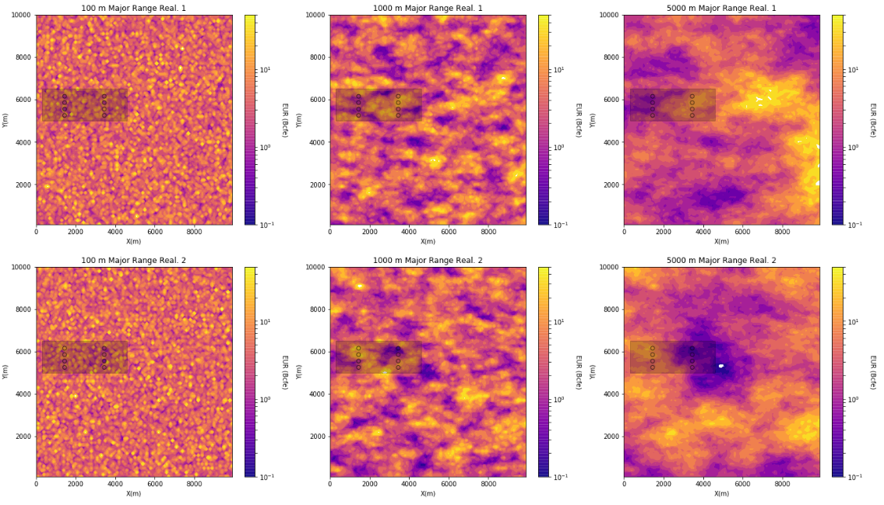
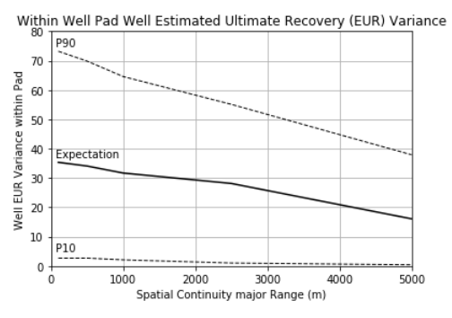
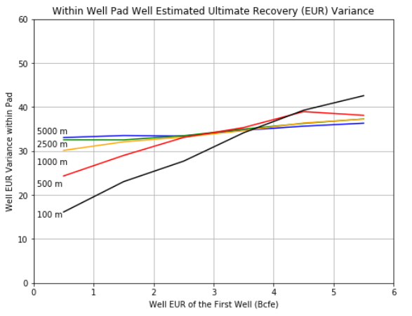
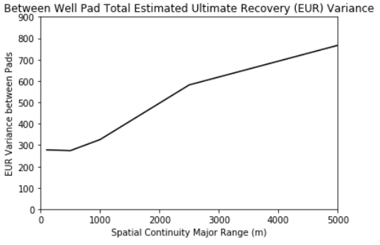
The University of Texas at Austin
Texas Center for Geostatistics
Python Workflow in Jupyter Notebook for Spatial Uncertainty
Michael Pyrcz, University of Texas at Austin (@GeostatsGuy)
What is the uncertainty for the aggregate of multiple samples from a pad within the area of interest? What is the impact of spatial continuity of the spatial phenomenon? How much variability should we expert pre-sampling within the pad? How much variability between pads? How much does one sample tell us about the remainder of the pad? Is it an early indicator? Important for ground water, mineral grade, contaminants, oil and gas, geomechanics etc. The workflow is posted on GitHub at https://git.io/fpr2M.
Multiple realizations with variable spatial continuity and samples in a pad
Variability within sampling pad
Value of information of the first sample
Variability between sampling pads
Value of information of the first sample.
The workflow that: (1) builds synthetic models, (2) calculates conditional statistics, (3) plots results and (4) saves results to .csv file.
Workflow from the paper ‘Pyrcz, M., in press, Geostatistical Workflows for Modeling Uncertainty in Unconventional Reservoirs, Bulletin for Canadian Society of Petroleum Geologists’ submitted on November 28, 2018. Workflow is published to support reproducible research. I welcome review.

