Slide 1
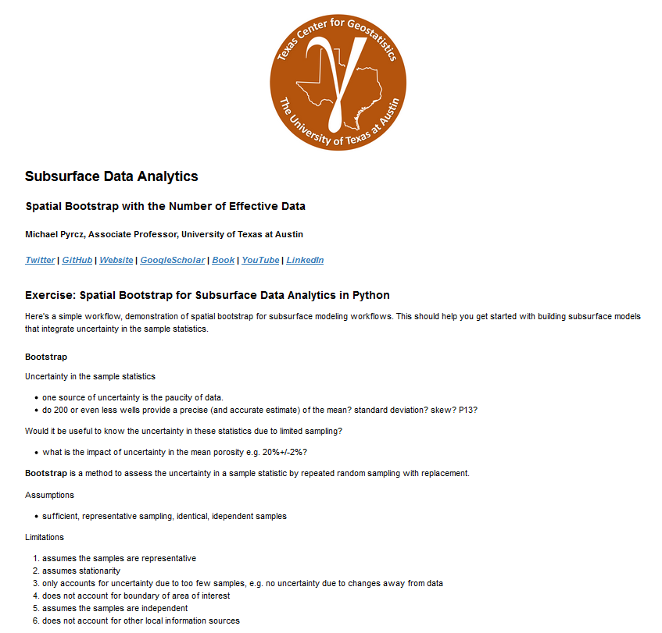
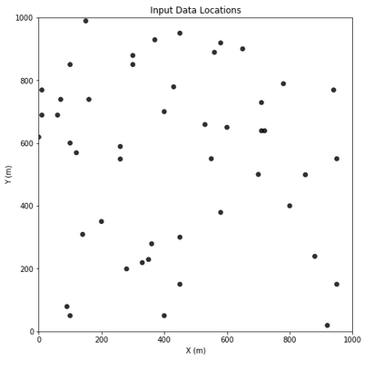
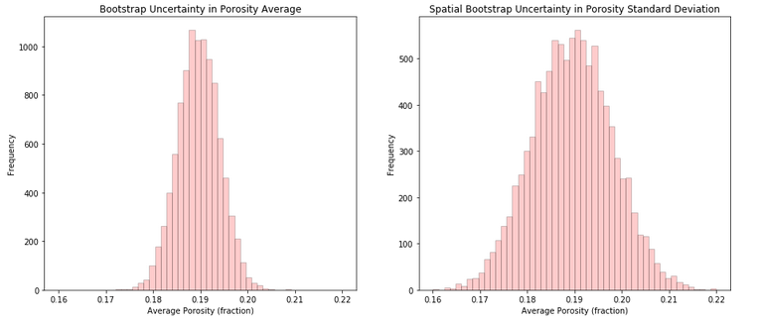
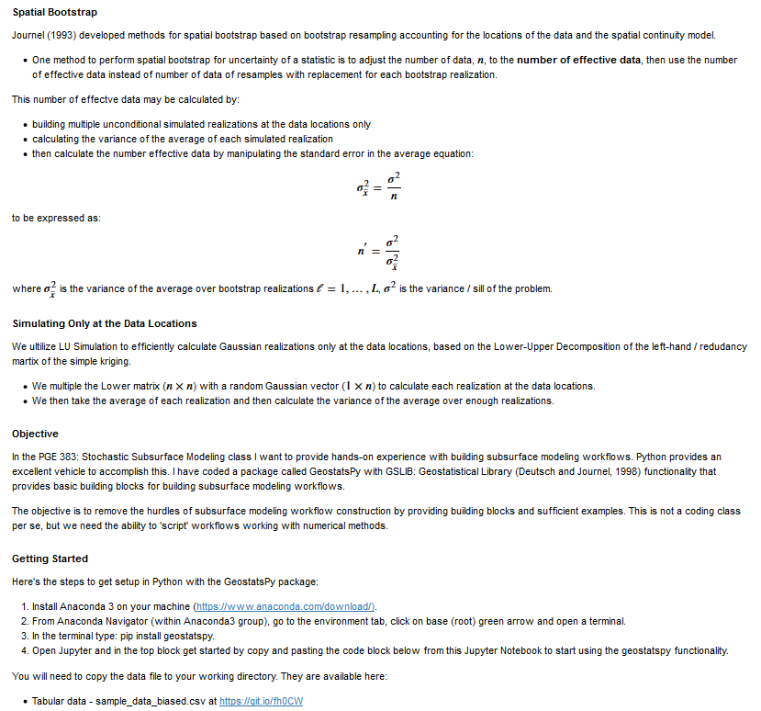
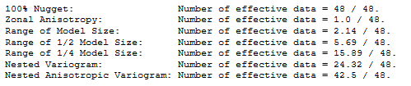
Python Workflow in Jupyter Notebook for Spatial Bootstrap
Michael Pyrcz, University of Texas at Austin (@GeostatsGuy)
The University of Texas at Austin
Texas Center for Geostatistics
Heard of the Bootstrap? It’s awesome, uncertainty in any sample statistic, but the bootstrap method ignores the spatial context. No worries, Prof. André Journel (1993) (https://en.wikipedia.org/wiki/Andre_G._Journel) worked it out with Spatial Bootstrap. Want to try spatial bootstrap in Python? Compare it to bootstrap? Here’s a well-documented Python Jupyter Notebook workflow posted on GitHub at https://git.io/fjO1Y. Adding method soon to the GeostatsPy package.
Well-documented Python Workflow in Jupyter Notebook
Number of Effective Data
Uncertainty in the Sample Average Comparing Bootstrap and Spatial Bootstrap

