Slide 1
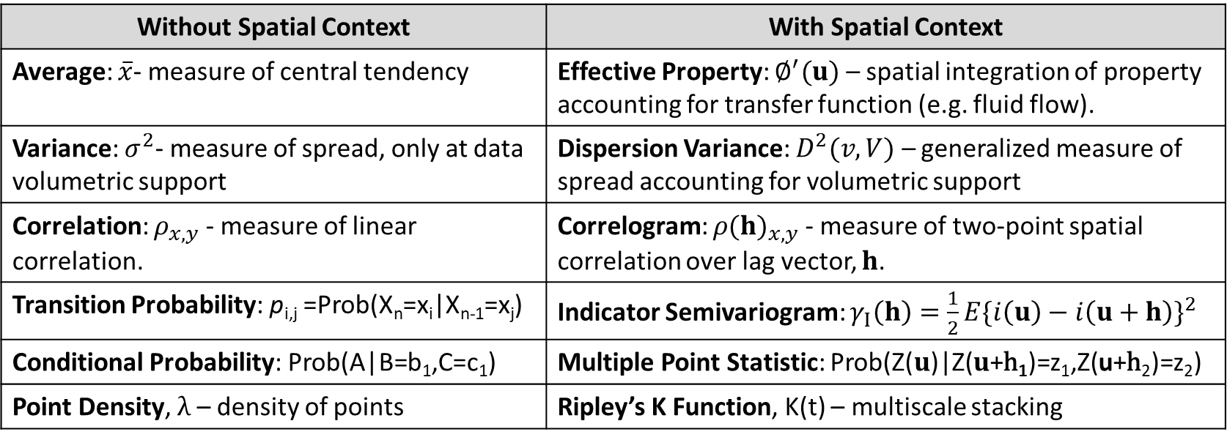
Without Spatial Context | With Spatial Context
Average: $\overline{x}$- measure of central tendency | Effective Property: $∅^{′}(u)$ – spatial integration of property accounting for transfer function (e.g. fluid flow).
Variance: $σ^{2}$- measure of spread, only at data volumetric support | Dispersion Variance: $D^{2}(v,V)$ – generalized measure of spread accounting for volumetric support
Correlation: $ρ_{x,y}$ - measure of linear correlation. | Correlogram: ${ρ(h)}_{x,y}$- measure of two-point spatial correlation over lag vector, $h$.
Transition Probability: p_{i,j} =Prob(X_{n}=x_{i}|X_{n-1}=x_{j}) | Indicator Semivariogram: $γ_{I}\left(h\right)=\frac{1}{2}E{\{i\left(u\right)−i\left(u+h\right)\}}^{2}$
Conditional Probability: Prob(A|B=b₁,C=c₁) | Multiple Point Statistic: Prob(Z($u$)|Z($u$+h₁)=z₁,Z(u+h₂)=z₂)
Point Density, $λ$ – density of points | Ripley’s K Function, K(t) – multiscale stacking

