Slide 1
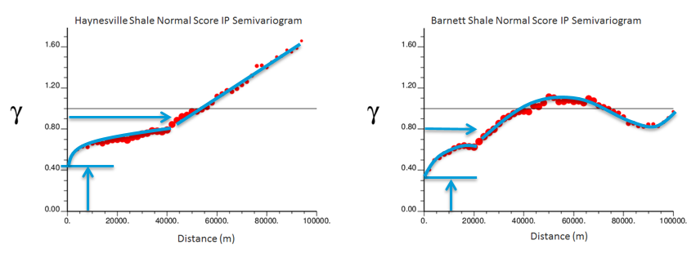


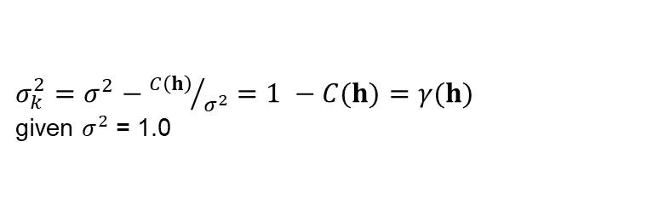
How is Spatial Uncertainty Represented? Michael Pyrcz (Univ. of Texas at Austin, @GeostatsGuy)
Uncertainty is represented by distribution variance, and variance is partitioned spatially with nested variogram structures.
Linking spatial continuity to local estimation variance:
Local estimation variance is a function of spatial continuity. E.g. for 1 data the kriging estimation variance simplifies to !
Data
Unknown
${σ_{k}^{2}=σ}^{2}−{C\left(h\right)}/{σ^{2}}$ $=1 −C(h)$ $=γ(h)$
given $σ^{2}$ = 1.0
$γ(h)$
$γ(h)$
Additive nested structures each describe spatial uncertainty components.
$γ\left(h\right)=γ\left(h\right)$_{nugget} + $γ\left(h\right)$_{medium range} + $γ\left(h\right)$_{long range}
Nested variogram is formulated as the addition of distinct spatial structures; therefore,
each structure describes a component of the variance, in other words, spatial uncertainty.
σ_{k}² = σ²_{nugget} + σ²_{medium range} + σ²_{long range}
Example:
Haynesville Shale Initial Production
Barnett Shale Initial Production
Calculate and model a nested variogram model for Haynesville and Barnett Shale initial production rates.
Calculate uncertainty (distribution variance) away from well locations and interpret impact of each spatial structure.
e.g. Haynesville at 3km form a well there is 78% variance, 51.2% from nugget, 48.8% from medium + long range structures.
78%
long range
long range
medium range
medium range
nugget
nugget
3km
Data from Railroad Commission of Texas, results from Pyrcz et al. (2016).

