Slide 1
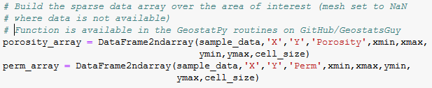

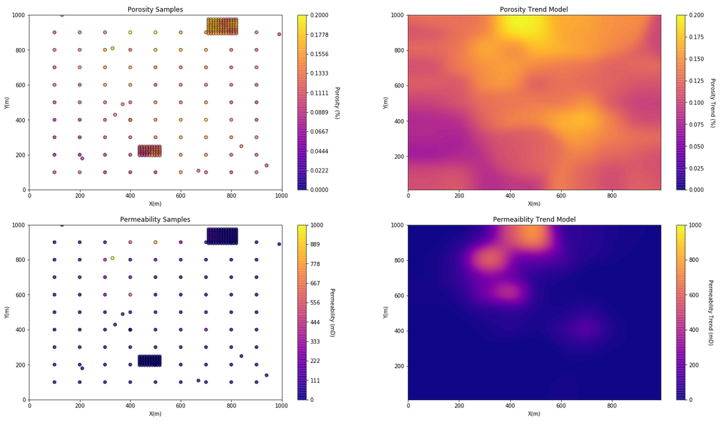
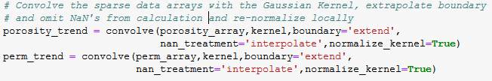
The University of Texas at Austin
Data-driven Spatial Trend Calculation in Python for Geoscientists, Data Scientists and Engineers
Michael Pyrcz, University of Texas at Austin (@GeostatsGuy)
Texas Center for Geostatistics
Spatial property trends are an essential component of spatial data analytics, characterization and modeling. Spatial trends are explored through multi-disciplinary integration of information from geoscience, geophysics and engineering along with data-driven trend modeling. Convolution methods provide efficient methods to build 1D, 2D and 3D data-driven trend models, but are typically not designed for sparse spatial datasets. A simple and efficient workflow is demonstrated with the astropy package (http://www.astropy.org/) in Python. This convolution method works well in this sparse data setting.
Step 1: Build Sparse NumPy ndarray
Sparse Spatial Data
Convolution Based Spatial Trend Models
Multivariate Subsurface Example
Step 2: Build Kernel
A Gaussian Kernel reduces possible discontinuities due to sparse data.
Step 3: Convolve the Sparse Data Array with the Kernel
The NaN treatment removes locations without data values and the kernel is renormalized locally.
Sparse data sampling with a variety of regular, random and local study areas.
Convolution-based trends models globally unbiased and robust with sparse data.
Step 4: Check the Results
This includes summary statistics, distributions and contours.

