Slide 1
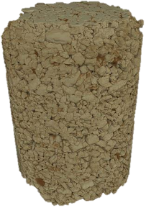
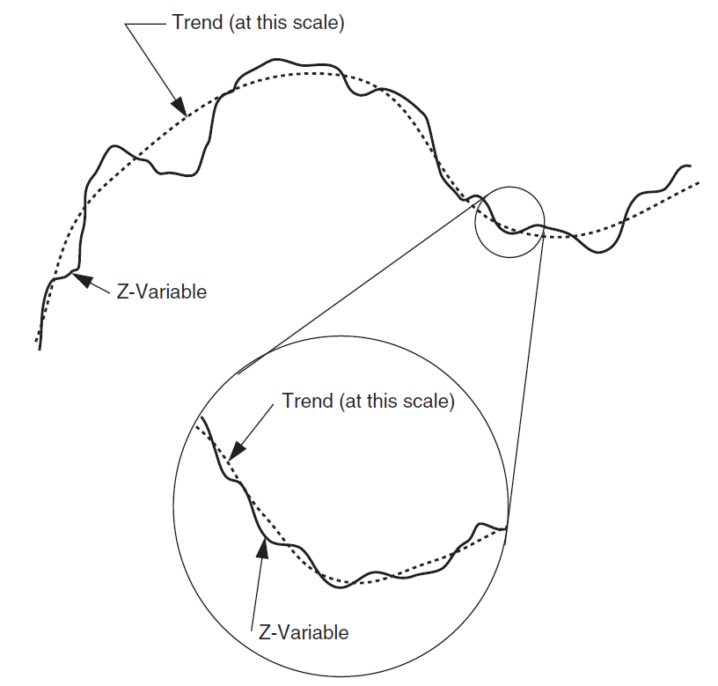
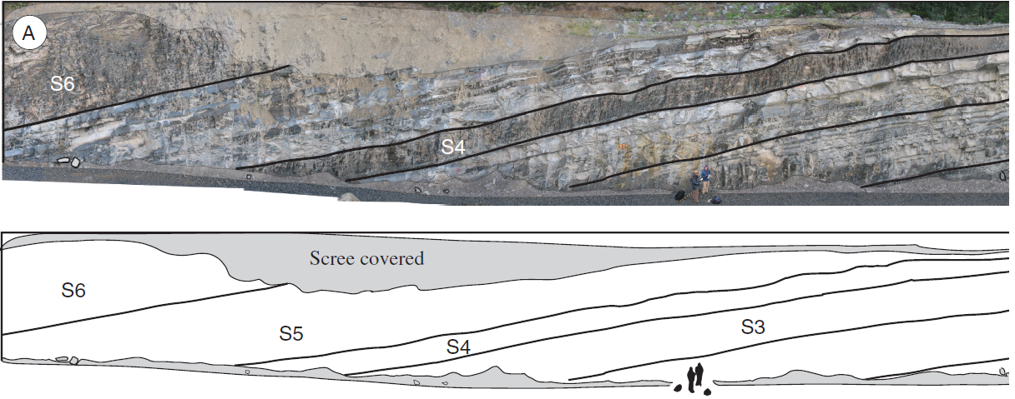

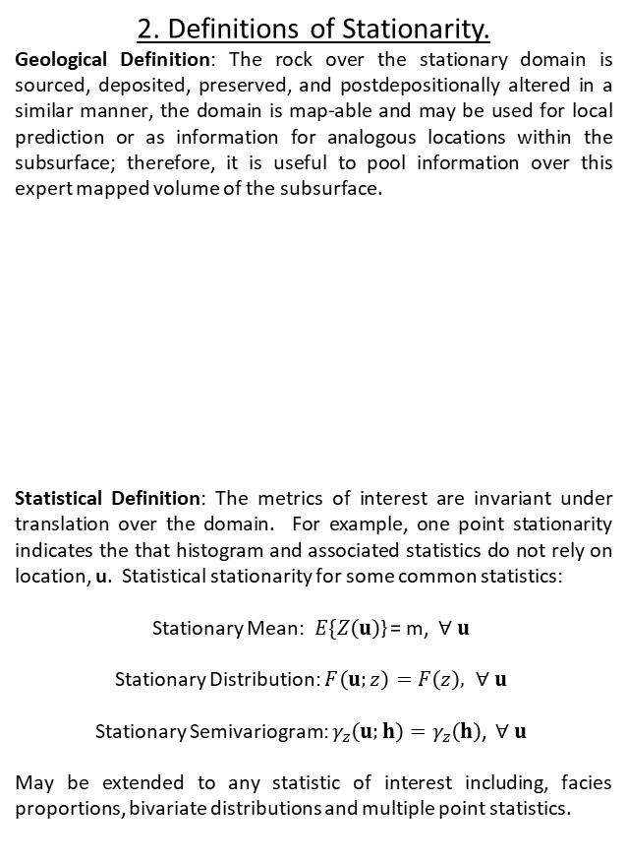
An explanation of STATIONARITY for Geoscientists, Data Scientists and Engineers
Michael Pyrcz, University of Texas at Austin, @GeostatsGuy
The University of Texas at Austin
Texas Center for Geostatistics
A description of the concepts of stationarity that are central to collecting spatial information and applying it in subsurface modeling.
1. Substituting time for space.
Any statistic requires replicates, repeated sampling (e.g. air or water samples from a monitoring station). In our geospatial problems repeated samples are not available at a location in the subsurface.
Instead of time, we must pool samples over space to calculate our statistics. This decision to pool is the decision of stationarity. It is the decision that the subset of the subsurface is all the “same stuff”.
The decision of the stationary domain for sampling is an expert choice. Without it we are stuck in the “hole” and cannot calculate any statistics nor say anything about the behavior of the subsurface between the sample data.
2. Definitions of Stationarity.
Geological Definition: The rock over the stationary domain is sourced, deposited, preserved, and postdepositionally altered in a similar manner, the domain is map-able and may be used for local prediction or as information for analogous locations within the subsurface; therefore, it is useful to pool information over this expert mapped volume of the subsurface.
Statistical Definition: The metrics of interest are invariant under translation over the domain. For example, one point stationarity indicates the that histogram and associated statistics do not rely on location, u. Statistical stationarity for some common statistics:
Stationary Mean:$E\{Z\left(u\right)$} = m, $∀ u$
Stationary Distribution: $F\left(u;z\right)=F\left(z\right), ∀ u$
Stationary Semivariogram: $γ_{z}\left(u;h\right)=γ_{z}\left(h\right)$, $∀ u$
May be extended to any statistic of interest including, facies proportions, bivariate distributions and multiple point statistics.
3. Comments on Stationarity.
Stationarity is a decision, not an hypothesis; therefore it cannot be tested. Data may demonstrate that it is inappropriate.
The stationarity assessment depends on scale. This choice of modeling scale(s) should be based on the specific problem and project needs.
We cannot avoid a decision of stationarity. No stationarity decision and we cannot move beyond the data. Conversely, assuming broad stationarity over all the data and over large volumes of the earth is naïve. Good geological mapping is essential.
Geomodeling stationarity is the decision (1) over what region to pool data and (2) over what region to use the resulting statistics.
Nonstationary trends may be mapped and the remaining stationary residual modelled stochastically, trends may be treated uncertain.
After Sample
Extraction
Extracted Sample at Location, u₁
Hole Remains at Location, u₁
Photomosaic, line drawing Punta Barrosa Formation sheet complex (Fildani et al. (2009).
u₃
Image from Pyrcz and Deutsch, 2014.
u₇
u₆
u₁
u₄
u₅
Property of Interest
Histogram
u₂
Stationary domain, samples at locations, u₁₋₇
Core image from https://www.fei.com/oil-gas/
For more information check out Pyrcz, M.J., and Deutsch, C.V., 2014, Geostatistical Reservoir Modeling, 2nd edition, Oxford University Press.
Check out the Stationarity Lecture at GeostatsGuy Lectures on YouTube.

