Slide 1
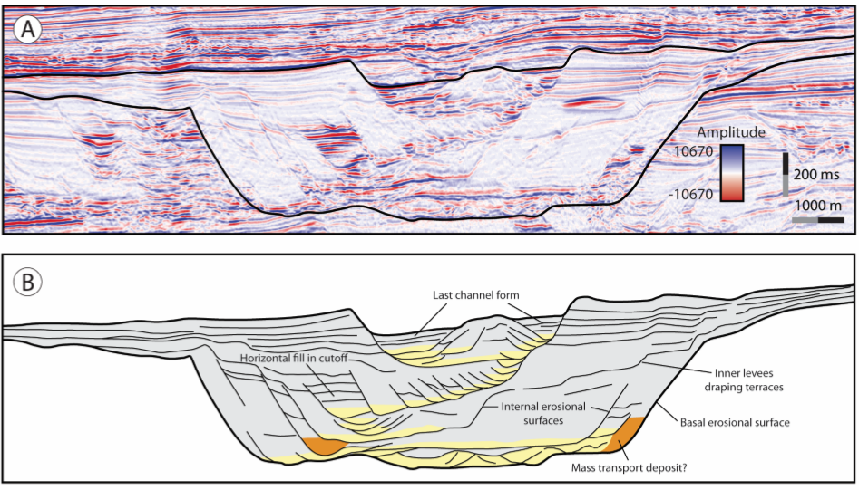
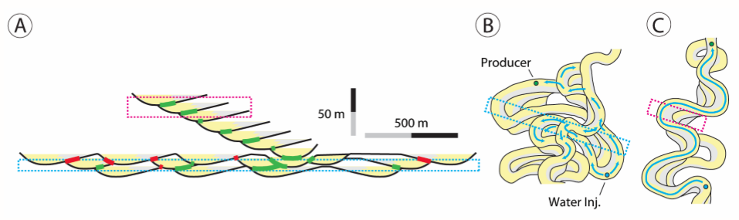
Figure 3: (A) High-resolution (~80 Hz) seismic-reflection profile across submarine-channel system CLS3 of the Indus Fan (Deptuck et al., 2003; Sylvester et al., 2011). (B) Interpretive line-drawing of the channel-levee system shown in (A), illustrating the change from laterally to vertically stacked channel deposits. Yellow is sand-rich; gray is mud-rich lithology.
Figure 5: …(B) Lower zone of cutoff and eroded channel deposits. Downstream continuity of sand-rich facies is likely oversimplified. Water injector well (Water Inj.) is a blue dot. Producer well is a green dot. (C) Upper zone of more continuous and vertically connected sandstone-rich facies.

